Slide 1
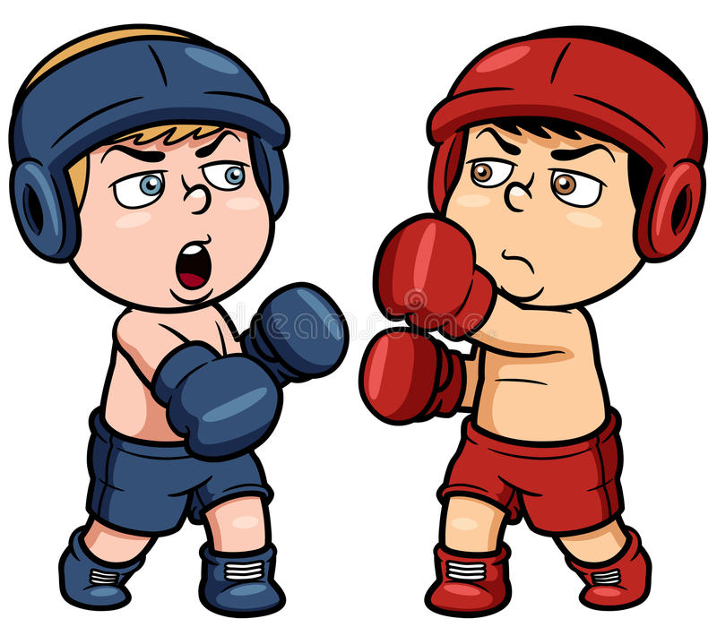
Boxing

Slide 2
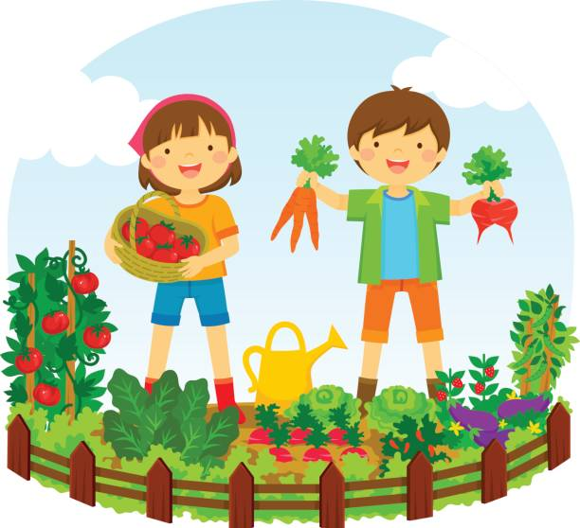
Gardening

Slide 3
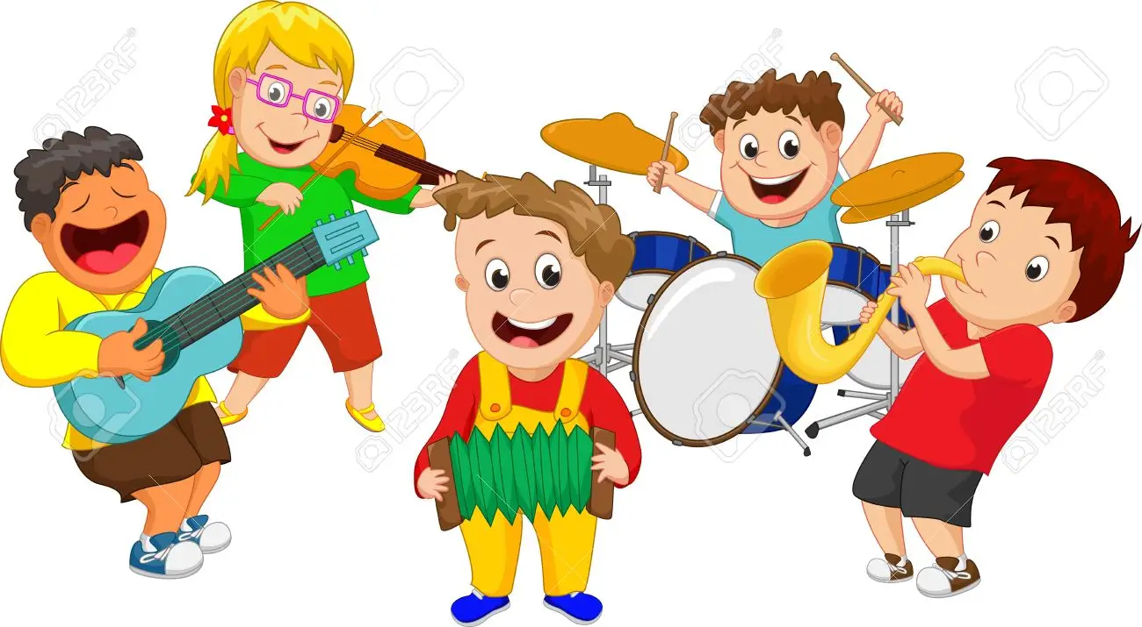
Play an instrument

Slide 4
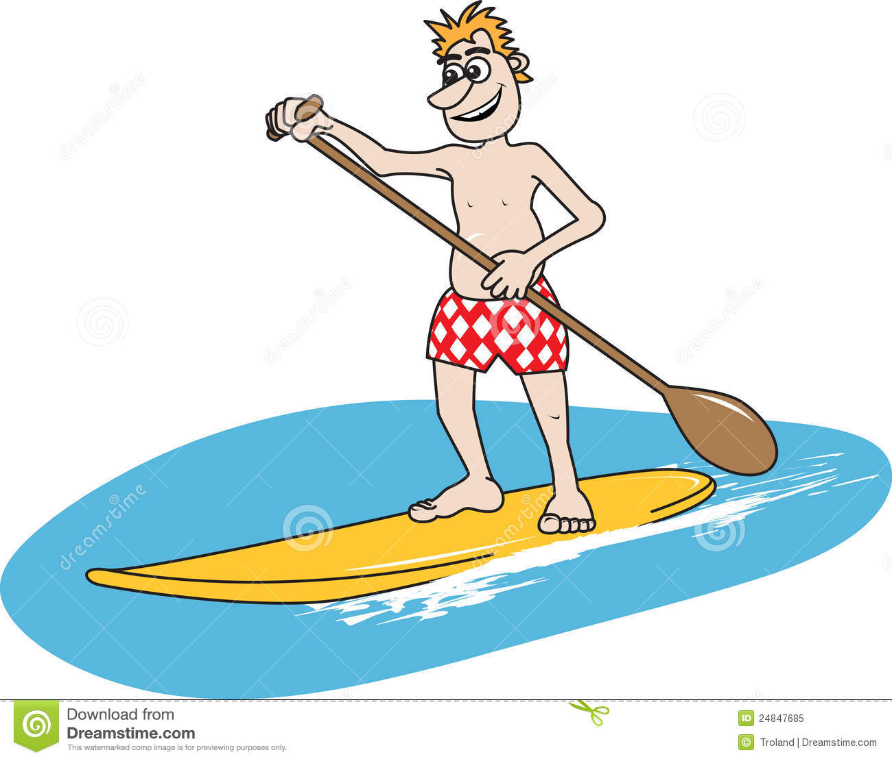
Paddle Boarding

Slide 5
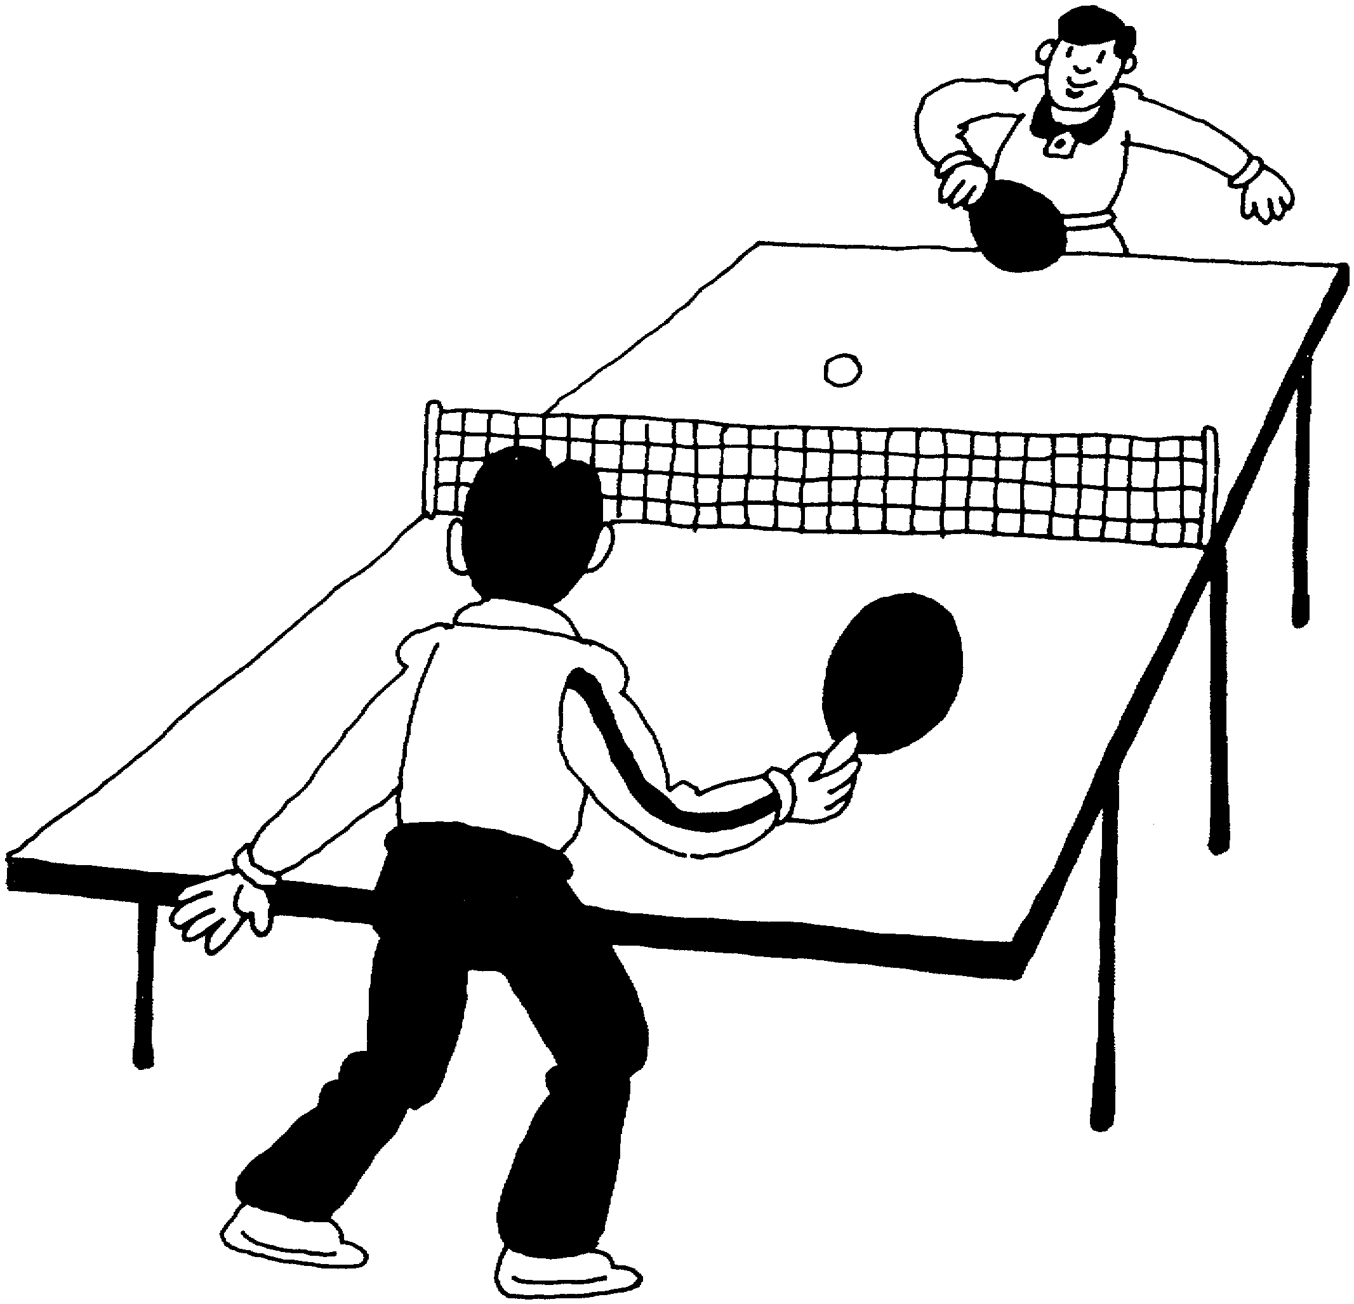
Table Tennis

Slide 6
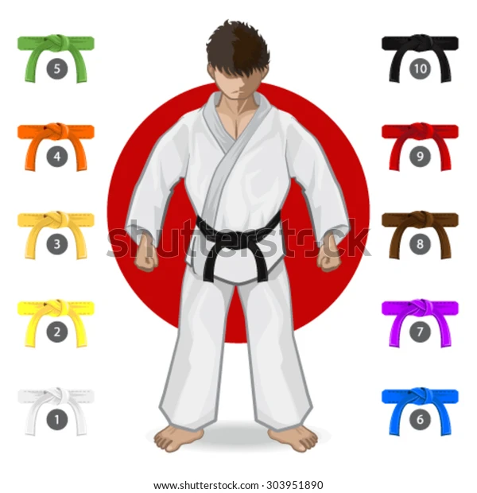
Martial Arts

Slide 7
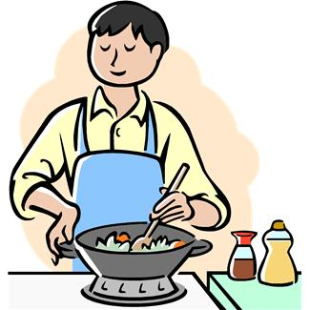
Cooking

Slide 8
DIY

Slide 9
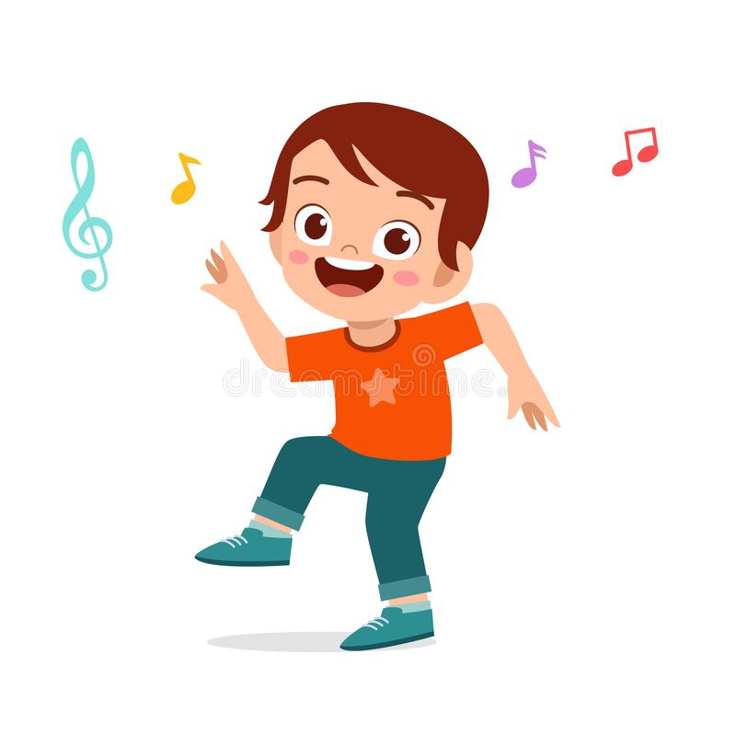
Dancing

Slide 10
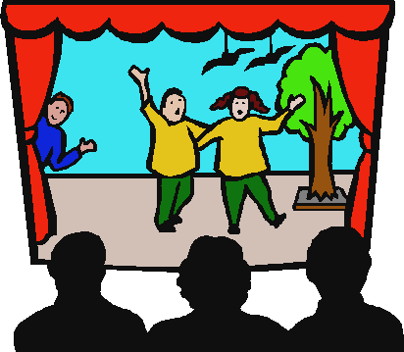
Acting

Slide 11
Singing

Slide 12
Sign Language

