Slide 1
ONLINE STRESS
Learning objectives
Learning outcomes
We are learning how to manage the stress that may result from excessive use of social media or as a result of interacting with online content, including FOMO (the ‘fear of missing out’).
By the end of the lesson you will be able to…
Recognise the difference between online and real friends and understand that social media sometimes does not reflect real life
Know from whom to get help and advice about online stress, including the Every Mind Matters website
Identify helpful strategies to manage online stress.
KEY
VOCABULARY
Online, social media, post, followers, comments, ‘likes’, unfollowing, blocking, trolling, YOLO (you only live once), FOMO (fear of missing out), phubbing (phone snubbing), sharing, uploading, content, views, selfies

Slide 2


ONLINE STRESS
FOMO: FEAR OF MISSING OUT
@We_Every_Mind_Matters
@We_Every_Mind_Matters
@We_Every_Mind_Matters
@We_Every_Mind_Matters
@We_Every_Mind_Matters
What matters most in a real-life relationship?
What matters most with online friends or followers?
What are the positive sides to social media?
What are the potentially negative sides to social media?
How can social media make people feel?
Notes:
Ask students to look at the Twitter-style questions on the screen, and write very short answers to each question (no more than 140 characters).
This activity can be carried out in pairs, small groups or as a whole class ‘graffiti wall’ activity. For the graffiti wall, put up large sheets of paper around the classroom and write one of the questions on each sheet. Students circulate in small groups and write a brief response under each question.
Once all the groups have circulated and added their thoughts, pick some students to read through each sheet.

Slide 3
ONLINE STRESS
SELF ASSESSMENT
How confident are you about online stress, such as FOMO?
I can go without using my phone or social media without it affecting my mood.
I know where to get help or advice if something gets out of hand online.
I can help a friend who is having a hard time online.
I know how to respond if someone is negative to me online.
0
10
NOT CONFIDENT
EXTREMELY CONFIDENT
Notes:
Ask students to answer the three baseline questions on the confidence scale: 0 = not confident, 10 = extremely confident.

Slide 4


ONLINE STRESS
FOMO: THINK, PAIR, SHARE
How would you describe FOMO?
How would you define stress?
Do you think that FOMO is regularly experienced by young people? What might be the reasons they experience it?
What advice would you give a friend who was experiencing stress all the time because of FOMO?

Slide 5

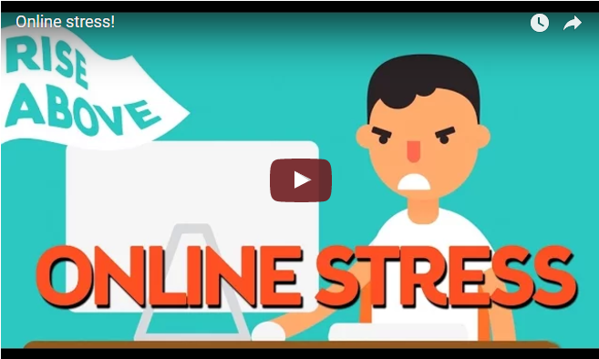

ONLINE STRESS
FOMO: THINK, PAIR, SHARE
Online stress
Notes:
Show students the video: https://www.youtube.com/watch?v=pNdYD-AsVwA

Slide 6
ONLINE STRESS
FOMO: THINK, PAIR, SHARE
After watching the video, discuss:
Do you agree with what it says about social media?
Are there any parts you disagree with?
Why is it important to understand that some people’s social media profiles may not reflect reality?
Notes:
After students watch the video, ask them to discuss the questions.

Slide 7

ONLINE STRESS
REAL FRIENDS VS. ONLINE FRIENDS
How would you describe these people?
Real-life friend
Online friend
Notes:
In groups, ask students to draw out two silhouettes to represent a ‘real-life friend’ and an ‘online friend’. Around each silhouette, ask them to write down words that describe that person.

Slide 8
ONLINE STRESS
REAL FRIENDS VS. ONLINE FRIENDS
What are the most significant differences between a person’s real-life friends and those they only interact with online?
What are online friendships really about? What are the potential benefits, disadvantages and risks to communicating online?
Does it matter if you talk to your friends mainly online rather than face to face?
What effect can ‘phubbing’ (‘phone snubbing’, or paying more attention to your phone than to the real people you’re with) have on relationships and friendships? Why do people do it?
Notes:
Review the advice given in the film: to avoid stress and anxiety it’s important to switch off social media regularly and stay connected with real life, real people and real friends. Don’t let social media become a substitute for real-life connections with family, friends and other people.

Slide 9
ONLINE STRESS
WALL OF IDEAS
How to deal with stress
Use the Every Mind Matters website (www.nhs.uk/oneyou/every-mind-matters/youth-mental-health/) and your own knowledge to find any tips and advice about:
dealing with social media
coping with stress
how to have conversations that may be awkward. For example, telling someone that you are in a worrying situation online.
Notes:
This could be done in pairs or groups and then fed back to create a whole class ‘wall of ideas’. Use sticky notes or place all the ideas written on A4 paper together to form a wall.

Slide 10

ONLINE STRESS
PLENARY: POSITIVE POSTS
Create a social media post with tips for avoiding online stress, such as FOMO.
Which social media channel would you choose?
What would the main message be?
How can you make it stand out?
Notes:
In small groups, ask students to generate quick ideas for a social media post that will suggest tips for avoiding online stress. Then ask them to share their ideas with the class, and offer constructive suggestions to improve each other’s concepts.
Optional extension
Ask students to actually create these ideas, for example making video clips using their phones.

Slide 11

ONLINE STRESS
PLENARY: POSITIVE POSTS
If you, or anyone you know needs support in this area, speak to a trusted adult, a teacher, form tutor or head of year.
Notes:
Emphasise to students the importance of talking to a trusted person if they are experiencing online stress. They can talk to teachers, tutors, parents, siblings, friends or classmates. It is important to get help and not suffer in silence!
Encourage them to visit the Every Mind Matters website (www.nhs.uk/oneyou/every-mind-matters/youth-mental-health/) in their own time, along with other helpful websites and sources of information.

Slide 12
ONLINE STRESS
SELF ASSESSMENT
How confident are you about online stress, such as FOMO?
I can go without using my phone or social media without it affecting my mood.
I know where to get help or advice if something gets out of hand online.
I can help a friend who is having a hard time online.
I know how to respond if someone is negative to me online.
0
10
NOT CONFIDENT
EXTREMELY CONFIDENT
Notes:
Ask students to think back to the confidence line that they shared at the start of the session and consider the same questions.

