Slide 1
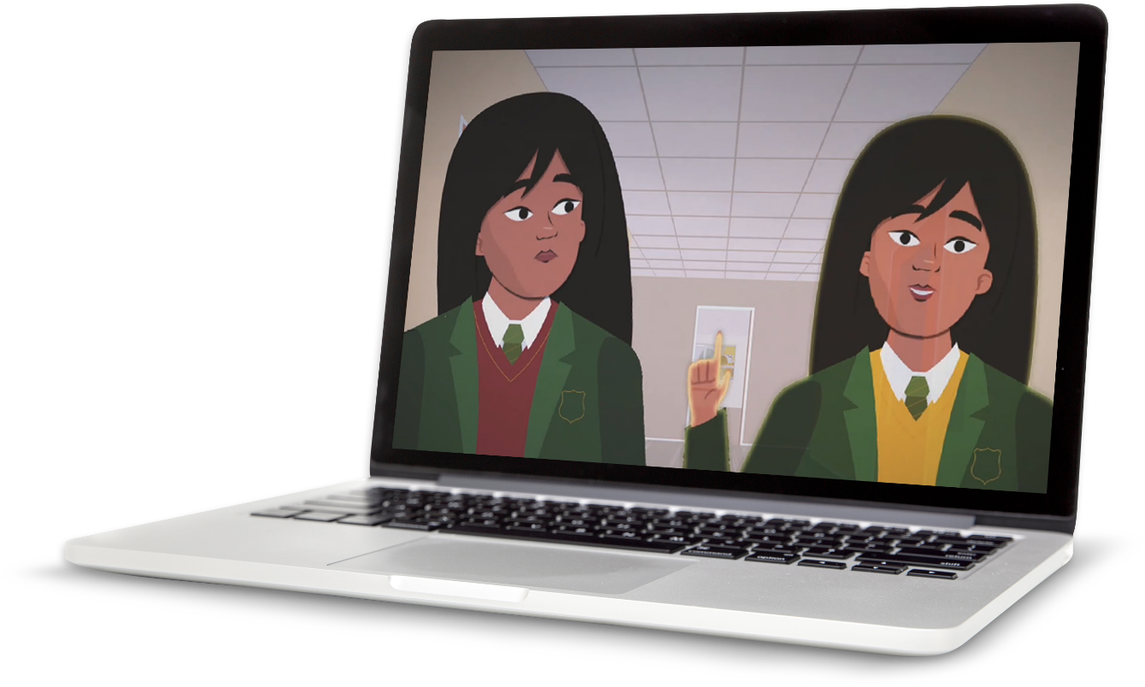
Unhelpful thoughts

Slide 2
Overview
In this activity, students learn examples of some unhelpful thought patterns and are introduced to ‘reframing thoughts’ as a way to combat these thought patterns when they arise.
Recommended age group
Education providers for ages 11-16 (KS3/4)
Time
20-30 mins approximately
Preparation
Before delivering the activity:
consider cross-curricular links and how this could be
related to other subjects
watch the film on slide 7 of this PowerPoint
read through classroom tips on slide 3
This activity has been designed to be used within form time as a flexible tool to explore specific aspects of the PSHE education programme and should be taught within the context of other PSHE education lessons.
It supports the Mental wellbeing strand of the Relationships Education and Health Education statutory guidance. See Curriculum Links for further information.
Resources
Blank A4 paper and pens
What do you think? scaffold activity (optional – print slide 12 for each student who needs support)
Key vocabulary
Unhelpful, check, challenge, catastrophising (thinking the worst will happen), disqualifying (banning or ruling out), support (help)

Slide 3

What do you think?
What might this young person think about the upcoming task?
A student in
your class has
a presentation tomorrow in front of lots of people.
Helpful thoughts?
Unhelpful thoughts?
Notes:
Stimulus: What do you think? (5 mins)
Ask students to discuss the scenario on the board, listing possible helpful or unhelpful thoughts. If students are stuck:
Helpful thoughts - I am excited, I think it will go well, I’m looking forward to the challenge
Unhelpful thoughts – I am scared, I think it will not go well, and repetitive thoughts about possible negative outcomes
Support: The statements from the optional printable sheet (slide 13) can be provided so they can categorise these into helpful and unhelpful thoughts.
Challenge: How do you know when a thought is unhelpful? (Consider feelings that might accompany an unhelpful thought and the impact these feelings might have on our behaviour). Can students take that one step further and define an unhelpful thought? Based on that definition – what is a helpful thought?
Reassure students that everyone has a mixture of helpful and unhelpful thoughts and this is perfectly normal. The activity today will help them spot the signs of unhelpful thinking, learn some skills they can use to combat unhelpful thoughts and know when to seek support.

Slide 4
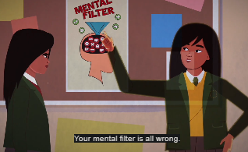

Unhelpful ways to think
Watch the video
What different types of unhelpful thinking can you spot?
Notes:
Activity: How to deal with unhelpful thoughts (4 mins)
Explain to students that they are going to learn about different types of unhelpful thinking as well as strategies to challenge these thoughts in the future. They will watch a short film and then complete an activity on the next slide to encourage different ways of thinking.
Tell students they will be watching a short clip - How to deal with unhelpful thoughts. What different types of unhelpful thinking can they spot? Examples are listed on the next slide.
Note, you can play the film by clicking on the play button (when the PowerPoint is in presentation mode) or by copying and pasting this link into your web browser: https://www.nhs.uk/oneyou/every-mind-matters/youth-mental-health/
On this web page, you will need to select the film titled ‘How to deal with unhelpful thoughts’.

Slide 5
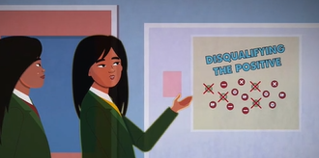
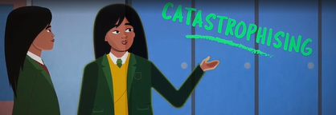
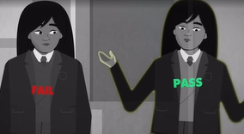
Identifying unhelpful thoughts
Match the three types of unhelpful ways of thinking to the examples below…
Disqualifying the positives
Ignoring the positives and only paying attention to the negatives.
A: The last Instagram picture I uploaded didn’t get any comments – people don’t like me.
Catastrophising
Imagining that the worst possible scenario will happen.
B: I am terrible at football; last match I played I scored a goal but I lost the ball loads of times.
Thinking in black and white
Thinking something can only be good
or bad / right or wrong and ignoring the shades of grey in between.
C: Everyone in the whole class will think I am not clever if I get an answer wrong in the lesson.
Notes:
Activity: How to deal with unhelpful thoughts (5 mins) continued
This slide focuses on three types of unhelpful thinking (note that five types of unhelpful thinking are mentioned during the video – the remaining two can also be discussed if time permits – further information is below).
Read information from the slide about each type of unhelpful thinking.
Ask students to consider the examples provided and identify the specific type of unhelpful thinking.
Answers:
Disqualifying the positives = B
Catastrophising = C
Thinking in black and white = A
Next ask, how can you help others with unhelpful thoughts?
All five types of unhelpful thoughts from the video:
Mental filter – this is a bit like someone wearing glasses with a special filter – they only notice things that get through their special (and often negative) filter and that fit with their (often negative) beliefs about themselves or the world. For example, if someone thinks they’re bad at football they would only notice when they make a mistake like losing the ball and not pay attention to the times they do something well, like a good pass
Disqualifying the positives – this is similar to ‘mental filter’. It is ignoring the positives and only paying attention to the negatives. For example, in the football scenario above, the young person who thinks they are bad at football might disqualify or dismiss their scoring of a brilliant goal as a one off.
Thinking in black and white – thinking something can only be good or bad / right or wrong and ignoring the shades of grey in between. For example, thinking the only options are to pass or fail a test, to be popular with others or be a loner or loser and so on.
Catastrophising – imagining that the worst possible scenario will happen. For example, in the presentation scenario on slide 7, the student might imagine that they will mess up completely and their classmates will laugh at them.
Over-generalising – taking one event and making a broader generalisation based on it. For example, if one friend is busy and can’t help a young person with a problem, that might be generalized into the thought ‘everyone is too busy to help me’.

Slide 6

Reframing unhelpful thoughts
Choose one of the unhelpful thoughts below.
Use the thought clouds to discuss how these students could think differently.
I have so much homework.
I can’t do any of it!
Does the thought make them feel good?
If your friend had this thought, what would you say?
I don’t want to do sports day; everyone will laugh at me.
Why might this
not be a great way to think?
What is the opposite thought to this?
I’m scared to start my new school;
I won't make any friends.
Why might the thought not be correct?
Are there other things that could happen which they have not thought about?
That exam was so hard, I’ve definitely failed.
Notes:
Activity: Stop. Check. Challenge. (10 mins)
The video introduces students to the idea of stop, check and challenge – where young people try to think differently about the thoughts they are having. This slide offers some examples of unhelpful thoughts that teenagers might have. Use the thought clouds to help students ‘reframe’ these statements encouraging students to re-write the unhelpful thought and turn in into a more helpful way of thinking.
Students could also produce their own examples of what they think are relevant unhelpful thoughts for people in their age group. Note that students should not be encouraged to share their own personal unhelpful thoughts in the classroom.
Support: The scenarios can be printed and given to pairs/groups as they are discussing the work, although again students should not be encouraged to use any of their own experiences. If delivering the lesson remotely, be sure to leave this slide on screen in your recording/live lesson to support students – or, if available to them, ask if students could print the slide off at home.

Slide 7


Thinking together
What might trigger unhelpful thoughts?
Do situations always turn out the way you thought they would? Why do you think this is?
Do you think people are more critical of themselves than others? How might this impact their thoughts?
Notes:
Plenary: Thinking together (5 mins)
Discuss the questions below. Note that if delivering this lesson remotely, you could ask students to complete personal responses to these questions or use a chat function to have students submit their responses. However, stress to students beforehand that they should not share personal examples of unhelpful thoughts.
What might trigger unhelpful thoughts?
(Examples of situations that could cause unhelpful thinking: stress, tiredness, fear, confusion, failure, trauma. Emphasise to students that other people’s words or behaviour can also trigger personal unhelpful thought patterns).
Do situations always turn out the way you thought they would? Why do you think this is?
(Usually the reality of a situation is very different to prior thinking. This is because there are many factors that can alter how an event occurs).
Do you think people are more critical of themselves than others? How might this impact their thoughts?
(People can sometimes be more tough on themselves which means they can have more unhelpful thoughts about themselves than other people. It can sometimes be helpful for young people to think about themselves as if they were a friend, as it is likely they will be more caring and empathetic).
Additional question: This could also be used as an opportunity to discuss what specific unhelpful thoughts might have arisen as a result of COVID-19 and reflecting on which of the strategies might be most applicable.

Slide 8


Having unhelpful thoughts is normal.
But sometimes a young person might feel stuck in a pattern of negative and damaging thoughts and need some help.
If things get difficult, it is important to speak to a trusted adult and get some more support.
Childline: childline.org.uk/info-advice
Or call 0800 1111
Shout: Text 85258
Notes:
Signposting (1 min)
Share this slide with students and remind them that everybody has unhelpful thoughts sometimes. It is always good to try out the different actions they have learned in class, but if thoughts become very unhelpful it is important that they speak to a trusted adult and get some more help.
If things become difficult, they should speak to a trusted adult in school, at home or contact Childline (0800 1111 or https://www.childline.org.uk/) or Shout. Childline runs free telephone helplines for children and young people, while Shout offers free text messaging support.
Optional personal reflection (2-3 mins)
If time allows, students could be given a few minutes to think about one thing that will try and do the next time they notice an unhelpful thought and decide on one person to talk to if they feel overwhelmed with unhelpful thoughts.

Slide 9
What do you think?
For each statement tick the box to show whether you think
it is a helpful or unhelpful thought.
Statement | Helpful thought | Unhelpful thought
I am not going to be good at speaking in public.
I will feel proud of myself once I’ve finished it.
There is no point in trying as I will not do well.
I should be ok as I have done presentations before and they were ok.
My teacher says I am a good public speaker.
Students will laugh if I say something wrong.
Challenge:
How might students feel
when they have unhelpful thoughts?
Notes:
Optional scaffold
Print this slide for students who may require additional support to access the activity on slide 7.

