Slide 1
EXAM STRESS
Learning objectives
Learning outcomes
We are learning about the potential effects of exam stress on our physical and emotional wellbeing, and ways to manage it.
By the end of the lesson you will be able to…
Identify signs of exam stress in yourself and spot the signs of it in others
Know who to ask for advice and where to look for guidance on exam stress,
Select and use strategies to help them manage exam stress, including revision techniques.
KEY
VOCABULARY
Exams, pass, fail, stress, signs, symptoms, revision, conversations, relaxation, planning, organisation, strategies, support, management

Slide 2




EXAM STRESS
EXAM BUDDY
You’re going to design an ‘Exam Buddy’ app. But first, think about:
Why do exams cause stress?
How could you tell if you or a friend is experiencing stress?
What would you like to know about dealing with exam stress?
SIGNS AND SYMPTOMS
Label the head and body diagram with:
What a person might think or say when stressed (head)
The physical symptoms a person might experience (body)
Notes:
Ask each group to feed back the signs and symptoms they discussed in their group to the rest of the class. Before the feedback commences, ask two students to create a master list on the whiteboard/ flipchart of everything that has been shared. Emphasise that as we are all different, everyone experiences stress in a slightly different way so we all need different coping strategies. See teachers notes for examples.
Optional extension
Create a ‘vocabulary of stress’: words that a person may use when they are feeling the pressure, to which the Exam Buddy app might need to recognise and respond.

Slide 3
EXAM STRESS
SELF ASSESSMENT
How confident are you about:
Knowing how to spot when you’re stressed?
Thinking of ways to relax and de-stress?
Revising for exams?
Knowing what you want or need to achieve in your exams?
Having a revision plan that will work for you?
Knowing where to get help and advice about revising?
0
10
NOT CONFIDENT
EXTREMELY CONFIDENT
Notes:
Ask students to answer the baseline questions on a confidence scale 0 = not confident, 10 = extremely confident.
These are differentiated (the last three are more challenging). You can choose to discuss them all or skip some depending on class ability.

Slide 4


EXAM STRESS
EXAM BUDDY
Tips and advice database
How to ace an exam
Notes:
Tell students that after watching the video (https://www.youtube.com/watch?v=O7W2yMxWaJk) they will compile a database of advice for anyone experiencing exam stress.

Slide 5
EXAM STRESS
EXAM BUDDY
Tips and advice database
Stress before the exam
Stress during the exam
Stress after the exam
Notes:
Ask students to write down advice about dealing with exam stress using the video they have just watched and their own ideas.
See the Managing exam stress: tips and advice sheet (for teachers) for the kinds of ideas students should be coming up with. Emphasise to students the importance of talking to a trusted person if they are experiencing stress. They can talk to teachers, tutors, parents, siblings, friends or classmates. It is important to get help and not suffer in silence!

Slide 6
EXAM STRESS
EXAM BUDDY
Tips and advice database
Can you add more ideas to your database about exams, stress and revision?
Add more detail based on the following questions:
When is the right time to put each idea into action?
Which ideas need to be put into practice well in advance?
Which tools (e.g. sticky notes, a diary, study buddy) can someone use to help plan and do their revision?
Notes:
Students can add ideas based on their own knowledge. If time allows, they could also explore relevant films (such as The worry tree or Dealing with change) on the Every Mind Matters website: https://www.nhs.uk/oneyou/every-mind-matters/youth-mental-health/
After compiling their database, ask each group to share their tips and advice with the rest of the class in turn. Other students can ask questions and offer constructive suggestions.
See the Managing exam stress: tips and advice sheet (for teachers) for the kinds of ideas students should be coming up with.

Slide 7
EXAM STRESS
ADVICE FORUM
My best mate always seems to have done loads more work than me. It’s making me stressed out. – Sam
I’m sure I’m going to fail, no matter how much work I do. What is the best way to revise? – Jack
During exams I get freaked out by the first question if I can’t answer it and then I get stuck. – Niamh
I get a headache nearly every day. I keep thinking about what my parents will say if I don’t get the right grades. They’ll be so upset and disappointed. I’m finding it hard to focus and actually revise. – Nav
My exams are over but I’m so worried that I can’t sleep. I need to find out what I got but it won’t be for weeks! – Alex
How do I make sure to leave enough time to answer all the questions in the exam? – Harry
Sometimes in exams I break out in a cold sweat and start breathing really fast. I’m starting to panic it will happen again this time. – Jas
I’m struggling to manage my time and fit all my revision in. It feels like there’s far too much to do. I keep forgetting to eat lunch. – Millie
Notes:
Instruct students to write back to the young person in the style of a message board post and suggest solutions to their problems. This can be completed in pairs or groups. Answers should be shared to the whole class.
Optional extension: Vote now! (10 minutes)
As an option if time permits, students can present their app ideas to the rest of the class, including the name, look and feel, features and functionality. Once everyone has finished presenting all students must vote, but they are not able to vote for themselves.

Slide 8
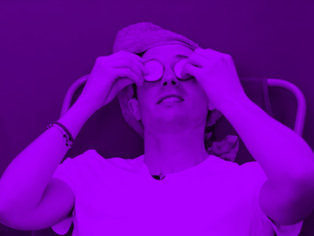
EXAM STRESS
PLENARY: I CAN
If someone I know is stressing about planning their revision, I can...
If I see someone who needs to take a break from revising and relax, I can...
When someone I know needs to get help with their revision planning, I can...
If my friend gets stressed in the middle of an exam, I would advise them to...
Notes:
You can use the following questions as prompts:
• Have your feelings about exam stress changed since the beginning of the lesson?
• Do you feel more confident in preparing for exams and handling any exam stress?
• Do you know where to get more ideas or help if you need it?
• Could you spot when you’re starting to get stressed and know what you can do to deal with it?

Slide 9
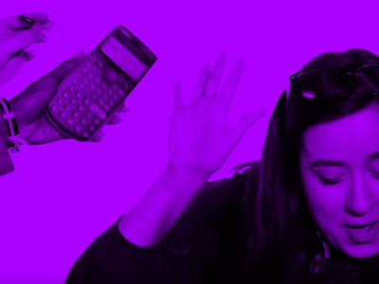
EXAM STRESS
PLENARY: I CAN
If you, or anyone you know needs support in this area, speak to a trusted adult, a teacher, form tutor or head of year.
You can also get support at the Every Mind Matters website.
Notes:
Emphasise to students the importance of talking to a trusted person if they are experiencing stress. They can talk to teachers, tutors, parents, siblings, friends or classmates. It is important to get help and not suffer in silence!
Encourage them to visit the Every Mind Matters website in their own time, along with other helpful websites and sources of information.

Slide 10
EXAM STRESS
SELF ASSESSMENT
How confident are you about:
Knowing how to spot when you’re stressed?
Thinking of ways to relax and de-stress?
Revising for exams?
Knowing what you want or need to achieve in your exams?
Having a revision plan that will work for you?
Knowing where to get help and advice about revising?
0
10
NOT CONFIDENT
EXTREMELY CONFIDENT
Notes:
Ask students to think back to the confidence line that they shared at the start of the session and consider the same questions.

