Slide 1

Transition to
secondary
school

Slide 2
Overview
In this lesson, pupils explore the transition to secondary school, identify some of the challenges that can arise and where
to get support if needed.
Recommended age group
Education providers for ages 10-12 (Year 6/Year 7)
Time
45 minutes approximately
Preparation
Before delivering the lesson:
familiarise yourself with the film on slides 8 and 11 of this PowerPoint
read through the classroom tips on the following slide
consider cross-curricular links and how this could be related
to other subjects
This lesson has been designed to be part of the planned programme for PSHE education and should be taught within the context of other PSHE education lessons. It supports the Mental wellbeing strand of the Relationships Education and Health Education statutory guidance. See Curriculum Links for further information.
Pupils might be learning about growing up and managing change in a variety of contexts, with moving on to secondary school being one part of this.
Resources
Blank A4 paper and pens
Key vocabulary
New, relationships, transition (change), routine (usual), unknown,
challenge (hard), support (help)
Follow up
You may wish to extend pupils’ learning with one of the
extended learning projects on slides 19 and 20.

Slide 3
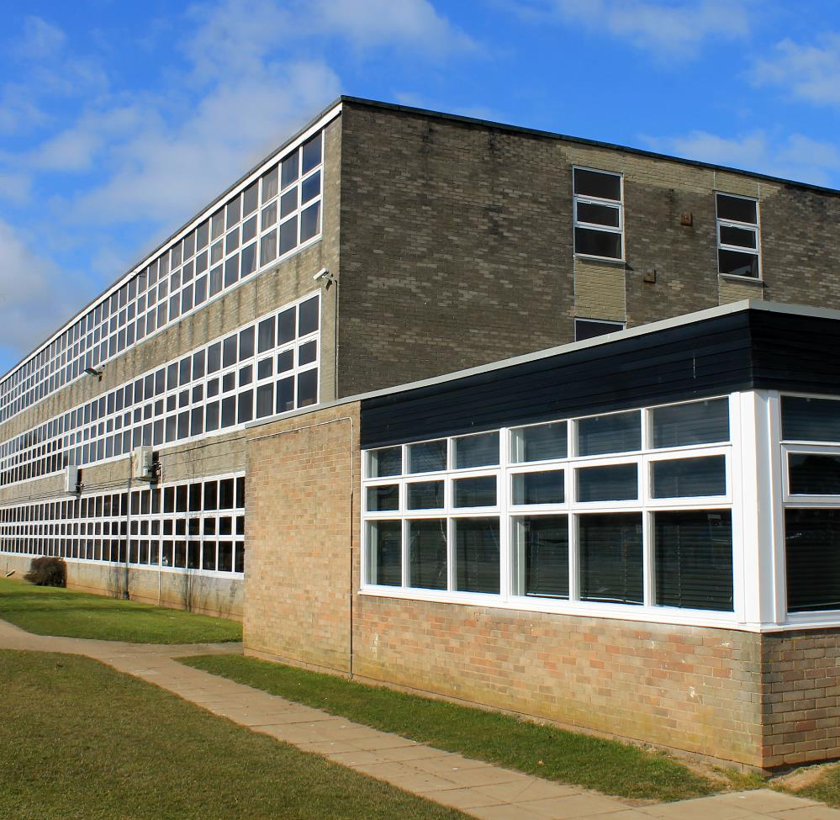

Transition to secondary school
Create a list of words you associate with the picture opposite.
3
Notes:
Lesson stimulus (3-4 mins)
Ask pupils to create a list of words they associate with the picture of a secondary school.
Pupils can complete this initial activity on their own, in pairs on in groups. They can either write down or discuss their ideas. Pupils could submit their words in an anonymous way, for example writing them on paper and placing in a collection box at the front of the class.

Slide 4
How confident are you in…
10
Extremely confident
9
8
7
6
identifying the differences between primary and
secondary school?
describing how it might feel
to move to secondary school?
explaining some ways
to manage change?
5
4
3
2
1
0
Not confident
4
Notes:
Baseline assessment : How do you feel? (3-4 mins)
Show pupils the statements and ask them to rate their confidence in each using a scale from 0-10 (0 = not confident, 10 = extremely confident). There are lots of ways you might do this activity. Pupils could respond to the statements individually by writing their three numbers down on paper, or verbally by discussing their feelings in pairs/groups. Alternatively, you could ask pupils to reflect silently, before holding up the relevant number of fingers in response to each statement.
Pupils should answer the three baseline statements below on a confidence scale (0 = not confident, 10 = extremely confident):
How confident are you in…
identifying the differences between primary and secondary school?
describing how it might feel to move to secondary school?
explaining some ways to manage this change?

Slide 5


Making the move
Let’s talk
about change
What will the similarities
be between primary school
and secondary school?
What will the differences
be between primary and secondary school?
What are the most important things a Year 6 pupil needs to know about secondary school?
Notes:
Activity 1: Making the move! (10 mins)
Show the first part of the video clip https://bcove.video/3aTMEPY (00:00- 01:13) about change.
Explain to pupils that in this lesson they will be exploring change in relation to moving on the secondary school - what they think the transition to secondary school might be like, how it might feel and what they can do to prepare for or manage the change.
Be aware of any pupils who have moved, or are going to be moving, area or schools, as they may face additional challenges – particularly those who are not moving with friends.
Ask the class to discuss the questions on the slide. If pupils get stuck on the last question, prompt them to consider things like the structure of the day, how many teachers the pupil will have, how many people in class and so on.
The challenge question gives pupils the option to think about the additional challenges faced by moving school during the Covid-19 pandemic. Example answers could include; more time to get to know the school building and teachers as they might have not had an induction or transition visits, support in catching up with learning because of time missed during lockdown, more pastoral support, support with learning new school rules including those around hygiene and social distancing.
Alternative option for social distancing: Pupils could draw out their answers individually on A3 paper or mini-whiteboards and then hold them up to share with the person in front or behind them.

Slide 6
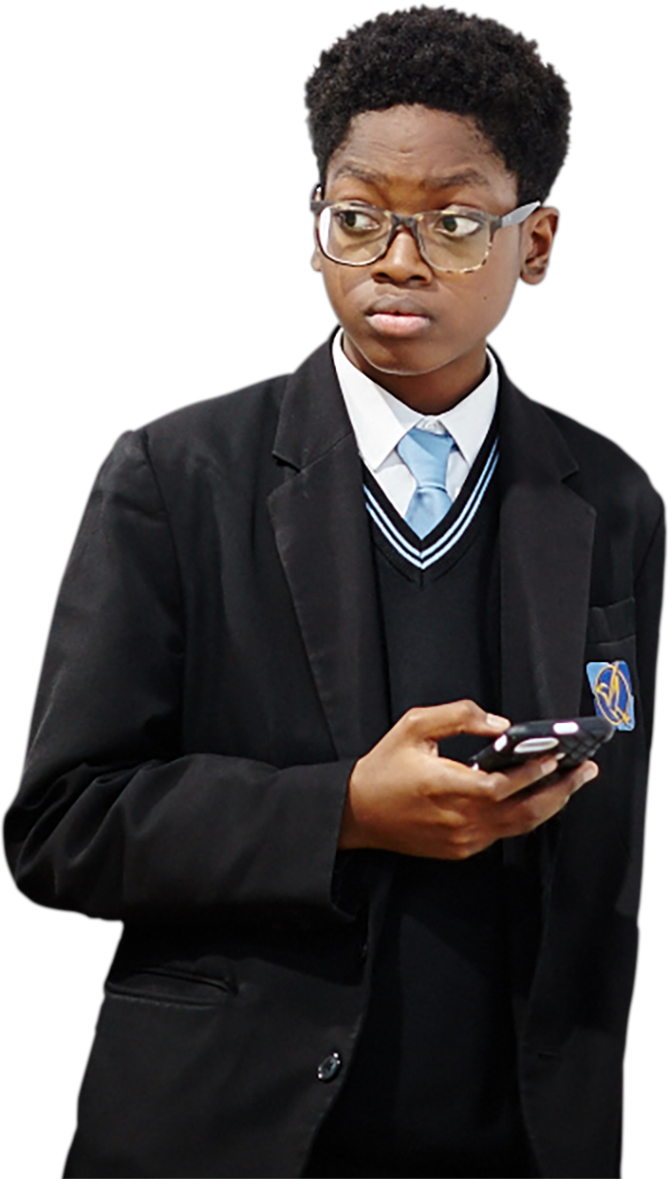
Challenge
What extra support or knowledge might a pupil
need if they have moved to
a secondary school during
the Covid-19 outbreak?
Notes:
Activity 1: Making the move! (optional challenge)
Use this challenge question with pupils if time allows and it feels appropriate.
If relevant, acknowledge that starting a new school in 2020 may be stranger or more stressful than other years, and it is normal to feel that way.

Slide 7
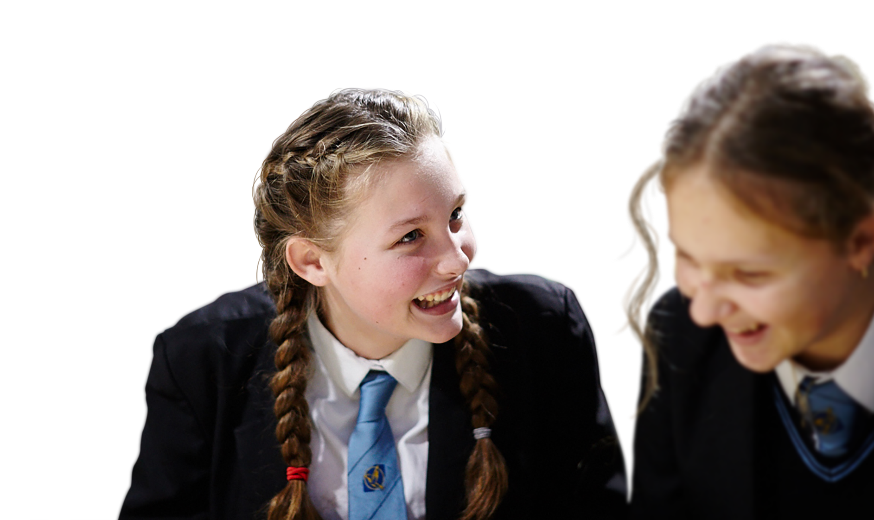

Making the move
Head
What might new Year 7 pupils be thinking on their first day of school?
Heart
How might it feel to start
a new school?
Notes:
Activity 1: Making the move! (continued)
This activity can be done in pairs or small groups. Give pupils an A4/A3 sheet and ask them to draw a stick person with a head, heart and hands.
Ask pupils to write down thoughts near the head showing what new Year 7 pupils might be thinking on their first day. E.g. ‘I wonder what my teachers will be like’
It may be preferable to place pupils in mixed ability groups rather than facilitating yourself in order to encourage as much pupil-led work as possible.
Additionally, an outline of a stick person with the following sections written on it could support pupils with SEND to complete the following activities throughout the lesson:
Thoughts (Head): Things I am thinking are…
Feelings (Heart): I am feeling…
Actions (Hands): Things I could do are…

Slide 8
Changes
Discussion questions
What do you think are the most exciting things about starting secondary school?
What do you think some pupils
are nervous about when starting secondary school?
How do you think pupil’s feelings
might change over the first year
at secondary school?
Notes:
Activity 2: Changes (15 mins)
Show the second part of the video about change https://bcove.video/3aTMEPY (1:20-3:05)
Ask the class to discuss the questions on the slide.

Slide 9
Individual
Reflection
Organised
Being prepared by
making a plan and
finding what you need
Honesty
Talking about how
you feel and being
able to ask for help
Think about a time you
had to manage a change
in the last year.
What helped you manage
this change?
Kindness
Looking out for and
helping other people
Fun
Finding time for
things you enjoy
Courage
Being brave and
having a go even when
things are tricky
Hope
Staying positive and
looking for the best
in a situation
Discuss
Which strengths are most
important when managing change?
Notes:
Activity 2: Changes (continued)
Ask pupils to spend a minute reflecting in private on what has helped them manage changes in their lives in the past year. This is a personal reflection and shouldn’t be shared with anyone in the class.
Then ask pupils what strengths they think are important when managing change. They could write their answers down or discuss them in pairs.
Support: Show pupils the six examples on the board to help with their thinking and ask them to pick two from the board and explain why they are important .
Challenge: Encourage pupils to think of other strengths that might help someone who is managing change.
Note, you may want to explain to pupils that the secondary school should be able to help them to manage some of the changes – for example, by showing them the school layout and routines.

Slide 10
Scenarios
Scenario 1
“I’m worried I have fallen behind
from missing so much school
last year. I hope the work isn’t
too hard and that I get to know
my new teachers quickly.”
Scenario 2
“I’m going to a different school
than most of my friends but my
sister loves her new friends from secondary school, so maybe
this will be the same for me.”
Scenario 3
“I have dyslexia and had
brilliant support from my primary school, I hope it is the same in secondary school.”
Scenario 4
“I find changes hard to start with, but my cousin got extra help and it went OK for her.”
Notes:
Activity 2: Changes (continued)
Show pupils the four scenarios/viewpoints about starting secondary school on this slide, and the list of strategies to manage change on the next slide. Ask them to match up suitable strategies to each of the viewpoints (these can projected on the board or printed out). This can be done in pairs or small groups. Different groups could be given different scenarios.
Support: Give pupils who might need extra support one or two of the scenarios, print out the strategies on the next slide and ask them to read through each strategy and circle/underline any of the listed strategies that they think might help in that scenario.
Challenge: Ask pupils to also add on strengths from the last activity and explain how that strength could benefit the pupil in that scenario.
If this text size is too small for your class, we recommend printing out the viewpoints and strategies as a handout.
Alternative option for social distancing:
The four different scenarios could be placed around the room and pupils could take it in turns to get up and put post-it notes with their advice/strategies/strengths on the scenarios.
Each scenario could be discussed as a whole class and pupils could hold up mini-whiteboards showing the number of the strategy they think would work best.

Slide 11

Possible strategies
Find out who you can speak to
in school if you’re finding it difficult
Take your time getting to know people
Ask teachers for help if you are
finding the work difficult
Ask someone you trust to do the journey
to school with you before doing it alone
Talk to a trusted adult about your worries
Make a homework timetable
Remember what you are good at
Think positively (I can do this!)
Further Challenge:
Can you think up other
strategies that could help
in each of the scenarios?
Explain why.
11
Notes:
Activity 2: Changes (continued)
If this text size is too small for your class, or certain pupils would benefit from having printed copies, print this slide and the scenarios (on the previous slide) as a handout.
Note that for pupils who are new to secondary school, they might be able to ask their form tutor about the best person to support them if they are finding things difficult. Pupils with autism or anxiety disorders may benefit from extra time spent getting familiar with their new school – whether it’s the journey there or the school itself.

Slide 12
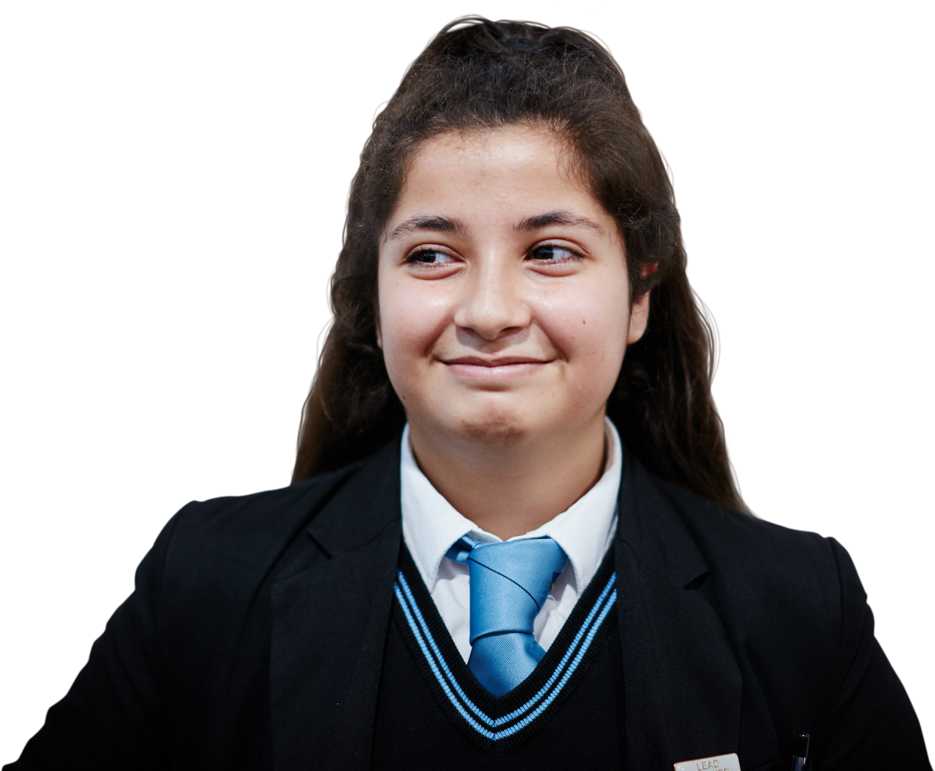
Handy advice!
What can pupils do to manage the changes
in secondary school?
Notes:
Activity 2: Changes (continued)
Ask pupils to go back to their sheets with the stick person and add information to the hands of the body about what actions or strategies pupils could take to manage change – moving to secondary school. E.g. I could talk to a teacher I like if I’m finding the change hard.
Pairs/small groups move around the classroom and find a different group’s body sheet, discuss their comments and the questions below, adding any additional information to the sheet they see fit.

Slide 13
How confident are you now in…
10
Extremely confident
9
8
7
6
identifying the differences between primary and
secondary school?
describing how it might feel
to move to secondary school?
explaining some ways
to manage change?
5
4
3
2
1
0
Not confident
13
Notes:
Follow up assessment (3-4 mins)
Show pupils the statements from the initial assessment once more and ask them to rate their confidence in each using a scale from 0-10 (0 = not confident, 10 = extremely confident) or whichever response method was used in the initial activity.
It is an opportunity for pupils to reflect on what they have learned in the lesson. Ask pupils to consider why their scores have changed and give an example of something new they have learned or thought about.

Slide 14
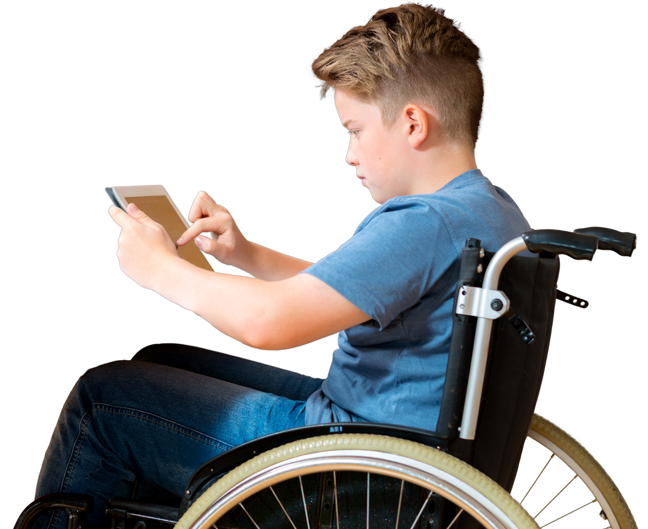
Reflection
What could a pupil
pack on their first day
of secondary school to help them manage the change ahead?
Notes:
Plenary: Transition backpack (3-4 mins)
Ask pupils to complete this activity by reflecting on the strategies and strengths they have learned about in the lesson. Pupils will have lots of different answers. For example, a pupil might take a notepad to help them stay organised, or a familiar object from home to help them to feel at ease.

Slide 15
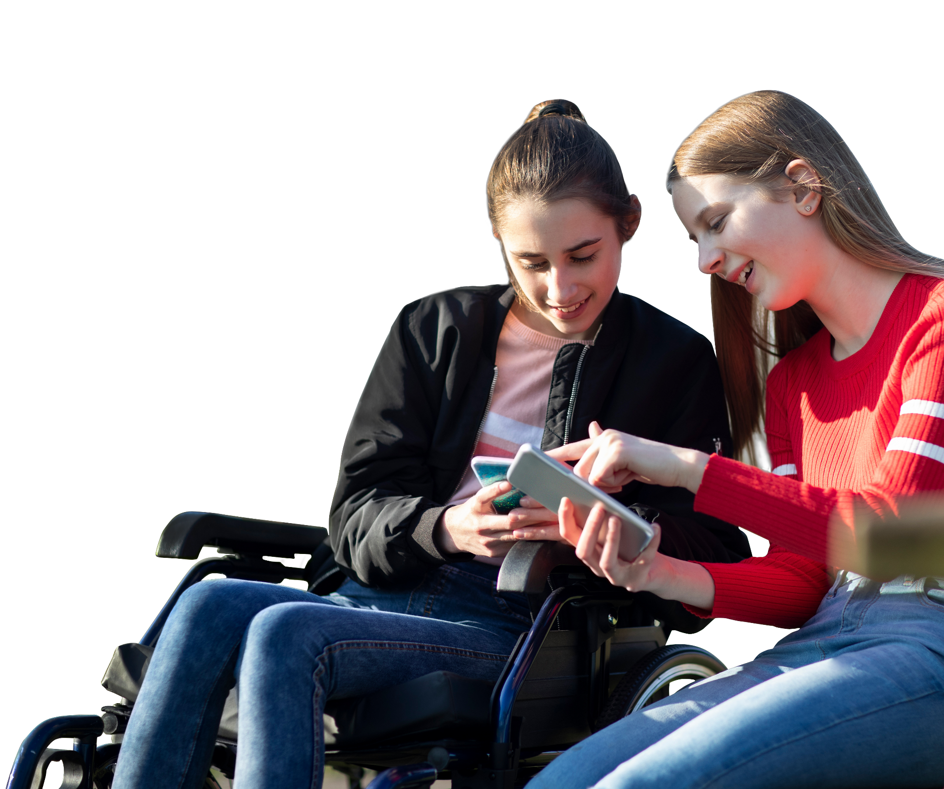
It’s normal to have different feelings when change occurs.
If you are worried about changes
affecting you or a friend, you can always speak to a trusted adult, perhaps at home or at school, and get some more help.
Childline: childline.org.uk/info-advice
Or call 0800 1111
Shout:
Text 85258
15
Notes:
Signposting
Share this slide with pupils and remind them that everybody feels worried or nervous at times. It is always good to try out the different actions they have learned in the lesson, but if worries get too much it is important that they speak to a trusted adult and get some more help.
If things become difficult, they should speak to a trusted adult in school, at home or contact Childline (0800 1111 or www.childline.org.uk) or Shout. Childline runs free telephone helplines for children and young people, while Shout offers free text messaging support.

Slide 16
Extended learning projects
Dear diary...
Ask pupils to write 3 diary entries from a pupil on the night before their first day at school, half way through the year and the end of the year.
Create a class ‘change collage’
Everyone in the class is given a torn piece of paper (roughly A5 size) and they have to decorate it with an image that represents a strength they bring to the
class that they can take forward with them to secondary school. The pieces can then be stuck down to make a large class collage.
Letter for the end of the year
Pupils write themselves a letter outlining three realistic goals they would like to achieve in their first year of secondary school. Pupils can seal the letters and open them later in the year to see if they have achieved their aims.
Create a board game for
secondary school
How would the board look? How do you succeed in the game? What are the challenges in the game? Which year group would it be suitable for?
Notes:
Setting realistic goals
You may want to highlight the need for pupils to be realistic with their goals in their letters, given the uncertain times we are in.

Slide 17
Extended learning projects
Create an assembly presentation
Aim it at Year 6 pupils about their transition into secondary school. Pupils should include:
one thing you know will change
in secondary school
two challenges that may occur
as a result of this change
three ways to manage this
change and seek support.
If time allows, pupils can present their assembly ideas to each other and feedback ‘P’s and I’s’ – positive things they have learned or ideas they thought were interesting. (NOTE: you can provide a list for pupils to choose from for their change, or allocate the changes to specific groups, such as: Friendship, Workload, Rules, Orientation, Teachers, Routines.)
Write a letter to a Year 7 class in a local secondary school
Invite them to write to you about their experiences of moving to secondary school and ask them any questions you might have. You could also ask if they could come and do a presentation on transition in your school.
Assembly success criteria
No longer than five minutes, use pictures, a
PowerPoint, or create a role play, rap or song, groups
of five or less, everyone in the group should contribute.

