Slide 1
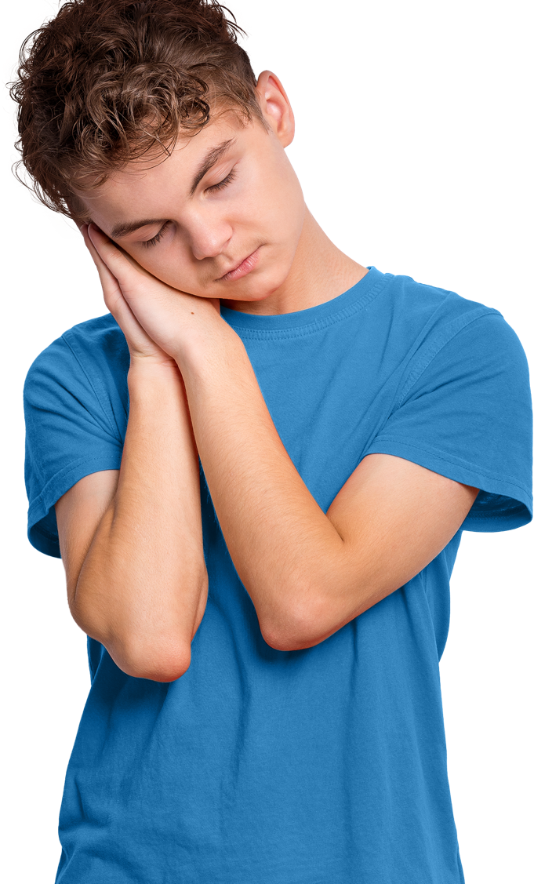
Sleep

Slide 2
Overview
In this lesson, students will explore what happens when we
sleep, the benefits and challenges of getting a good night’s sleep and strategies to promote good quality sleep, including where
to seek support.
Recommended age group
Education providers for ages 11-16 (KS3/KS4)
Please note: If teaching this lesson with Year 7 students that there are age restrictions for joining social media platforms, in most cases students will be required to be 13 years of age.
Time
60 minutes approximately (note that more time may be needed if students present as part of Activity 3. See slides 15-18)
Preparation
Before delivering the lesson:
familiarise yourself with the film content on slides 13 and 16
of this PowerPoint
read through the classroom tips on slide 3
consider cross-curricular links and how this could be related to other content such as the Every Mind Matters resources on puberty and positive relationships
Resources
PowerPoint presentation
blank A4 paper and pens
Key vocabulary
Sleep, routine (usual), growth, mood, memory, rest, energy, immunity (staying well), environment (surroundings) and sleep hygiene (actions for a better night’s sleep)
Follow up
You may wish to extend students’ learning with one of the extended learning projects on slide 22.
Visit MindEd for further reading for teachers, parents or carers
on sleep in young people. You may need to sign up to access this item.

Slide 3
Classroom tips
Climate for learning
Read through Guidance for Learning in a Safe Environment.
This includes advice on:
developing and revisiting effective ground rules drawn
up with students
familiarity with your school’s safeguarding policy and procedures, including Child Protection and other relevant policies
being prepared in case students make a disclosure
including and protecting vulnerable students
using distancing techniques so that students can discuss sensitive issues without being encouraged to make a disclosure
handling sensitive questions
involving students with special educational needs
and disabilities (SEND) and/or autism
You may also wish to familiarise yourself with any schemes or offers available in your school, organisation or local area to support young people’s mental health which clearly links to the promotion of healthy sleep habits. Your local public health team or school nurse should be able to help signpost you to local sources of support.
Anonymous question box
Place a question box or envelope somewhere in the classroom.
Students write down any questions that occur to them during the
lesson and submit them anonymously. You can address these questions in the next lesson.

Slide 4
Social distancing
Preparation
Returning to school and managing the changes that have come about in their lives because of Covid-19 will have posed many different challenges for young people. It will have affected every young person differently and it will be more important than ever before for students to have a safe space to explore their feelings and experience.
Reassure students that it’s normal to worry about the impact of Covid-19 and that everyone will have had different responses. For example, some may have experienced loneliness, while others may have enjoyed lockdown – for many, there will have been a mixture of different emotions.
There is clear guidance for teaching sensitive issues in the Guidance for Learning in a Safe Environment document and it is important that this is read before delivering this lesson.
Adapting lessons to social distancing
Please also refer to the Government guidelines and your own school’s advice.
Where pair or small group discussions aren’t possible, replace with personal reflections or individual contributions to whole class discussions.
Activity 2 (Slide 12): Good quality sleep vs. poor quality sleep
Students could either do both students A and B on their own or half of the class could do student A and the other half of the class could student B. Students could then feed back as a whole class.
Activity 3 (Slide 15): B-E-D
Students could work individually to create their own idea for an app or podcast or students could write an article with an advice column about sleep.
Alternatively the class could also be split into three and asked to create a script of interview questions and answers on each of the three areas for a collaborative class podcast. These could then be recorded and shared on the school website.

Slide 5
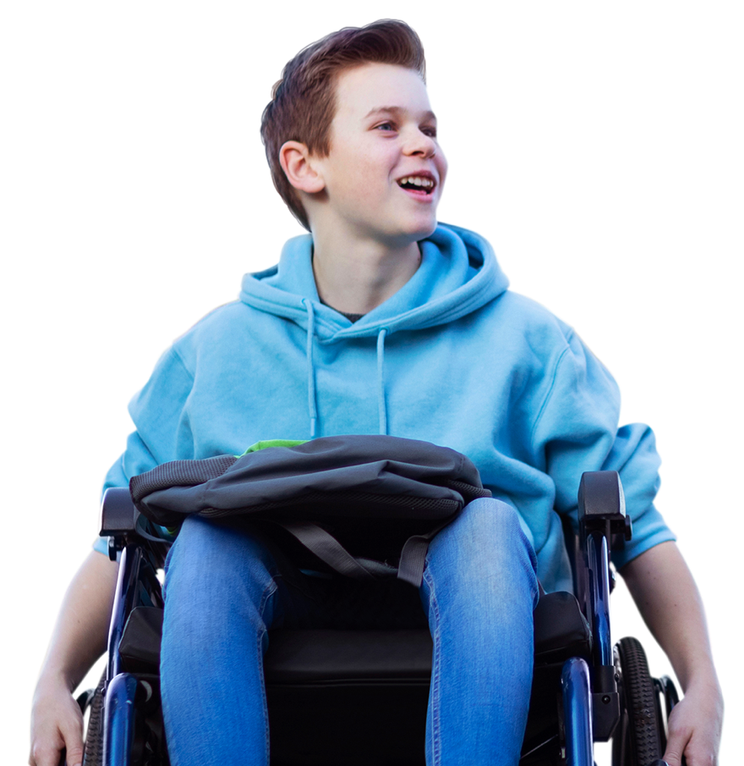
What are we learning?
Key vocabulary
Learning outcomes
Learning objectives
We are learning what happens when we sleep, the benefits
of having a good night’s sleep
and strategies to promote good quality sleep, including where
to seek support.
We will be able to...
identify what happens
when we sleep
describe the benefits
of good quality sleep
explain strategies to promote good quality sleep and
where to seek support if
sleep is difficult
sleep
routine (usual)
growth
mood
memory
rest
energy
immunity (staying well)
environment (surroundings)
sleep hygiene (actions for a better night's sleep)
Notes:
Please note that this slide contains animated content and is best viewed in presentation mode.
Briefly share the learning objectives, outcomes and key vocabulary with students. For key vocabulary, note that easier-to-understand alternative words are provided in the brackets.

Slide 6
How confident are you in…
10
Extremely confident
9
8
7
6
identifying what happens when we sleep?
describing the benefits of good quality sleep?
knowing strategies to promote good quality sleep and where
to seek support if sleep is difficult?
5
4
3
2
1
0
Not confident
Notes:
Baseline assessment: How do you feel? (3-4 mins)
Show students the three statements and ask them to rate their confidence in each using a scale from 0-10.
There are lots of ways you might do this activity. Students could respond to the statements individually by writing their three numbers down on paper, or verbally by discussing their feelings in pairs/groups. Alternatively, you could ask students to reflect silently, before holding up the relevant number of fingers in response to each statement.
How confident are you in:
identifying what happens when we sleep?
describing the benefits of good quality sleep?
knowing strategies to promote good quality sleep and where to seek support if sleep is difficult?

Slide 7
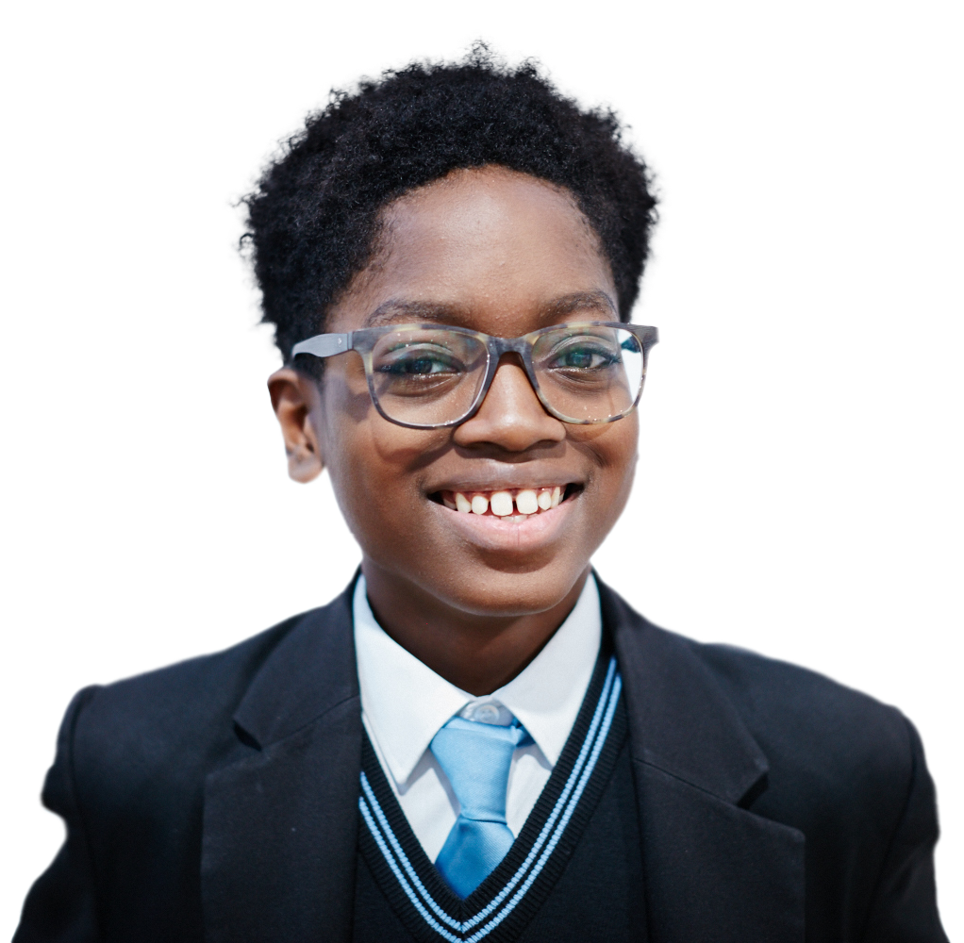
Sleep…
Notes:
Lesson stimulus (3-4 mins)
Ask students to create a mind map in pairs or groups using the sentence starter ‘Sleep…’ .
Encourage them to write down as many facts or pieces of information that they can to show what they already know about sleep.
Depending on the outcome of this activity and student’s existing knowledge, you may wish to adapt the lesson.

Slide 8
All about sleep
When it’s dark our bodies produce
a hormone called melatonin which tells our bodies it’s time to sleep.
A good night’s sleep has a positive impact on the brain and body, improving performance and productivity.
11-16 year-olds are recommended to get 8 to 10 hours sleep a night.
It is recommended to
not use any screen technology one hour before bedtime.
Physical activity during
the day improves your sleep.
Sleep affects your physical appearance as well as your mood, mental health and your memory.
Notes:
Activity 1: Why do we sleep? (5 mins, slides 8-11)
Ask students to look back at their mind maps. Before students begin looking at the information on this slide, explain that you are going to show them three separate slides with different information on them (slides 8-10). Their task is to remember as much information as they can from each and add this to their mind map.

Slide 9
Sleep helps the brain function
Concentration and mood
Activity in the brain during sleep
improves concentration and mood.
Memory
Overnight, information moves from our short-term to our long-term memory.
Productivity and performance
Decision making and cognitive performance (our ability to think)
are improved by sleep.
Notes:
Activity 1: Why do we sleep? (5 mins) continued

Slide 10
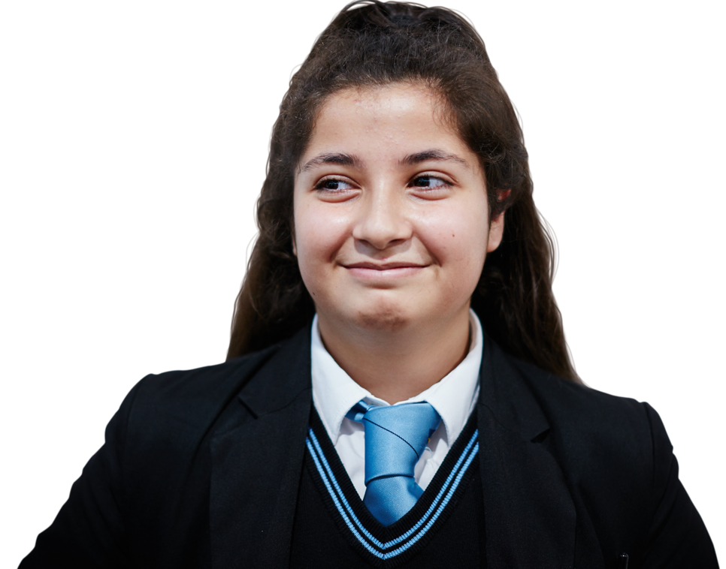
Sleep helps the body function
Immune system
Special proteins are released,
which support the immune system.
Regulates hormones
The hormone levels in the body
are balanced out.
Repair and growth
The body works to grow and repair
muscles, organs and other cells.
Notes:
Activity 1: Why do we sleep? (5 mins) continued

Slide 11

What can you remember?
In a different coloured pen, add as many
new facts to your mind map as you
can remember.
How did you do?
Notes:
Activity 1: Why do we sleep? (5 mins) continued
Please note that this slide contains animated content and is best viewed in presentation mode.
Ask students to add any information they can remember to their mind map using a different colour pen.
Show the student the information for a second time (slides 8-10) so they can see what they remembered and what they might have missed. Emphasize that sleep has a positive impact on both our brain function and our body function.
NOTE: Explain to students that a good night’s sleep would help them with this activity because good quality sleep has a positive impact on memory function, productivity and performance.

Slide 12
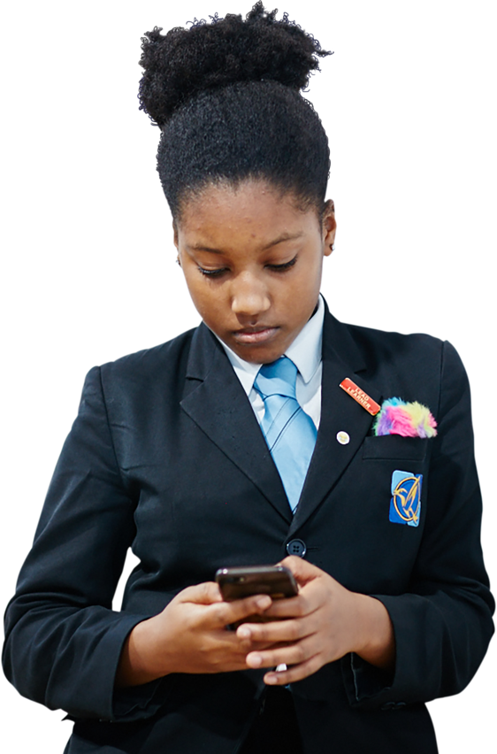
What impact does sleep have?
A:
Draw an outline of a student and makes notes around the outline
to show how good quality sleep might impact them.
In pairs, select A or B.
B:
Draw an outline of a student and makes notes around the outline
to show how poor quality sleep might impact them.
Notes:
Activity 2: Good quality sleep vs. poor quality sleep (15 mins, slides 12-14)
Ask students to complete the following activity:
In pairs, ask students to select either A or B.
Ask the ‘A’ students to draw an outline of a student and makes notes around the outline to show how good quality sleep might impact them.
Ask the ‘B’ students to draw an outline of a student and make notes around the outline to show how a lack of sleep (or poor quality sleep) might impact them.
Clues: Ask students to think about how the person performs in school, how they look, how they feel, what they do or don’t do and anything else you can think of.

Slide 13
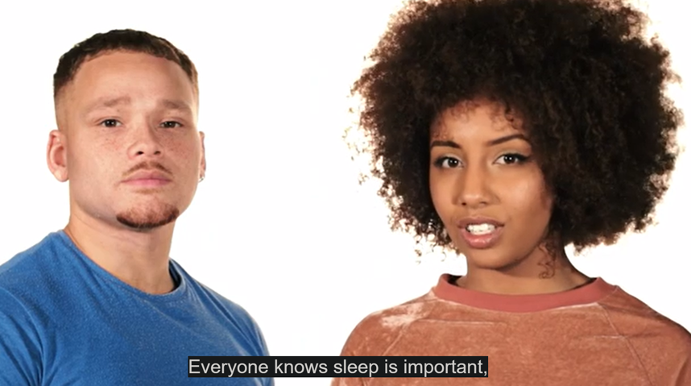
Good quality vs. poor quality sleep
Watch the first half of this video and add any new ideas to your outline.
Notes:
Activity 2: Good quality sleep vs. poor quality sleep (15 mins) continued
Show the class the first half of the video (00:00 - 1:28). You can play the ‘Sleep’ video by copying and pasting this URL into your web browser: https://www.nhs.uk/oneyou/every-mind-matters/youth-mental-health/
Note that you will need to select the video titled ‘Sleep’. Alternatively, watch the video here: https://bcove.video/2LqyUDq
Ask students to compare their image with their partners and in a different coloured pen, add on any new ideas they have learned from the video to their sheets.

Slide 14
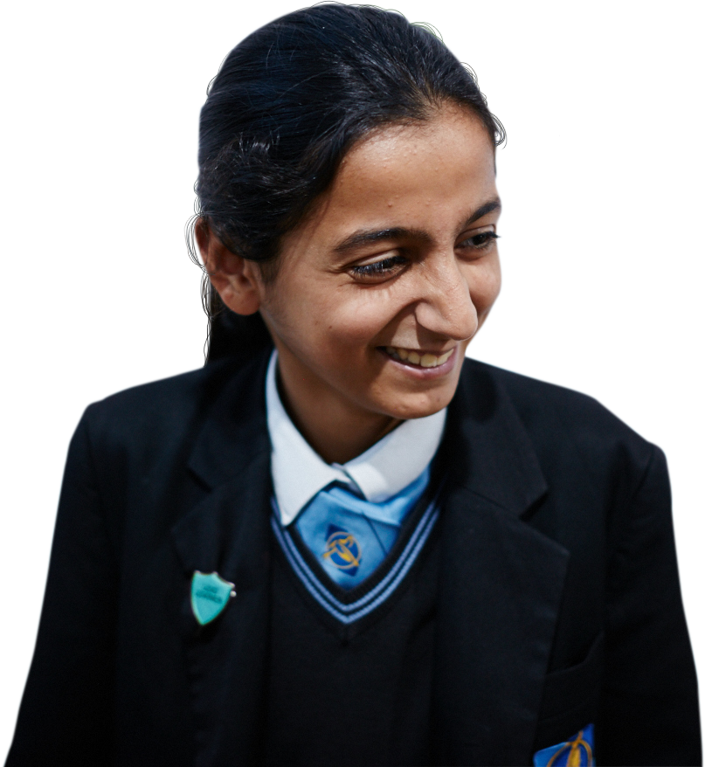
Discuss
All
Further challenge
How would you define
good quality sleep?
What are the
main factors that impact sleep?
How might
puberty impact
on sleep?
Why can sleeping
be difficult?
How might someone’s
sleep change
with different circumstances?
What does
a good sleep routine look
like to you?
How would someone know
they have slept well?
Notes:
Activity 2: Good quality sleep vs. poor quality sleep (15 mins) continued
Discuss the questions on the slide in pairs, small groups or as a whole class.
All
• How would you define good quality sleep? Encourage students to think about length of sleep, and uninterrupted sleep
• Why can sleeping be difficult? For example, mood, thoughts, phones, screens, noises, lights, uncomfortable, stress, substances – like caffeine or alcohol.
• How would someone know they have slept well? For example, feeling alert, rested, better mood, better appetite, memory
Further challenge
• What are the main factors that impact sleep? For example, health, stress, age, sleeping environment, diet, use of technology at bedtime and caffeine (caffeine can make it harder to get to sleep and decrease a person’s quality of sleep)
• How might puberty impact on sleep?
For example, changes in hormones, mood, changing peer groups, period pain, more use of phones and electronic devices
• How might someone’s sleep change with different circumstances?
For example, stressful situations, new environments, new baby in the house, different seasons
• What does a good sleep routine look like to you?
This answer will vary depending on the individual, but possible responses might include relaxation techniques, minimising use of screens, and creating a bedroom environment that helps them switch off

Slide 15
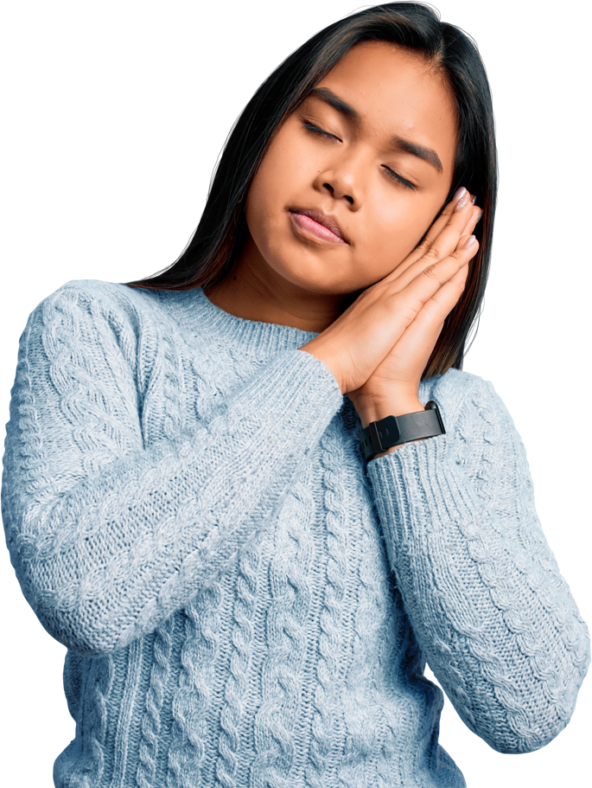
B-e-d
Can you help design an
app or a podcast to support young people struggling with their sleep?
Bedroom routine
Bedroom environment
Daytime routine
Notes:
Activity 3: B-E-D (20-25 mins, slides 15-16)
Explain that students are going to be working in small groups to create a B-E-D app or podcast to help support young people struggling with their sleep.
Each group will produce a feature of the app or podcast to give advice and suggestions in one of the three areas, Bedtime routine, bedroom environment, or Daytime routine.
Allocate one of the three features to groups or allow students to choose for themselves.
The next slide shows the second half of the video to give students ideas.

Slide 16
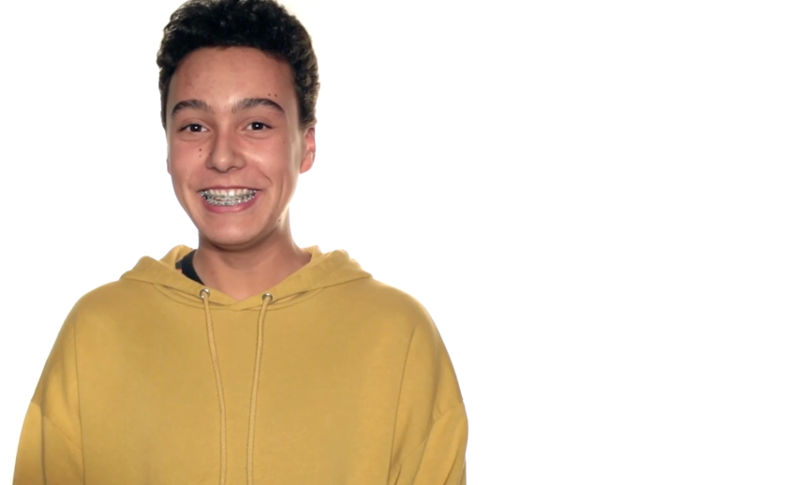
B-e-d
Can you help design an
app or a podcast to support young people struggling with their sleep?
Watch the second half of this video for some ideas.
Notes:
Activity 3: B-E-D (20-25 mins, slides 15-18)
Show the class the second half of the video (1:28 - end).
You can play the ‘Sleep’ video by copying and pasting this URL into your web browser: https://www.nhs.uk/oneyou/every-mind-matters/youth-mental-health/
Note that you will need to select the video titled ‘Sleep’. Alternatively, watch the video here: https://bcove.video/2LqyUDq
Each group can then prepare a two minute presentation to feed back to the rest of the class. Students can re-watch the video if needed.

Slide 17
B-e-d
Success criteria
Bedroom routine
Try to include:
an explanation of how either bedtime
routine, bedroom environment or daytime
routine benefits sleep
suggestions on how to build
opportunities for rest and downtime
strategies for how someone could
improve their quality of sleep
advice on what to do if someone’s
quality of sleep does not improve
Bedroom environment
Daytime routine
Notes:
Activity 3: B-E-D (20-25 mins) continued
Share the success criteria with students to help them structure their app or podcast. Encourage students to be creative, they could make up rhymes, draw images, suggest music or anything else to make an awesome app or podcast! If students need additional support with this activity, the next slide has an ideas bank.
Presentation
Allow ten minutes for students to present their ideas to each other and provide feedback using ‘What went well...’ and ‘Even better if...’
NOTE: Presentations could be spread over two lessons if limited for time.

Slide 18
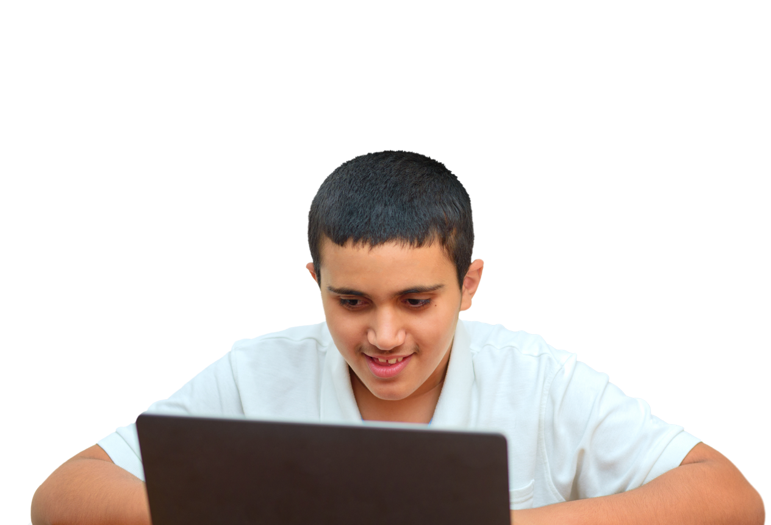
Ideas bank
Daytime routine
eating a balanced diet
exercise
limited screen time
meditation
rituals
tidying
relaxing music
Evening routine
spray a nice scent
rest time
routine
turning
phone off
washing
brushing teeth
reading
Notes:
Activity 3: B-E-D (20-25 mins) continued
If students need additional support with this activity, share this ideas bank.

Slide 19
How confident are you in…
10
Extremely confident
9
8
7
6
identifying what happens when we sleep?
describing the benefits of good quality sleep?
knowing strategies to promote good quality sleep and where
to seek support if sleep is difficult?
5
4
3
2
1
0
Not confident
Notes:
Assessment for learning (3-4 mins)
Show students the three statements from the initial assessment once more and ask students to rate their confidence in each now they have completed the lesson.
It is an opportunity for students to reflect on what they have learned in the lesson. Ask students to consider why their scores have changed and give an example of something new they have learned or thought about.
How confident are you in:
identifying what happens when we sleep?
describing the benefits of good quality sleep?
knowing strategies to promote good quality sleep and where to seek support if sleep is difficult?

Slide 20
Advice
I’ve just moved to a new home. There are lots of noises at night and often I find it hard to get to sleep or
wake up during the night.
Someone I really care about won’t talk to me. I wake up in the night thinking about it and can’t get back to sleep.
What advice would you give to two
of the following students?
I share a room with my younger sibling who can be very messy! And sometimes
the light from her screen tablet keeps me up.
I find it really hard to get
up in the mornings and I’m
really tired in the day so
I’ve stopped doing sports and going out so much.
I’m in loads of WhatsApp groups - my phone never stops buzzing and I keep staying up late even after I’ve finished messaging.
Notes:
Plenary: Dream on... (3-4 mins)
These five students are struggling with their sleep. Ask your students to choose two of the scenarios and think of some advice they might give in response.
Use this opportunity to assess how students have met the learning outcomes.
This could be completed as a verbal activity, although students can write responses if time allows.

Slide 21
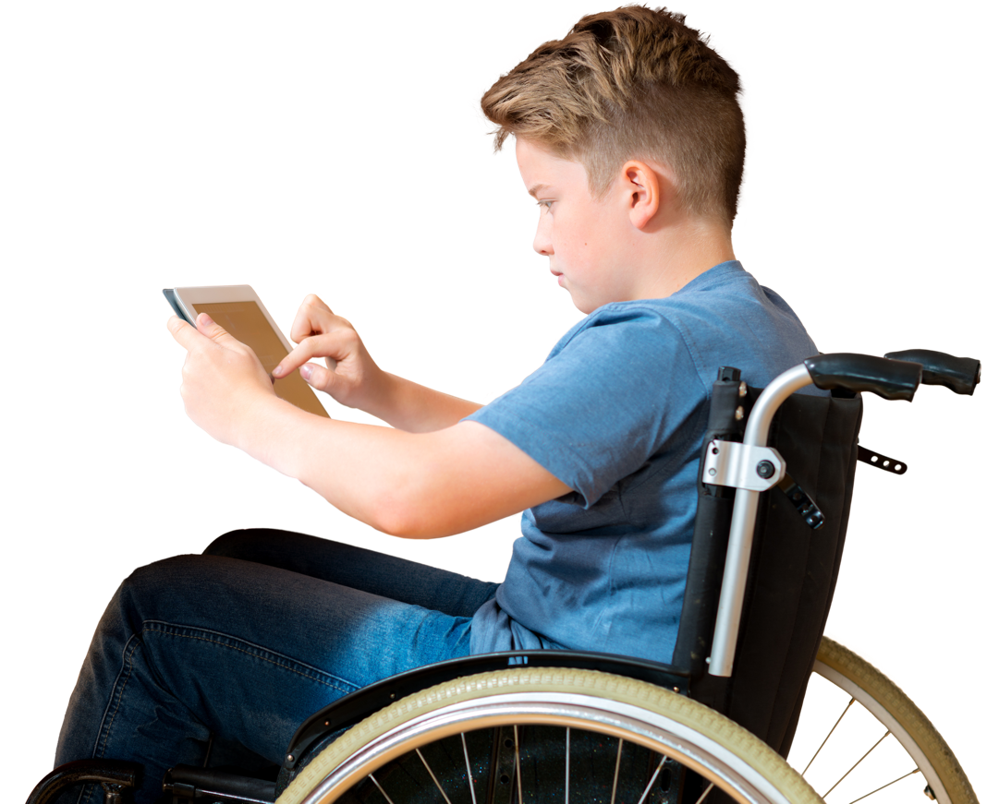
It can be common to struggle with sleep
If you are worried about it or if a lack of sleep is making things difficult, you can speak to a trusted adult or ask them to make you an appointment with your GP.
Childline: childline.org.uk/info-advice
or call 0800 1111
The Mix: call 0808 808 4994
Shout: text 85258
Notes:
Signposting (1 min)
Share this slide with students and remind them that everybody is different when it comes to sleep. Sometimes, people might struggle with falling asleep or with staying asleep.
Students can use the different actions they have learned in the lesson but if things become difficult, they should speak to a trusted adult in school, at home or contact:
Childline (0800 1111 or https://www.childline.org.uk/) – a free, confidential support service. They also have sleep advice: https://www.childline.org.uk/info-advice/your-feelings/feelings-emotions/problems-sleeping/.
The Mix has call and chat services for young people to talk through anything that’s on their mind.
Shout is a free and confidential text messaging service to support mental health and emotional wellbeing that can be used anytime, day or night.

Slide 22
Extended learning projects
Draw an image of a positive bedroom environment for good quality sleep and annotate it with notes on what makes good quality sleep.
Make a timetable for both daytime routine and bedtime routine that could promote good quality sleep.
Create a poster of ways to encourage students to use less technology in their bedtime routine that could be put up around school or published in a school magazine.
Create a sleep diary which includes daytime routine, bedtime routine and number of hours slept. Keep it for a week and then write a conclusion about what you have noticed from your own sleep patterns and habits.

