Slide 1
ALCOHOL
Learning objectives
Learning outcomes
We are learning about why young people may choose to drink, the risks associated with underage drinking and how to make safe choices around alcohol.
By the end of the lesson you will be able to…
Describe the reasons why people drink alcohol and the impact it can have
Identify and assess the risks of underage drinking
Suggest strategies to manage peer pressure around alcohol misuse and identify sources of guidance and support.
KEY
VOCABULARY
Depressant, addictive, peer-pressure, family, friends, support, communication, units, incapacitated, risk

Slide 2


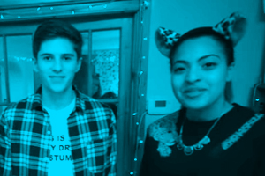
ALCOHOL
PLUS
POINTS
MINUS
POINTS
INTERESTING
POINTS
Why do some people like drinking alcohol?
What are the possible negative effects of drinking alcohol?
What facts do you already know about alcohol?
Notes:
Discuss students’ responses to the stimulus question – if it hasn’t been mentioned already, highlight that
purchasing alcohol under the age of 18 is illegal.

Slide 3

ALCOHOL
SELF ASSESSMENT
A. How confident are you at describing some of the reasons why people drink alcohol?
B. How confident are you in knowing the risks of underage drinking?
C. How confident are you about knowing how to find support for yourself and friends?
0
10
NOT CONFIDENT
EXTREMELY CONFIDENT
Notes:
Students should answer the three baseline questions on a confidence scale (0 = not confident, 10 = extremely
confident) for each of the questions.

Slide 4
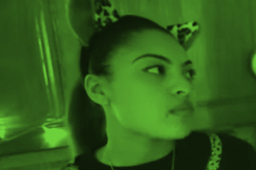

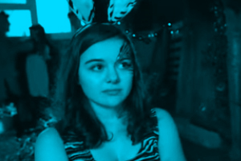
ALCOHOL
IT’S YOUR CHOICE…
REASONS
FEELINGS
RISKS
What are the reasons that some
young people choose to drink?
How can it make them feel?
What are some of the risks associated with underage drinking?
Notes:
Thoughts should be captured using an alcohol ‘mind map’, which is a good way to display thoughts and ideas in a clear
and non-hierarchical fashion.

Slide 5

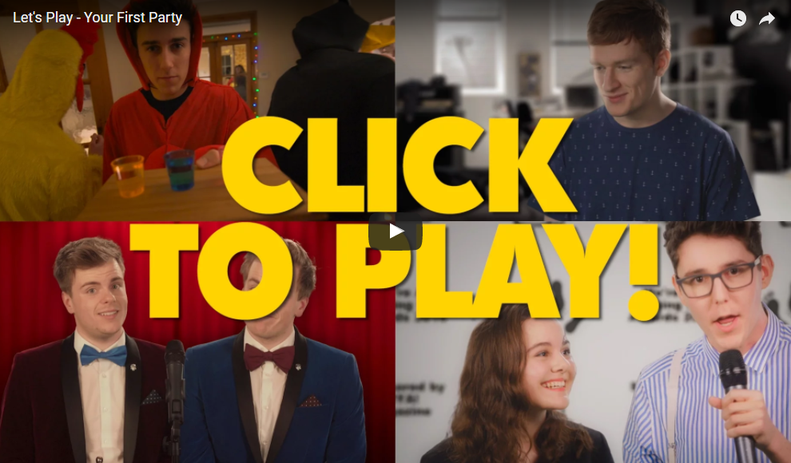

ALCOHOL
IT’S YOUR CHOICE…
https://www.youtube.com/watch?v=uGiZC3ivJ98
Notes:
In pairs, small groups or as a whole class play https://www.youtube.com/watch?v=uGiZC3ivJ98 (timings vary).
Hands up and eyes closed voting is recommended if carried out as a whole class.
Students should talk though each decision as a pair or group and reach a consensus.

Slide 6

ALCOHOL
IT’S YOUR CHOICE…
What are some of the short-term side effects of drinking alcohol? (physical/emotional/social)
What are some of the long-term side effects of regularly drinking alcohol? (physical/emotional/social)
How did people respond when your character decided not to drink?
How did people respond when your character decided to drink?
FURTHER CHALLENGE
Drinking alcohol can lower your inhibitions. Why could this be a problem?
Why might it have been difficult for your character to resist the temptation to drink?
Why do some people pressure other people into drinking?
What could someone do if they make a decision that has (unforeseen) dangerous/negative consequences?
Notes:
After playing 10 minutes’ worth of the game, students discuss the questions as a class.

Slide 7

ALCOHOL
UNDER PRESSURE
https://www.youtube.com/watch?v=MgLsoD3VxNM
Notes:
This activity could be done individually using devices or completed as whole class using a projector. The video resource only needs to be watched for the first 39 seconds. (Timings 0 – 0:39).
Prior to the lesson, the drink dodger hit list could be printed off if this would be appropriate to the class.

Slide 8

ALCOHOL
UNDER PRESSURE
Create a storyboard, comic strip or creative writing piece about the scenario. Use the Every Mind Matters Website to get ideas for solutions.
Scenario
A young person experiences a pressurised situation relating to drinking alcohol.
Do not base this on your
real-life experiences
or anyone you know
Share your work with other students. Do you agree with their outcome or would you have chosen something different?
Notes:
Using the video and article listed below, their experience of playing the interactive game ‘Up to you – party edition’ and their own ideas, students create a comic strip or storyboard featuring a young person who has experienced a pressurised situation relating to drinking alcohol. (Some students may prefer to create a piece of creative writing rather than a comic strip.)
If possible, allow students to browse the Every Mind Matters website independently to find solutions to their comic strip
situation.
If time permits groups can share their work and provide peer-to-peer feedback, discussing whether they would agree
with the outcome or would have created an alternative ending.

Slide 9

ALCOHOL
PLENARY: NOW I KNOW
Go back to your mind-map and add information you have learnt today in a different colour pen.
Underline key words from the lesson
Highlight or circle one ‘take away’ message from the lesson
Notes:
Briefly recap the key learning covered in the lesson by asking students to follow the steps on the slide.

Slide 10

ALCOHOL
PLENARY: NOW I KNOW
If you, or anyone you know needs support in this area,
speak to a trusted adult, a teacher, tutor or head of year. You can also get support from Talk to Frank at:
http://www.talktofrank.com/drug/alcohol
Notes:
Emphasise the importance of speaking to a trusted adult if a student or someone they know needs help with alcohol
or addiction. Signpost students to the Every Mind Matters website, Talk to Frank and other sources listed on the teacher
support sheet.

Slide 11
ALCOHOL
SELF ASSESSMENT
A. How confident are you at describing some of the reasons why people drink alcohol?
B. How confident are you in knowing the risks of underage drinking?
C. How confident are you about knowing how to find support for yourself and friends?
0
10
NOT CONFIDENT
EXTREMELY CONFIDENT
Notes:
Ask students to think back to the confidence line that they shared at the start of the session and consider the same questions.
Ask students to consider why their scores have changed and give an example of something new they have learnt or thought about. They might have ideas about how to handle risks more safely, such as ensuring their phone is charged, being with friends that have not been drinking, and planning a way to get home safely.

