Slide 1



Ensure you read the guidance before teaching the lesson
Teacher
slide
Drug and alcohol education
Upper KS3
Year 9 Lesson 3:
Drugs and their effects: Alcohol and cannabis
© PSHE Association 2020

Slide 2
Teacher
slide
Using this PowerPoint
The slides in this presentation are divided into two sections:
Teacher slides (purple) – provide key information regarding lesson preparation
Pupil slides (white) – provide a visual focus point for pupils during the lesson and delivery notes for teachers about the activities. Click ‘notes’ to view these.
Ensure that you select ‘Use Presenter View’ under the ‘Slide Show’ tab – this will allow you to preview the teaching notes on your monitor while the main presentation is displayed on a screen/smartboard.
© PSHE Association 2020

Slide 3



Challenge and support
Teacher
slide
The lesson includes suggestions for challenge and support activities, to help you differentiate appropriately for your class.
Challenge activities deepen and extend the learning for those who need more challenge or who finish the activity quickly.
Support activities are adapted to be more accessible for those who need it.
Look for the logo on the pupil slides. See delivery notes for details of the activities.
Support
Challenge
© PSHE Association 2020

Slide 4
Context
Teacher
slide
This is the third of four lessons for Year 9, focusing on the risks and consequences of drug use. This lesson explores the effects of different patterns of alcohol use, in addition to the health risks associated with alcohol and cannabis use.
Neither this, nor any of the other lessons, is designed to be taught in isolation, but should always form part of a planned, developmental PSHE education programme.
© PSHE Association 2020

Slide 5
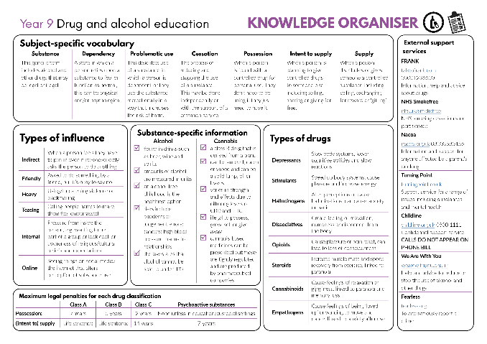

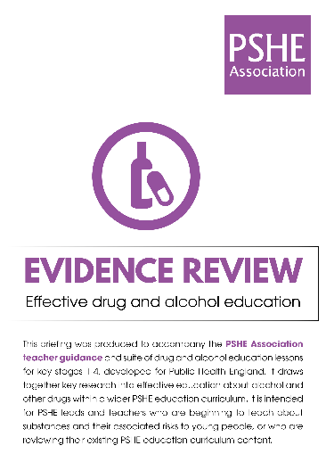
Developing subject knowledge
Teacher
slide
Key information on content related to these lessons can be found in the Year 9 Knowledge Organiser.
Advice on safe practice, dispelling common misconceptions, visitors to the classroom and other important information can be found in Teacher Guidance: Drug and alcohol education. This includes direction to further guidance regarding police stop and search powers, should this discussion arise during the lesson.
Data sources to inform your planning can be found within our document that outlines the approach of these lessons Evidence Review: Effective drug and alcohol education including advice regarding how to talk to young people about alcohol.
© PSHE Association 2020

Slide 6



Teacher
slide
      Learning objective
To learn about the short and long-term effects of alcohol and cannabis use on individuals
      Learning outcomes
Students will be able to:
  describe some of the health risks associated with occasional and problematic substance use
  recognise and challenge myths related to cannabis use and drinking alcohol
© PSHE Association 2020

Slide 7




Teacher
slide
Preparing to teach
      Climate for learning
Make sure you have read the accompanying teacher guidance notes before teaching this lesson for guidance on establishing ground rules, the limits of confidentiality, communication and handling questions effectively.
      Resources required
Box or envelope for anonymous questions
Flip char paper and markers
Resource 1/1a: Alcohol patterns [1 per group of 3-4]
Resource 2: Myth-busting [1 per pair]
Resource 2a: Myth-busting answers [1 per class]
      Duration
      This has been designed to be taught as a sixty minute PSHE education lesson
      Further guidance
      Members of the PSHE Association can access our website for further guidance www.pshe-association.org.uk
60
© PSHE Association 2020

Slide 8
Teacher
slide
Lesson summary
Activity | Description | Timing
Introduction | Introduce students to the learning objective and outcomes, and revisit ground rules | 5 MINS
2. Baseline assessment | Students create a mind map on the risks associated with the use of alcohol and other drugs | 5 MINS
3. Factors affecting decisions | Students evaluate how a person’s environment can affect their choice to drink alcohol or use other drugs | 15 MINS
4. Alcohol patterns | Students explore alcohol drinking patterns and analyse levels of risk | 10 MINS
5. Myth-busting | Students identify and correct myths in relation to cannabis | 10 MINS
6. Endpoint assessment | Students revisit their mind map, adding new learning to demonstrate progress | 10 MINS
7. Signposting | Remind students how to access further advice, guidance and support related to drugs issues | 5 MINS
© PSHE Association 2020

Slide 9


Lesson 3:
Drugs and effects:
Alcohol and cannabis

Slide 10

Ground rules
[Add your class rules here]
Notes:
Teacher Notes
Negotiate or revisit ground rules for the lesson. Remind students of the importance of not sharing any personal stories.
Use this slide to display your class agreement / ground rules for PSHE education lessons. See Accompanying Teacher Guidance Notes (separate document).

Slide 11
We are learning about the short and long-term effects of alcohol and cannabis use on individuals
      We will be able to:
  describe some of the health risks associated with occasional and problematic substance use
  recognise and challenge myths related to cannabis use and drinking alcohol
Notes:
Teacher Notes – Learning objective and outcomes
Introduce the learning objective and outcomes and explain that today’s lesson will explore the effects of drug use on mental and physical health, with a focus on alcohol and cannabis.

Slide 12
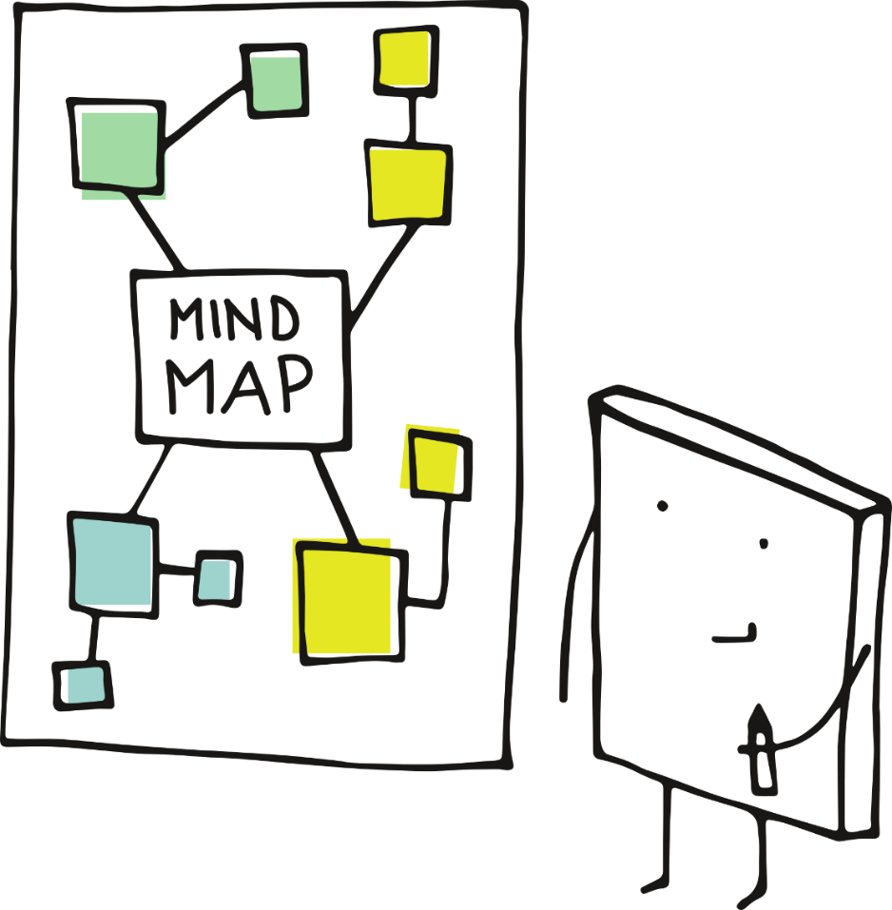
Mind-map
Create a mind-map responding to the question below:
What are the potential risks of using alcohol or other drugs?
Keep this safe!
We will revisit your mind-map at the end of the lesson.
Notes:
Teacher Notes - Baseline assessment (5 mins)
Ask students to create a mind-map around the following question:
What are the potential risks of using alcohol or other drugs?
As this is a baseline assessment, students should complete their mind-map individually and without any input or prompting. The activity is intended to measure what students currently perceive as a risk.
Take feedback from students, but remind them not to add to their mind-map while taking suggestions from the class.

Slide 13
Mind-map
Can you put any of the risks into categories?
For example:
Short- or long- term
Physical, emotional, social, financial or legal
Risks to the person using drugs, to their family and friends or to the community
Are there any situations that might increase or decrease these risks?
Notes:
Teacher Notes - Baseline assessment (5 mins)
As a class, discuss what categories the risks might fall into, for example: short or long-term; physical, emotional, social, financial or legal; risks to the person using the drug, their family and friends, their community. Ask students if they think there are any situations that might increase or decrease the risk associated with the use of alcohol and other drugs.

Slide 14
Factors affecting decisions
As a group, imagine that a young person is deciding whether to drink alcohol or use other drugs in the scenario you have been given.
On your paper, write responses to the following questions:
What effect (if any) might the situation have on whether the young person decides to drink alcohol or use other drugs?
How might the situation affect the risks the young person faces if they do choose to use a drink alcohol or use other drugs?
How might the situation be made safer and/or where could the young person get support?
Notes:
Teacher Notes – Factors affecting decisions (15 mins)
Write each of the situations below on separate pieces of flipchart paper, divide the class into six groups and hand each group one of the sheets:
Meeting someone unfamiliar
Preparing for exams
Dancing at a crowded party
Being in an unfamiliar place
Having had a stressful day
Being at home alone
Ask students to imagine that a young person is deciding whether to drink alcohol or use other drugs in each of these scenarios. In their groups, students should write on the flipchart paper their responses to the following questions:
What effect (if any) might the situation have on whether the young person decides to drink alcohol or use other drugs?
How might the situation affect the risks the young person faces if they do choose to drink alcohol or use other drugs?
How might the situation be made safer and/or where could the young person get support?
Afterwards, invite the groups to swap their sheets so that they can add any additional ideas to each other’s situations.
Gather feedback from the groups.
Students may identify that a person might be more likely to use drugs or drink alcohol in situations where many people are drinking or using drugs, such as at a party; or where they want to ‘impress’ someone they have just met.
They may also identify that each of the situations may have different effects for different people. For example, if a person felt stressed about their upcoming exams they may use unhealthy coping mechanisms, such as drugs or alcohol. Alternatively, in the same situation a person may consider their upcoming exams to be a reason that they do not want to drink alcohol or use a drug, as they need to care for their physical and mental health at this time, and maximise time for study and preparation.
Students may suggest that support could be sought in school through a teacher, member of pastoral staff or school counsellor; they may also suggest support a person could access outside of school such as through a parent, friend or contacting Childline or a similar service. They may also suggest ways to reduce risk in the immediate situation, for example by the person removing themselves from the situation; making a plan with friends before going out, for keeping each other safe; or utilising healthy coping strategies to deal with stress and anxiety.
Students may identify that the level of risk would vary depending on whom the person was surrounded by, for example the risk from using a drug would be especially high if a person was alone and needed medical support.
Challenge: Ask students to write down any other factors they can think of that might affect the level of risk a person experiences in relation to the use of alcohol, tobacco or other drugs.

Slide 15

Alcohol patterns
The Chief Medical Officer releases guidance on how to manage risk in relation to alcohol. We are going to consider what this advice might look like for an adult over the age of 18 over the course of a week, if they chose to drink alcohol.
The Chief Medical Officer advises that an alcohol-free childhood is the healthiest choice.
Read the guidance on your sheet, then draw or write the number of alcoholic drinks that an adult who chooses to drink alcohol could drink whilst keeping the risks relatively low.
Note: this guidance is intended as a maximum and not a target.
Notes:
Teacher Notes – Alcohol patterns (10 mins)
Remind students that many people do not drink alcohol for religious or cultural reasons, that statistics show that alcohol use amongst all young people is declining, and that most young people choose not to drink alcohol. For those who do choose to drink alcohol, whilst all alcohol consumption carries a degree of risk, there are ways to reduce the risk of harm.
Hand students Resource 1: Alcohol patterns and ask them to read the first part of the sheet that outlines what can be considered lower risk drinking and explain to students that whilst not drinking alcohol at all is the healthiest choice, drinking alcohol in a lower risk way reduces the chance of illness or injury, including lower risks of alcohol-related cancers, and short-term injuries or misjudgement of risks than higher risk drinking habits.
Next ask students to draw or write the number of alcoholic drinks that an adult could drink to be considered a ‘lower-risk’ drinker in the table on the lower half of the sheet using the information they have read. They should also decide on three key points they think would keep the risks to an adult low. For example, they may wish to consider how much or how often a person may want to drink or if there are further strategies to lower the risks present while drinking.
Key learning:
It is important to note that advice from the Chief Medical Officer states that an alcohol-free childhood is the healthiest choice.
For adults, drinking fewer than 14 units of alcohol per week constitutes lower risk drinking and this should be spread over time rather than all on one or two days.
Lower risk drinking reduces the risk of short-term injuries or illness such as accidents or misjudgements of risk that lead to injury or illness, and alcohol poisoning. It also reduces the risk of long-term risks to health such as liver or heart disease, some cancers and damage to the brain or nervous system.
Limiting the amount of drinking in one session, for example over an evening, also lowers the risk of short-term health risks including accidents and vulnerability to others. Students may also add that a person can ensure they have a plan to get home and stay in a group with people they trust as a way to reduce vulnerability and risk.
Students may have suggested a range of further strategies to lower a person’s risk whilst drinking. For example, if a person chose to have multiple drinks in one session then spacing drinking alcohol with non-alcoholic beverages, this can reduce the number of alcoholic drinks consumed in total, and can give the body time to process the alcohol as it slows drinking. However students should understand that this does not prevent the effects of alcohol completely.
Students may have also identified that eating food with drinking alcohol could be a strategy used to reduce risk in relation to drinking, as it allows the body to process alcohol gradually by slowing the alcohol entering the bloodstream. Again, students should understand that this will not negate the effects of alcohol and eating food after heavy drinking will not ‘sober up’ a person who is drunk. With higher levels of alcohol, it could also increase risk as the person may be sick which could present a choking hazard.
Support: Provide students with Resource 1a: Alcohol patterns support and ask them to comment on what is helpful and what is risky about each pattern. They should also circle the pattern they think is lowest risk.

Slide 16

Myth-busting
Read through your sheet or the next slide and indicate which statements you think are a myth, and which are a fact.
Wait to complete the explanation until after we’ve run through the answers!
Now we’ve addressed which are facts and which are myths, can you add any detail or explain why each of these statements are a myth or a fact?
© PSHE Association 2020
Notes:
Teacher Notes – Myth-busting (10 mins)
Explain to young people that drugs such as cannabis also have an impact on physical and mental health. Use the next slide or hand pairs of students Resource 2: Myth-busting and ask them to complete the first column, indicating whether they think each statement is a myth or a fact. Feedback to students using Resource 2a: Myth-busting answers to address misconceptions.
Then guide students to complete the explanation section of Resource 2: Myth-busting either explaining why a statement is true or correcting the myth. Ask students to feedback explanations they feel confident to share and use Resource 2a: Myth-busting explanations to feedback to students and challenge any remaining misconceptions.
Support: After students have decided which statements they believe are a myth and which are facts, provide students with the explanation cards from Resource 2a: Myth-busting explanations to match to the statements rather than asking students to generate these themselves.
Challenge: Ask students to draft a brief social media post of no more than two sentences that a charity could post to address one of the myths shared in the task.

Slide 17
Fact
Cannabis is a Class B drug. Previously it had been downgraded to Class C, however it was reclassified to Class B again in 2009.
This means that penalties include a prison sentence of up to 5 years for possession and up to 14 years for intent to supply or supply.
In both cases there can also be an unlimited fine.
Fact
Smoking cannabis can cause breathing difficulties, and increases the risk of lung cancer, even if tobacco is not used.
Cannabis can harm mental health including reducing motivation, impairing memory and cognitive function, as well as causing paranoia and anxiety.
Using cannabis can also harm relationships and affect a person’s studies/work.
Myth
Cannabis has different long-term effects to alcohol, so it is often dangerous in different ways.
With varying THC levels in cannabis and higher levels in newer strains, it is impossible to compare the effects of all strains of cannabis to alcohol.
It is especially unsafe to mix alcohol and cannabis.
Myth
Not everything that occurs naturally is inherently safe.
Different strains of cannabis have varying levels of the compounds CBD and THC. It’s hard to tell what the balance between these compounds will be and therefore difficult to judge how harmful a particular batch of cannabis will be.
Fact
If a person has used cannabis they are at an increased risk of having an accident if they drive.
This is because cannabis decreases attention, reduces the speed of information processing and slows response times-all of which are essential for driving safely.
Myth
In 2016, only 8% of young people between 11 and 15 stated that they had used cannabis at least once in the last year (so 92% had not).
This is a distinct decline from previous years and demonstrates that most young people do not use cannabis.
Myth
Prosecution for possession, supply or intent to supply cannabis follows the same process if the plants are being grown at home as if a person either possessed, supplied, or intended to supply prepared cannabis that they had purchased.
Myth
Medicines based on cannabis are now prescribed in very rare cases by a small number of specialists in the UK.
Medical cannabis has lower levels of the compound THC that gives users the ‘high’ associated with cannabis use.
A person cannot get in trouble for growing cannabis at home
Most people are using cannabis
A person cannot get in trouble for growing cannabis at home
Most people are using cannabis
Cannabis can cause harm
Cannabis is a Class B drug
Cannabis can cause harm
Cannabis is a Class B drug
Cannabis is used medicinally so it must be safe
Cannabis is used medicinally so it must be safe
Driving following cannabis use increases the likelihood of car accidents
Driving following cannabis use increases the likelihood of car accidents
Cannabis is from a plant so it is safe and natural
Cannabis is safer than alcohol or tobacco
Cannabis is from a plant so it is safe and natural
Cannabis is safer than alcohol or tobacco

Slide 18

What has been learnt?
Using a different coloured pen, can you add any new learning to your mind-map from the start of the lessons?
Notes:
Teacher Notes – Endpoint assessment (10 mins)
Using a different coloured pen, ask students to revisit their mind maps from the baseline assessment and add any new learning, or edit their ideas from the start of the lesson. Collect these and use them to check progress and assess future learning needs.
Take feedback from students on the aspects that they hadn’t considered. Are there any general themes to the risks they had missed? This may inform future planning on drugs and alcohol education

Slide 19

Further support
Speak to a tutor, head of year or other trusted member of staff in the school
Contact Childline www.childline.org.uk 0800 1111
Further information is available via FRANK
www.talktofrank.com/get-help
Notes:
Teacher Notes – Signposting support
Remind pupils who they can talk to if they are worried.
Reflecting on learning:
On a piece of paper, ask students to write down something unrelated to the lesson such as “What is one positive thing that has happened this week so far?”
Advise students that during this time they can also write an anonymous question on the same piece of paper (so that students do not have to be seen to be asking a question).
Collect all responses in an anonymous question box. Ensure the questions are responded to in the following lesson.

Slide 20

More activities
Design a myth-busting campaign to help young people access accurate information related to cannabis and alcohol use.
This could include:
posters
a 60 second news bulletin
a short script for an advert
fact check
Notes:
Teachers notes – Extension activities
Myth-busting campaign
Students design a myth-busting campaign to help young people access accurate information related to cannabis and alcohol use. This could include posters, a 60 second news bulletin or a script for a short advert.

