Slide 1
Ensure you read the guidance before teaching the lesson
Teacher
slide
Lesson 1
Valuing Diversity
Notes:
https://pixabay.com/vectors/circle-hands-teamwork-community-312343/

Slide 2
Teacher
slide
Using this PowerPoint
The slides in this presentation are divided into two sections:
Teacher slides (purple) – provide key information regarding lesson preparation
Pupil slides (white) – provide a visual focus point for pupils during the lesson and delivery notes for teachers about the activities. Click ‘notes’ to view these.
Ensure that you select ‘Use Presenter View’ under the ‘Slide Show’ tab – this will allow you to preview the teaching notes on your monitor while the main presentation is displayed on a screen/smartboard.
© PSHE Association 2019

Slide 3
Challenge and support
Teacher
slide
The lesson includes suggestions for challenge and support activities, to help you differentiate appropriately for your class.
Challenge activities deepen and extend the learning for those who need more challenge or who finish the activity quickly.
Support activities are adapted to be more accessible for those who need it.
Look for the logo on the pupil slides. See delivery notes for details of the activities.
Support
Challenge
© PSHE Association 2019

Slide 4
Teacher
slide
Context
Lesson 1: Valuing Diversity
This is the first in a series of three lessons focusing on building resilience to extremism.
This lesson develops understanding of the need for criticality when assessing media content, and the impact of people’s actions on community cohesion.
It supports pupils to be more aware of how their choices can impact others, and educates on the positive actions young people themselves can take to promote diversity.
Neither this, nor any of the other lessons, is designed to be taught in isolation, but should always form part of a planned, developmental PSHE education programme.

Slide 5
Teacher
slide
Learning objective
Students will:
learn about the impact of individual’s beliefs and actions on community cohesion
Learning outcomes
Students will be able to:
explain the importance of respecting diversity
assess the impact of media, social media and actions on people’s attitudes around diversity
© PSHE Association 2019

Slide 6
Preparing to teach
Resources required
A box or envelope for anonymous questions
Resource 1: Migration fact check
Resource 1a: Migration fact check teacher notes
Resource 1b: Migration true/false
Resource 2: Dealing with online hate speech
Extension Resource 3: Celebrity cards
Climate for learning
Make sure you have read the accompanying teacher guidance notes before teaching this lesson – for guidance on establishing ground rules, the limits of
confidentiality, communication and handling questions effectively.
Duration
This lesson has been designed to be taught as a 60 minute PSHE education lesson.
Further guidance
Members of the PSHE Association can access our website for further guidance www.pshe-association.org.uk
60
© PSHE Association 2019

Slide 7
Lesson summary
Teacher
slide
Activity | Description | Timing
1. Introduction | Establish ground rules and introduce lesson objectives and outcomes | 5 MINS
2. Baseline quotation response | Class comment on the Jo Cox quote: “We are far more united and have far more in common with each other than things that divide us” | 5 MINS
3. Migration fact check | Students sort fact and myth cards on immigration and discuss how sensationalised reporting has impacted on communities | 15 MINS
4. Diversity factors | Students consider the impact of each factor as it is introduced | 15 MINS
5. Hate speech video | Class watch the video on hate speech and consider how reposting such content affects their community | 10 MINS
6. Plenary and assessment | Students write an exit card explaining something the lesson caused them to reflect upon | 5 MINS
7. Signposting | Signpost sources of support and further information | 5 MINS
© PSHE Association 2019

Slide 8
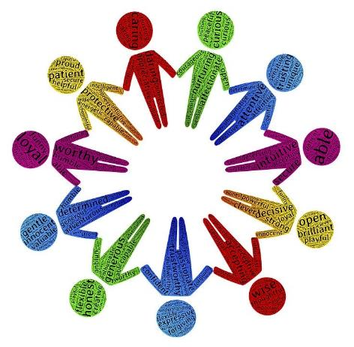
Lesson 1:
Valuing Diversity
Notes:
https://pixabay.com/illustrations/diversity-differences-qualities-1350043/

Slide 9
Ground rules
[Add your class rules here]
Notes:
Teacher Notes
Use this slide to display your class agreement / ground rules for PSHE education lessons. See Accompanying Teacher Guidance Notes (separate document). This lesson requires students to be particularly respectful of others’ contributions and mindful of language to enable positive discussion and avoid migrant or refugee students feeling victimised or upset.

Slide 10
We are learning:
about the impact of individual’s beliefs and actions on community cohesion
We will be able to:
explain the importance of respecting diversity
assess the impact of media, social media and actions on people’s attitudes around diversity
Notes:
Teacher Notes - Learning objectives and outcomes
Introduce the learning objectives and outcomes. Explain that today’s session focuses on diversity in our communities and how individuals’ actions impact on community safety and determines whether somewhere feels a welcoming place to be.

Slide 11
Jo Cox MP:
“We are far more united and have far more in common with each other than things that divide us”
Notes:
https://pixabay.com/illustrations/figures-silhouettes-human-1607182/
Teacher Notes – Quotation response – 10 mins
Share the quote from Jo Cox MP’s maiden speech to Parliament which inspired the #MoreInCommon movement after she was killed by a far right extremist.
Ask students to reflect on the truth of this statement. Ask students to then share their thoughts in pairs before sharing comments as a class. Be sure to value contributions which conflict with the quote but ask the class to keep an open mind.
Use this activity to gauge attitudes and understanding around issues of tolerance and diversity.

Slide 12
Fact check
Sort the cards into FACT or MYTH
Did any of the answers surprise you?
How did the facts make you feel about how the issue of immigration is presented in the media?
Notes:
Teacher Notes – Fact Check 15 – 20 mins
Pass students a set of cards (Resource 1: migration fact check) per pair/small group. Ask them to sort the cards into fact or myth. Ask students to reflect using the key questions.
Teacher notes to support discussion are available at Resource 1a: migration fact check teacher notes.
During feedback, it is important that teaching remain politically neutral and that a range of views are respected, while reinforcing the ground rules and ensuring migrant students are not upset by thoughtless comments.
Explain that for many people, the issue of immigration evokes strong feelings which are not a rational cost/benefit analysis, but come from a sense that British identity is being changed or lost. However, it is important to stress the benefits that people from other countries bring and that the UK has an historical tradition of welcoming migrants.
A key point to bring out in discussion is that media and social media messages around immigration are often inaccurate and sensationalised so it is important to think about the impact this has on attitudes and actions.
Additional connected Citizenship learning on this topic may be valuable to explore these issues further.

Slide 13
Diversity factor: 1
A new youth club opens where people from different backgrounds can mix
Notes:
Teacher Notes – Diversity Factors – 15 mins
Display slides 13-22 in turn. For each slide, ask students how the actions of 1 or more individuals in each situation might impact on how people in a community feel.

Slide 14
Diversity factor: 2
The local council approves the opening of a new place of worship for a faith group who are a minority group in the local community
Notes:
Teacher Notes – Diversity Factors – 15 mins
Display slides 13-22 in turn. For each slide, ask students how the actions of 1 or more individuals in each situation might impact on how people in a community feel.

Slide 15
Diversity factor: 3
A school student posts a comment online about immigration and a classmate responds saying they are a racist. The student faces daily bullying having been labelled a racist.
Notes:
Teacher Notes – Diversity Factors – 15 mins
Display slides 13-22 in turn. For each slide, ask students how the actions of 1 or more individuals in each situation might impact on how people in a community feel.

Slide 16
Diversity factor: 4
The person arrested for an attack on an old resident is a recent migrant from an ethnic minority background
Notes:
Teacher Notes – Diversity Factors – 15 mins
Display slides 13-22 in turn. For each slide, ask students how the actions of 1 or more individuals in each situation might impact on how people in a community feel.

Slide 17
Diversity factor: 5
Pictures of people enjoying a multi-faith celebration day appear in the local free newspaper
Notes:
Teacher Notes – Diversity Factors – 15 mins
Display slides 13-22 in turn. For each slide, ask students how the actions of 1 or more individuals in each situation might impact on how people in a community feel.

Slide 18
Diversity factor: 6
A group of volunteers from different backgrounds regularly visit a local care home to play games and sing with residents
Notes:
Teacher Notes – Diversity Factors – 15 mins
Display slides 13-22 in turn. For each slide, ask students how the actions of 1 or more individuals in each situation might impact on how people in a community feel.

Slide 19
Diversity factor: 7
A group of young people throw stones at a woman wearing cultural/religious dress
Notes:
Teacher Notes – Diversity Factors – 15 mins
Display slides 13-22 in turn. For each slide, ask students how the actions of 1 or more individuals in each situation might impact on how people in a community feel.

Slide 20
Diversity factor: 8
A group of local builders and trades-people from a range of backgrounds and faiths give their time for free to help fix up a local community centre
Notes:
Teacher Notes – Diversity Factors – 15 mins
Display slides 13-22 in turn. For each slide, ask students how the actions of 1 or more individuals in each situation might impact on how people in a community feel.

Slide 21
Diversity factor: 9
A school trip to the Anne Frank museum is run to mark Holocaust Memorial day
Notes:
Teacher Notes – Diversity Factors – 15 mins
Display slides 13-22 in turn. For each slide, ask students how the actions of 1 or more individuals in each situation might impact on how people in a community feel.

Slide 22
Diversity factor: 10
A local campaigner speaks out against violence in their community which is often racially motivated
Notes:
Teacher Notes – Diversity Factors – 15 mins
Display slides 13-22 in turn. For each slide, ask students how the actions of 1 or more individuals in each situation might impact on how people in a community feel.
Summarise this activity by stressing the impact that individual actions have on how the people in a community feel – whether on a small scale (e.g. a family or office), a medium scale (e.g. a school or village), or a larger scale (e.g. city, county). As we are all connected, small actions can have national and international significance in themselves or through the knock-on impacts on each person’s feelings. We therefore have a responsibility to act in a way which promotes kind, welcoming and tolerant communities.

Slide 23
Hate speech
Creating Positive Narratives in Response to Online Hate Speech
Notes:
Teacher Notes – Hate Speech - 10 mins
Explain that hate speech is abusive or threatening speech or writing that expresses prejudice against a particular group, especially on the basis of race, religion, or sexual orientation. Such hate speech contributes to the alienation and divisions we talked about in the previous activity.
Class watch the clip and feed back using questions provided (teacher notes in full lesson plan).

Slide 24
Exit card
Explain one thing this lesson has helped you think about.
Notes:
https://pixabay.com/vectors/bright-contemplation-idea-1296538/
Teacher Notes – Self-assessment - 5 mins
Ask students to write an exit card explaining one thing that this lesson has helped them to think about in relation to their role in keeping their community a safe and welcoming place to be. This can be kept as evidence of progress.
Class watch the clip and feed back using questions provided (teacher notes in full lesson plan).

Slide 25
Further support
If you have questions or concerns following today’s lesson, you can always speak to your parent or carer, or a teacher in school for more advice and support.
There are lots of places to get further advice.
ChildLine:
www.childline.org.uk Phone: 0800 1111
True Vision:
http://www.report-it.org.uk/home

Slide 26
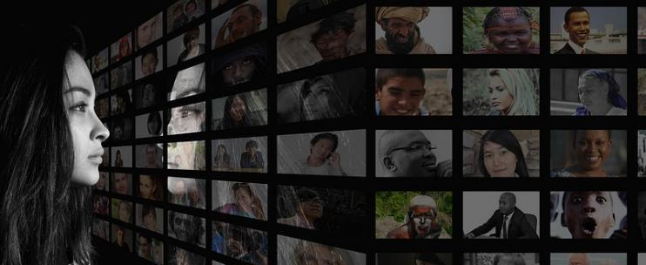
More activities
Celebrity cards
Collage
Play in teams to guess the celebrity from the card description!
Create a set of images that demonstrate how being part of a diverse community makes people’s lives better.
This cold be within school or within the wider community.
Be prepared to talk about the images you select.
I am an English cricketer who grew up in Birmingham.
I am mixed race and a Muslim.
I am an ambassador for StreetChance.
I have been banned from wearing political wristbands when I play for England.
My nickname is Moe.
Notes:
https://pixabay.com/photos/personal-woman-self-talk-mirror-2923048/
Teacher Notes
These activities can be used to extend the learning, either in lessons or as home learning.

