Slide 1
Notes:
Disclaimer:
This resource is provided for informational or educational purposes only. It is intended to offer general first aid advice and is not a substitute for professional medical advice specific to your circumstances.
We do not warrant that the information provided will meet your or your students’ specific health or medical requirements. It is up to you to contact a suitably qualified health professional if you are concerned about your health and it is up to you to advise your students to contact a suitably qualified health professional if they are concerned about their health.
You and your students are encouraged to act within the guidance provided by this resource and we do not accept responsibility for you or your students failing to do so.

Slide 2
What would you do if you saw this situation?
Would you do anything at all? Would you be too scared?
Would you know what to do?
Talk to your partner - if you were going to do something, what is the first thing you would do?
(Click to enlarge the picture.)

Slide 3
Back

Slide 4
Back

Slide 5
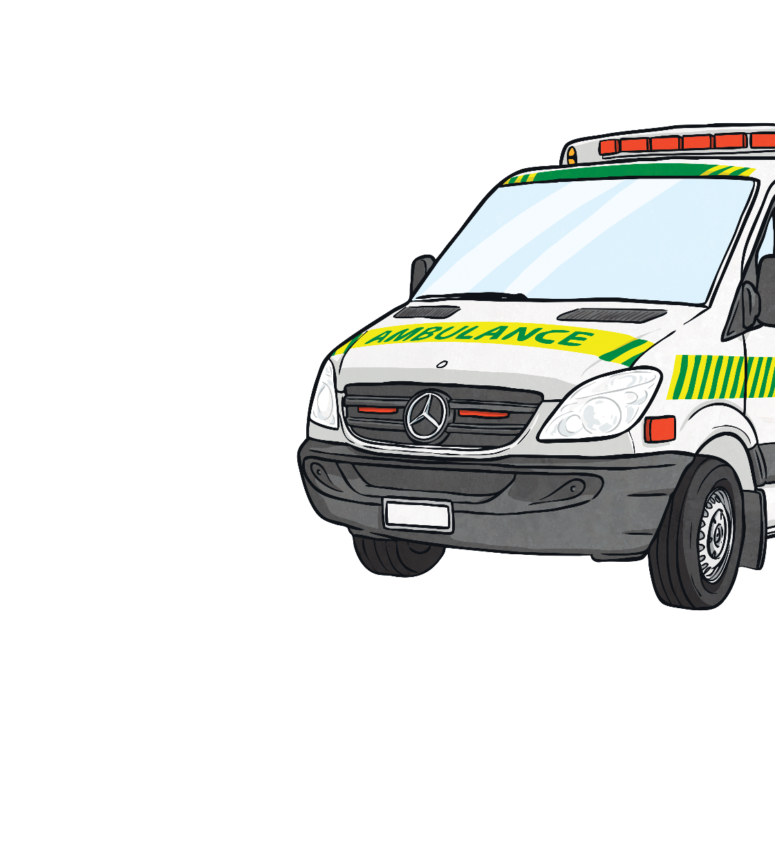
Introduction to First Aid
Anyone can be a first aider. These lessons will
help you to learn some important skills so that you can give injured people first aid.
The role of a first aider is to:
keep yourself and the casualty safe;
stop anyone getting any further injuries;
quickly and safely treat any injuries;
get help from the emergency services, if needed.
casualty:
A person who is injured and needs help.

Slide 6
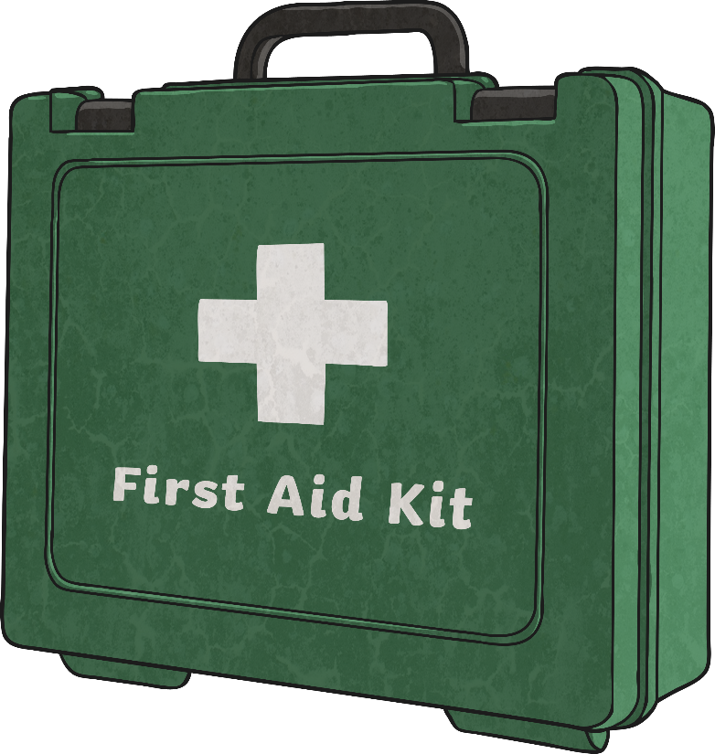
Introduction to First Aid
Sometimes you might feel nervous about doing first aid.
Here are some important things to remember:
stay safe;
stay calm;
keep talking to the casualty;
call 999 or 112 if it is an emergency;
do your best.
It is always better to do something
small than to do nothing at all.

Slide 7
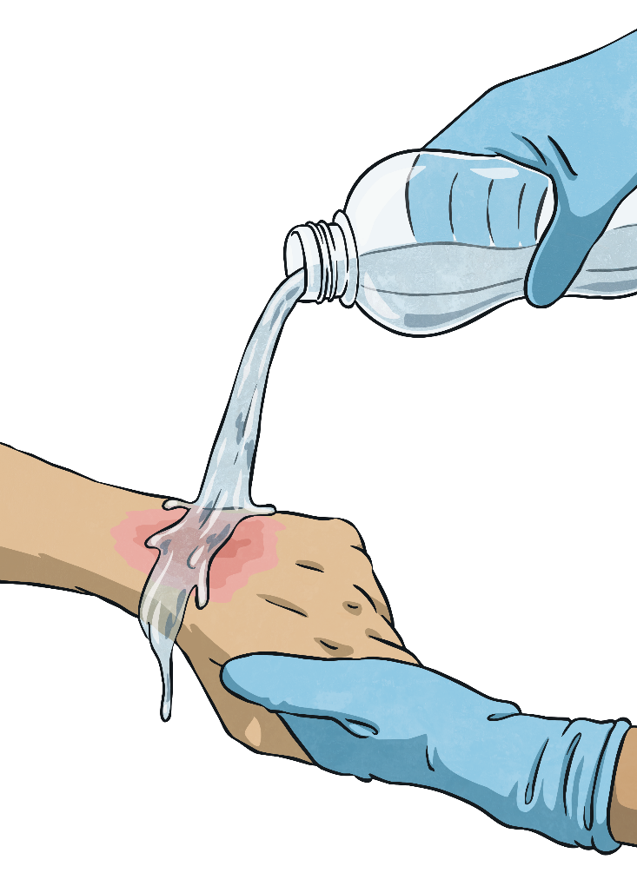
Staying Safe
The most important thing in any first aid situation is staying safe.
Who do you think is the most important person to keep safe?
The answer is YOU.
Keeping yourself safe is the most important thing.
If you are hurt, how will you be able to help anyone else?

Slide 8
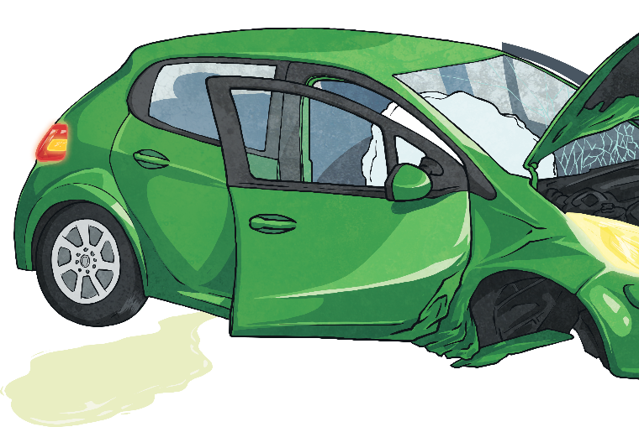
Staying Safe
The first and most important thing to do is to check the area is safe. Use your senses to check your surroundings.
Can you see anything that might be harmful to you? e.g. petrol leaking from a car or loose cables
Can you hear anything that could be dangerous? e.g. a car engine still running.
Can you smell anything unusual that could be poisonous? e.g. smoke or burning
Does anything look like it may be hot or sharp if touched? e.g. metal or broken glass from a window. If so, do not touch it or let it touch the casualty.

Slide 9
Activity 1: Staying Safe
Look at the scene on your activity sheets.
Circle each hazard and explain why it could be a danger to a first aider.
Think about what you could do to avoid the hazard or solve the problem without putting yourself in danger.

Slide 10
Activity 1: Staying Safe
Which hazards did you spot?
Were there any steps you could have taken without putting yourself in any danger?

Slide 11
Staying Calm
Being faced with a situation where someone has been hurt can be upsetting or may cause you to panic. If you feel yourself starting to panic, take slow, deep breaths to calm yourself down.
After the casualty has been treated, you may feel:
happy and proud;
confused;
angry;
sad or upset.
All of these feelings are completely normal. Talk to an adult you trust about what happened. They will be able to help you and put your mind at rest.

Slide 12
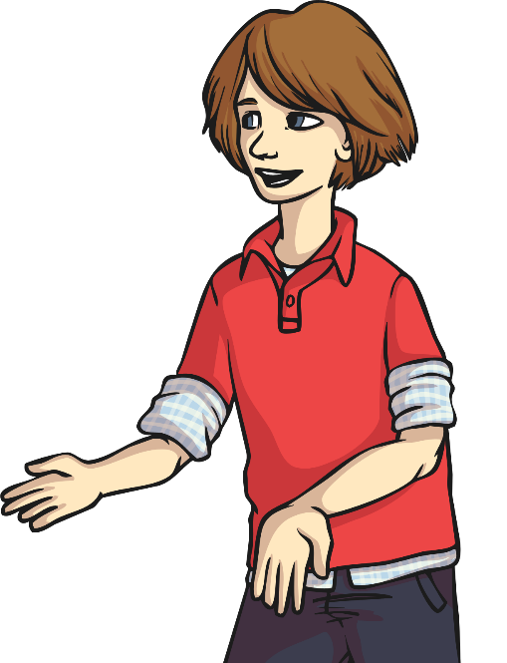
Talking to the Casualty
When you are in a situation which needs first aid, it is very important that you communicate clearly with the casualty.
When you are hurt, you may sometimes feel upset or confused. This is how your casualty could be feeling.
Talking to them and explaining what is happening will help them to stay calm and feel reassured.

Slide 13
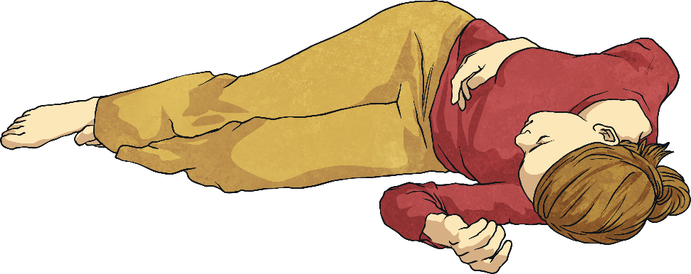
Talking to the Casualty
Here are three key things you can do when communicating with a casualty:
act calmly;
speak clearly;
listen closely.
Even if your casualty does not respond, you should still explain what you are doing. It will help you to remember what to do next and it will let everyone involved know exactly what you are doing.

Slide 14
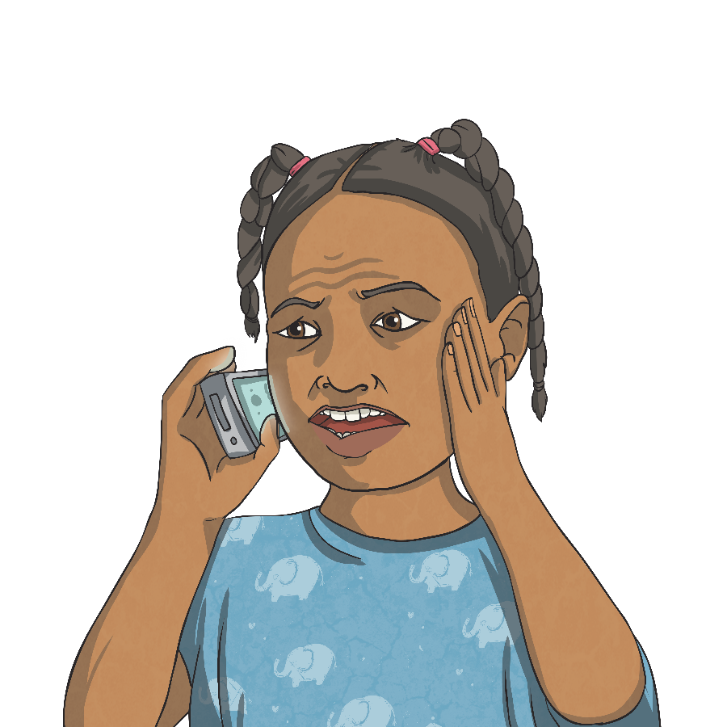
Doing Your Best
Sometimes, the casualty will need a lot more help than you are able to give. The best thing you can do is phone for emergency help.
Which two telephone numbers can you ring if you need help in an emergency?
You can ring 999
or 112 in an emergency.
What sort of information do you think you will need to give?

Slide 15
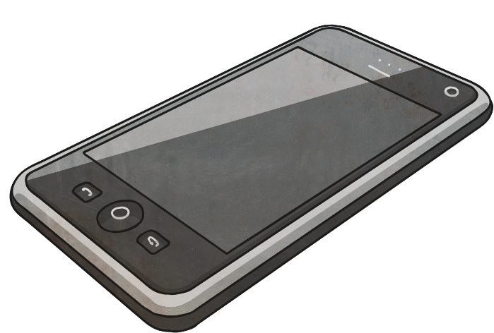
Doing Your Best
The operator who answers the phone will ask you:
Which emergency service do you require?
What is your name?
Where are you?
What has happened?
How many people are hurt?
When you have answered these questions, stay on the phone. You can put the phone on loud-speaker if you need to. The operator will give you more information about how you can help the casualty.

Slide 16
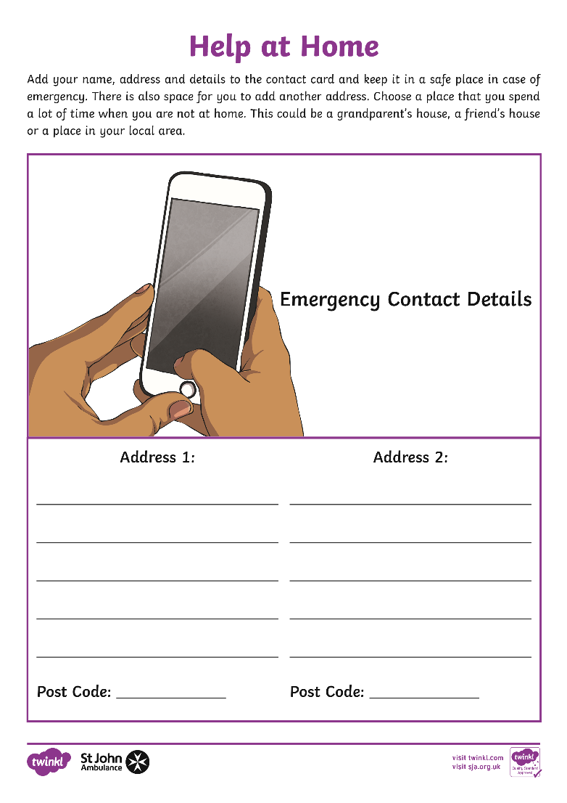
Activity 2: Help at Home
If you were at home and needed emergency help for someone in your family, would you be able to give the operator your full address and postcode?
Fill in this card with your details and keep it in a safe place in case you ever need to phone the emergency services.

Slide 17
Quick Quiz
Let’s see how much you’ve learned about being a first aider. Answer this question:
Who is the most important person to look after in a first aid situation?
The most important person to look after in any first aid situation is yourself.

Slide 18
Quick Quiz
Let’s see how much you’ve learned about being a first aider. Answer this question:
What is the first thing you should do when you see someone who needs first aid?
You should check the area for any dangers or hazards which could hurt you or the casualty.

Slide 19
Quick Quiz
Let’s see how much you’ve learned about being a first aider. Answer this question:
What should you do if you feel confused or upset after giving first aid?
Talk to an adult you trust and tell them about what happened and how you are feeling.

Slide 20
Quick Quiz
Let’s see how much you’ve learned about being a first aider. Answer this question:
If you need to phone the emergency services, what questions might the operator ask you?
The operator will ask you which service you need, who you are, your location and about the casualty’s injuries.

Slide 21
What would you do if you saw this in your local town?
Think back to what you said you would do if you saw this scene in your local town.
(Click to enlarge the picture.)
Have you changed your mind?
What is the first thing you would do now?

Slide 22
Find Out More
Click the logo below for more first aid resources.

