Slide 1
Presentation for

Slide 2
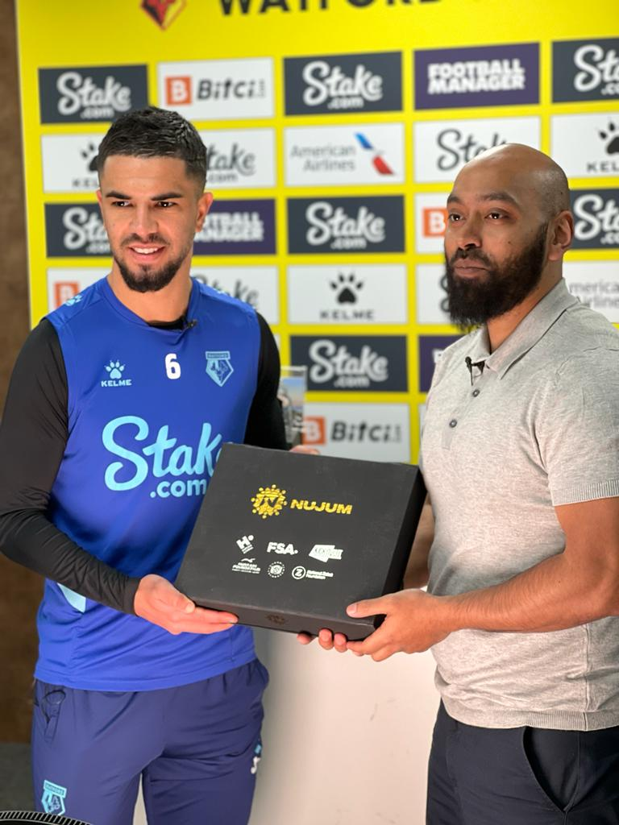
Introduction to
Nujum Sports
Presentation for

Slide 3
Our vision “To see a world where Muslim athletes flourish & fulfil their potential”
Our Mission By building, empowering and supporting a community of Muslim athletes, Nujum aims to empower our future generations to be positive and inspirational members of society.
Why do we exist?
Presentation for

Slide 4
Faith advice & direction
Counselling & mental health support
Athlete community building initiatives
Inspiring athletes to be positive role models
Educational training & Support (organisational)
Our Scope
Presentation for

Slide 5
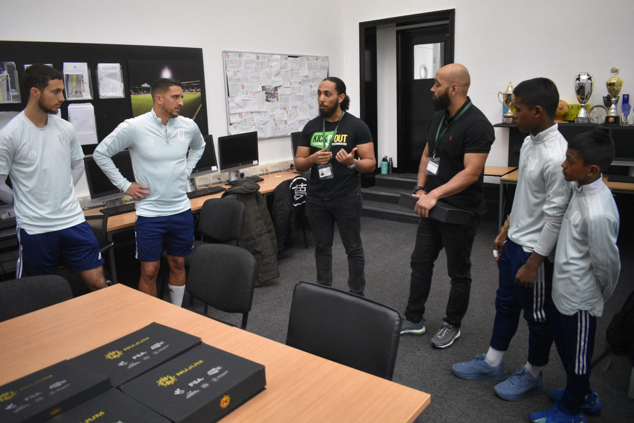
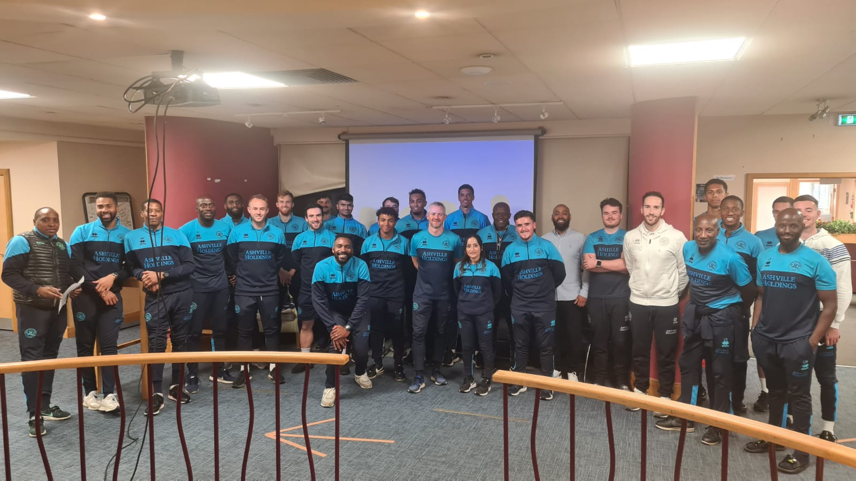
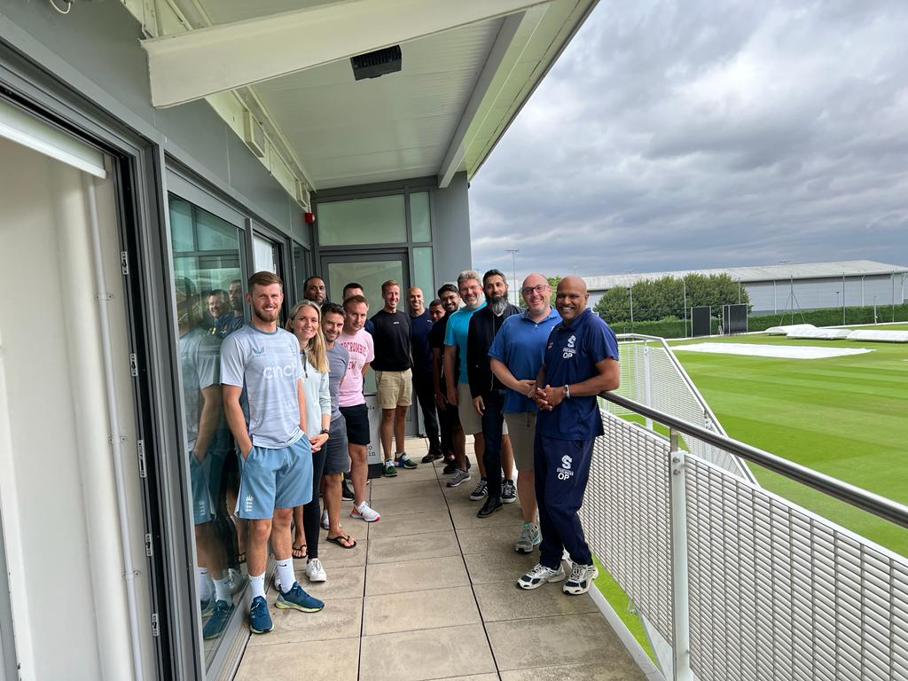
Workshops

Slide 6
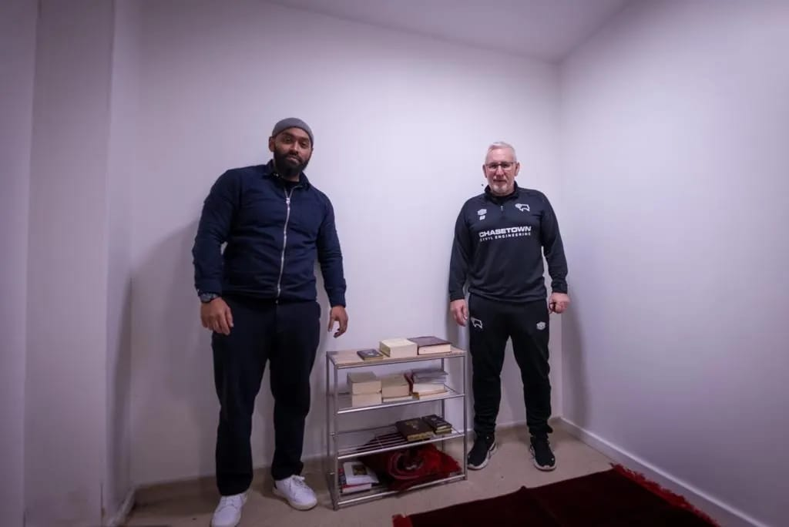
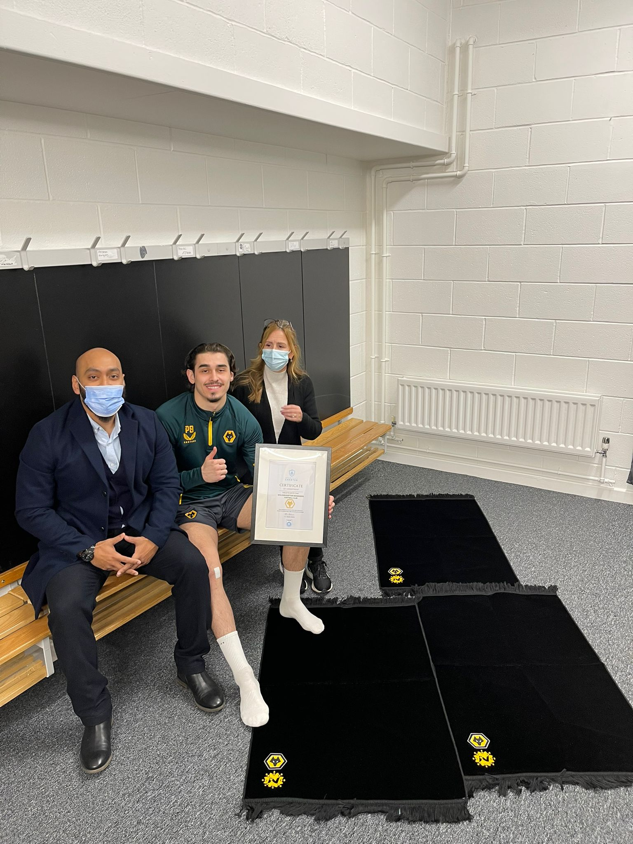
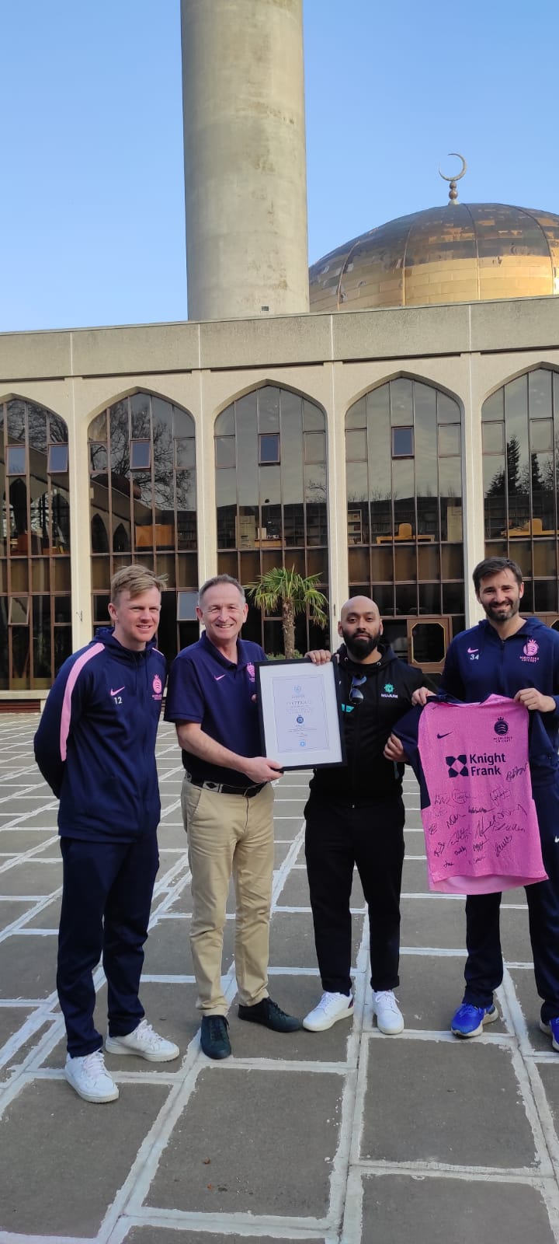
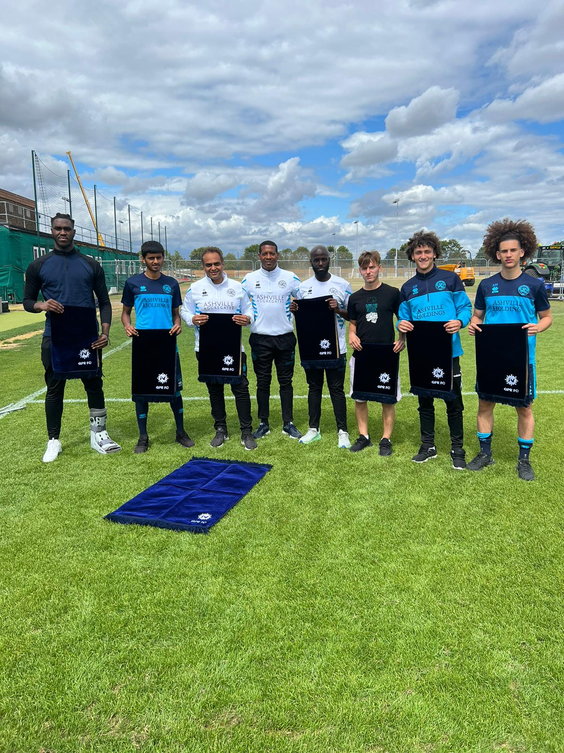
Prayers Rooms & Charter

Slide 7
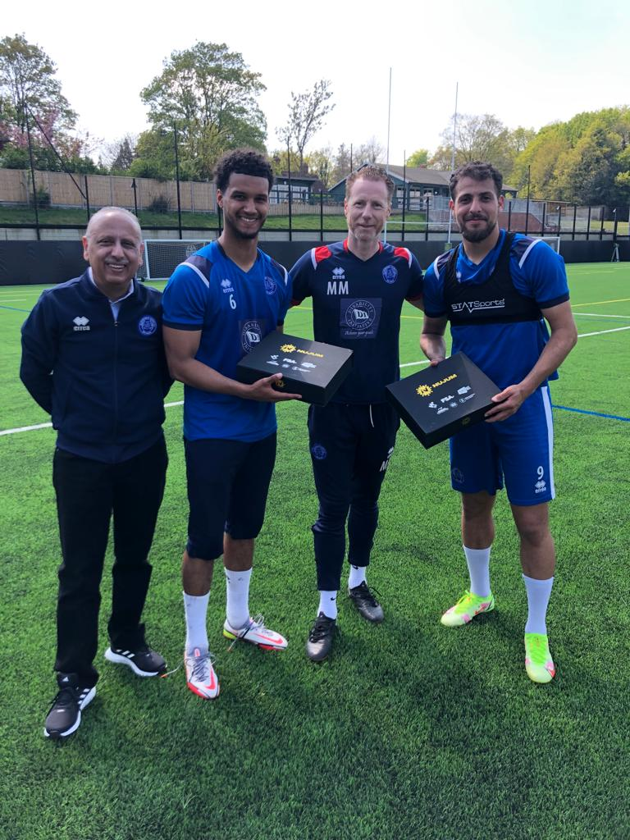
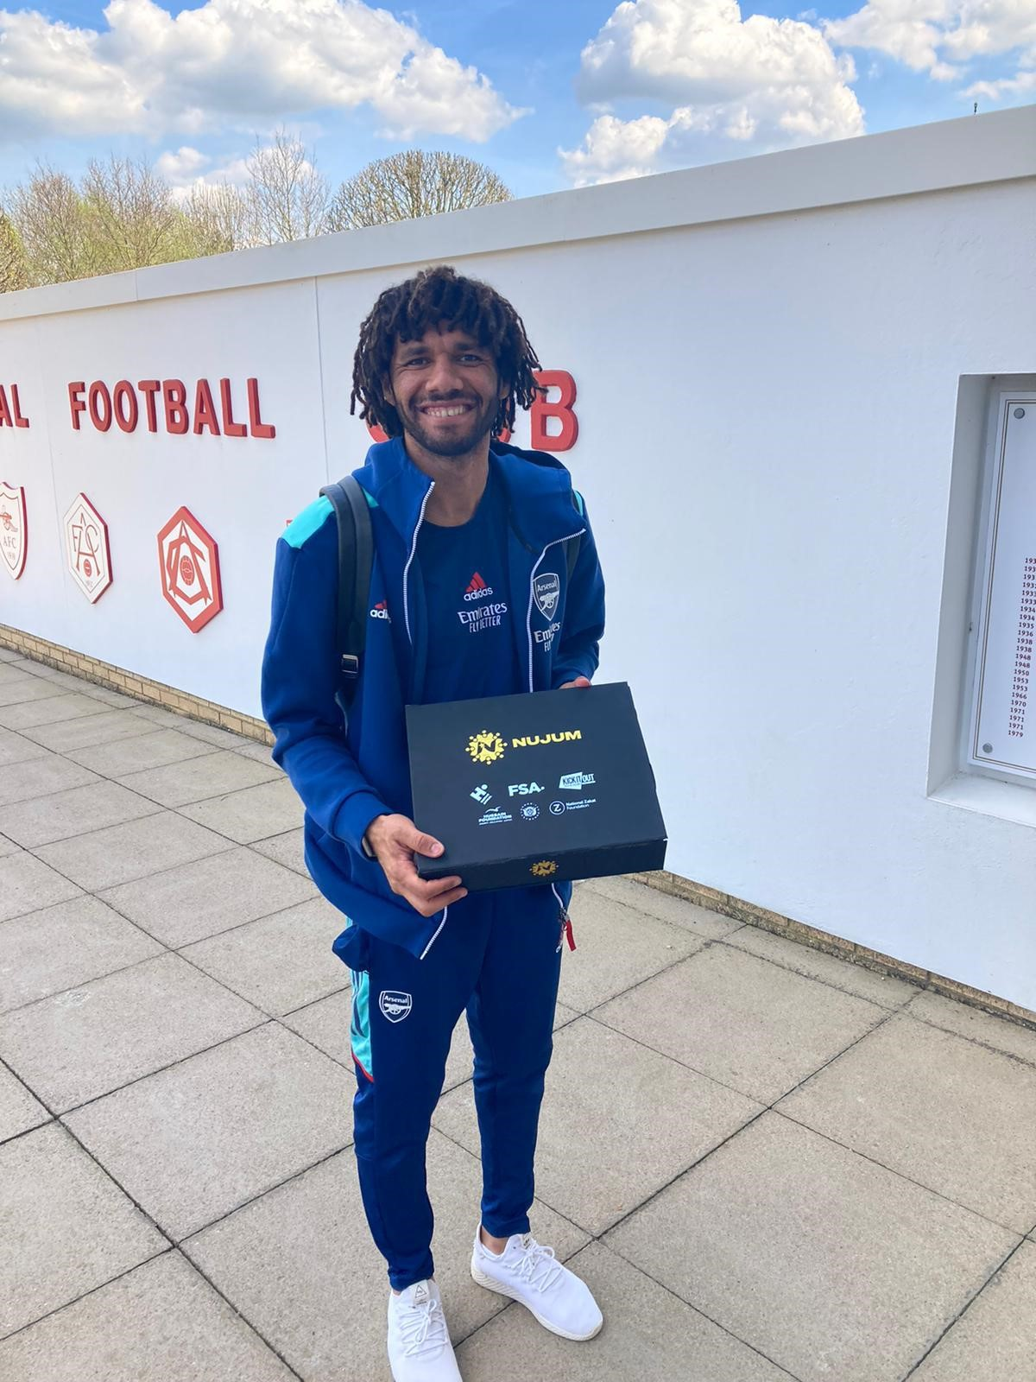
Ramadan Athlete Pack

Slide 8
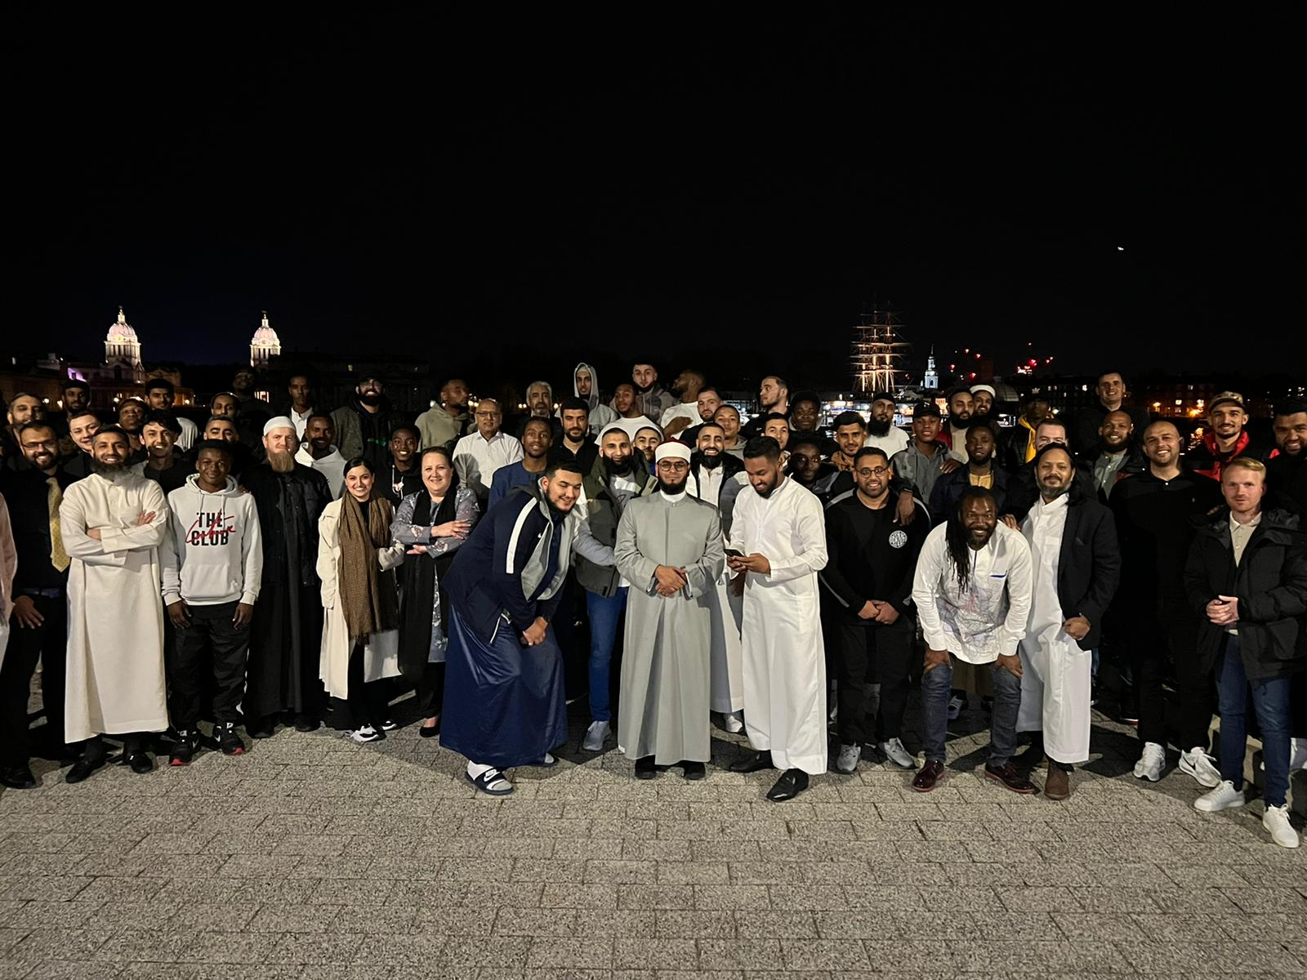
Athlete Meetups

Slide 9
What is Ramadan?
A guide to the basics of the blessed month of Ramadan
Presentation for

Slide 10
Most of the world's 1.9 billion Muslims will observe Ramadan.
This means there's a good chance you might encounter someone, a friend, a co-worker, the barista making your latte at Starbucks, your child's teacher, who will be celebrating, fasting, and doing all sorts of other activities that are unique to Ramadan.
Presentation for

Slide 11
Ramadan Origins
Ramadan is the name of the 9th month in the Hijri calendar.
The Muslim ‘Hijri’ calendar starts from the migration of Prophet Mohammed (Pbuh) to Medina
Islam has 5 main pillars, fasting in the month of Ramadan is the 4th pillar.
Ramadan can be 29 or 30 days in length, depending on the new moon
Ramadan moves forward 11 days yearly, compared to the Gregorian calendar.
The Hijri calendar is at 1444
Presentation for

Slide 12
Ramadan Basics
Ramadan 2023 will start on either the 21st or 22nd of March 2023
Ramadan will finish on the 20th or 21st of April 2023
Hijri calendar is the official calendar in countries around the Gulf, especially Saudi Arabia.
Other Muslim countries use the Gregorian calendar for civil purposes and only turn to the Hijri calendar for religious purposes.
Presentation for

Slide 13
Ramadan Basics
It is ordained in the Qur’an, chapter 2 (Al-Baqarah) verse 183.
The aim of fasting is to bring a person closer to God.
Like prayer, fasting is ‘compulsory’ upon all those who have reached puberty
The fast is from sunrise to sunset, no food or drink allowed.
Encouraged to reflect on yourself and your character.
To be more generous, patient and understanding of others
To carry out more acts of worship
Presentation for

Slide 14
Ramadan Basics
Those who haven’t reached puberty, those travelling, the ill, those breast-feeding or pregnant.
Those who are ill, travelling, pregnant or breast feeding must make up the missed fasts before the following Ramadan.
If a person is terminally ill, they can feed a poor person for each fast they miss.
Travelling;
There is a difference of opinion amongst Muslim scholars:
a) 80 Kilometres or more
b) What is customarily regarded as traveling, even if the distance is not 80 km. If in the custom 100 Kilometres is not regarded as travelling, then it shouldn’t be regarded as such.
Presentation for

Slide 15
Activities in Ramadan
Fast for the whole month.
Praying the night prayer in congregation daily.
Striving in the last 10 nights – ‘Laylatul Qadr’ Night of power (27th) (when the Qur’an was revealed).
Starting the fast with the ‘Sahoor’ meal before sunrise
Breaking fast with the ‘Iftar’ meal after sunset.
It’s a well-known custom to open your fast with a date.
Breaking the fast together with other Muslims & family.
The general increase in worship, such as reading the Quran, giving charity and voluntary prayers.
Presentation for

Slide 16
The ending of Ramadan
Determined by the new moon.
The Eid celebration, the day after the last fast, starts with congregational prayers in the morning.
The Eid day celebrations include visiting family and giving gifts.
The giving of food to the poor on the morning before the Eid prayer is compulsory for all.
Good idea for clubs to give Eid gifts to Muslim players and their families.
Presentation for

Slide 17
Eid day & Ramadan Greetings
‘Ramadan Mubaarak’ – usually said at the beginning of Ramadan, means ‘have a Happy/Blessed Ramadan’
‘Ramadan Kareem’ – also said at the beginning of Ramadan, means ‘have a Generous Ramadan’
‘Eid Mubarak’ – usually said on the day of Eid, means ‘have a Happy/Blessed Eid’
Presentation for

Slide 18
Nutritional aspects in Ramadan
No food or drink throughout the day.
Only 7-8 hours from sunset to sunrise.
Dates & milk are usually the first food items eaten when ending the fast.
Several smaller meals are preferred to a large meal when breaking the fast.
People are known to put on weight during Ramadan.
Nujum Sports nutritional guide for athletes, a good starting point for more info.
*Nujum Sports ‘Nutrition in Ramadan’ factsheet available
Presentation for

Slide 19
Quiz time?
A quick quiz on what we’ve learned today
Presentation for

Slide 20
Question 1.
Which month of the Islamic calendar is Ramadan?
a) 5th
b) 9th
c) 11th
Presentation for

Slide 21
Question 2.
Roughly, how many people across the world take part in Ramadan?
a) 2 million
b) 10 million
c) 1.9 billion
Presentation for

Slide 22
Question 3.
What is the name of the meal before the start of the fast?
a) Fajr
b) Sahoor
c) Iftar
Presentation for

Slide 23
Question 4.
Apart from drinking and eating, what else is prohibited during fasting?
a) Sexual relations
b) Smoking
c) Chewing gum
d) All the above
Presentation for

Slide 24
Question 5.
What do Muslims usually break their fast with?
a) chocolate bar
b) cup of orange juice and an apple
c) spoon of yoghurt and honey
d) dates & milk
Presentation for

Slide 25
Question 6.
What is the celebration at the end of Ramadan called?
a) Hajj
b) Eid Al-Adha
c) Umrah
d) Eid Al-Fitr
Presentation for

Slide 26
Question 7.
What is the name of the night in Ramadan in
which Muslims believe the Qur’an was revealed?
a) Laylat al-Qadr (Night of Power)
b) Laylat al-Qira’a (Night of Reading)
c) Laylat al-Quwa (Night of Strength)
Presentation for

Slide 27
Answers
Q1. Which month of the Islamic calendar is Ramadan?
A: B 9th.
Q2. Roughly, how many people across the world take part in Ramadan?
A: C 1.9 billion
Q3. What is the name of the meal before the start of the fast?
A: B Sahoor
Q4. Apart from drinking and eating, what else is prohibited during fasting?
A: D All the above
Q5. What do Muslims usually break their fast with?
A: D Dates & milk
Q6. What is the celebration at the end of Ramadan called?
A: D Eid al-Fitr
Q7. What is the name of the night in Ramadan in which Muslims believe the Quran was revealed?
A: A Laylat al-Qadr (Night of Power)
Presentation for

Slide 28
Thank you & your questions

