Slide 1
POSITIVE RELATIONSHIPS
Learning objectives
Learning outcomes
We are learning about friendships and how to deal with some of the challenges that can arise.
By the end of the lesson you will be able to…
Identify the qualities of healthy and unhealthy friendships
Describe strategies for dealing with challenges in friendship
Explain how friends can support each other effectively
KEY
VOCABULARY
Friendships, positive, respect, help, qualities, peer pressure, support, services

Slide 2
POSITIVE RELATIONSHIPS
A new student has just moved to the school halfway through the year.
What tips would you give them?
Tips for making new friends
Notes:
Ask students to create a mind map with their tips.

Slide 3
POSITIVE RELATIONSHIPS
SELF ASSESSMENT
How confident are you in knowing what makes a good friend?
How confident do you feel about managing changes in your friendships?
How confident are you in knowing how to support a friend?
0
10
NOT CONFIDENT
EXTREMELY CONFIDENT
Notes:
Ask students to answer the three baseline questions on the confidence scale: (0 = not confident, 10 = extremely confident).

Slide 4
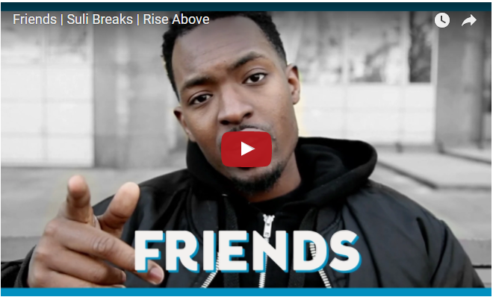
POSITIVE RELATIONSHIPS
WHAT MAKES A GOOD MATE?
Suli Breaks on friendship
Add your ideas to the posters around the room
Notes:
*IMPORTANT: This video includes a swear word. Please watch before to assess suitability. If not suitable, proceed with activity without using the video.
Note the video can be watched at: https://www.youtube.com/watch?v=88DIPQ2WIeg&list=PLYS82SXtJJt8Oy5frydcY61HrlHV1UXm4&index=2

Slide 5
POSITIVE RELATIONSHIPS
WHAT MAKES A GOOD MATE?
Good friends do… (how do they add to your life?)
Good friends don’t… (what do good friends avoid doing?)
The most important qualities of a friend are…
Conflicts that can arise in friendship include…
Respond to other people’s statements. Explain your reasons!
?
Agree
Disagree
Develop
Challenge
Notes:
If possible, each question should be written on a separate A3 sheet before the lesson. For large classes, doubles of each question can be prepared.
After watching the video, give each group one A3 sheet and have them write down their ideas. You could hang these on the wall around the room.
Then have groups rotate around the room (or pass around the sheets), looking at each poster and responding to the other students’ statements using the symbols and explaining their reasons.

Slide 6
POSITIVE RELATIONSHIPS
WHAT MAKES A GOOD MATE?
What did people agree on and why?
What did people disagree on and why?
ALL
FURTHER CHALLENGE
Why do some people have different expectations of what a ‘good friend’ means?
Are there similarities in these qualities to positive sibling relationships?
In what ways might our expectations of friendships change over time?
Notes:
This can be done in pairs, groups or with the whole class

Slide 7
WHEN THINGS GET TRICKY
Create a piece of creative writing or a storyboard to highlight the challenges that can arise in friendships. For example:
One friend is left out of a trip to the cinema
One friend lies to another friend about where they were at the weekend
A friend starts dating a person in the class they know their best friend likes.
Do not base this on your real-life experiences or anyone you know
Doug Armstrong on healthy relationships
Notes:
Depending on whether this activity is done in pairs or groups and time available, you can direct the number of scenarios they want each group to do.
Remind students that these should be fictitious and not based on people they know or real life experiences. e.g. One friend is left out of a trip to the cinema, one friend lies to another friend about where they were at the weekend, a friend starts dating a person in the class they know their best friend likes.
If devices for students are not available, the whole class can explore suggested resources together in the order listed above.
If devices are available, share the following URL with them: https://www.youtube.com/watch?v=k5Gr_mx-42M

Slide 8
POSITIVE RELATIONSHIPS
WHEN THINGS GET TRICKY
Swap your scenarios with another group
Create a flowchart: What happens next?
What are the solutions?
Notes:
After swapping with another group, ask students to create a flow chart to represent solutions and the possible outcomes to the challenging scenarios.
For ideas, students can look at the How to comfort a friend in need PDF.

Slide 9
POSITIVE RELATIONSHIPS
PLENARY
Add anything new you have thought about in the lesson.
Tips for making new friends
In another colour pen, add in ways to maintain healthy friendships.
Notes:
Look back at the mind map from the start of the lesson and ask students to add on anything new they have thought about or reflected on in the lesson.
Ask them to add on more tips in another colour about ways to maintain healthy friendships.

Slide 10
POSITIVE RELATIONSHIPS
SELF ASSESSMENT
How confident are you in knowing what makes a good friend?
How confident do you feel about managing changes in your friendships?
How confident are you in knowing how to support a friend?
0
10
NOT CONFIDENT
EXTREMELY CONFIDENT
Notes:
Ask students to think back to the confidence line that they shared at the start of the session and consider the same questions.

