Slide 1
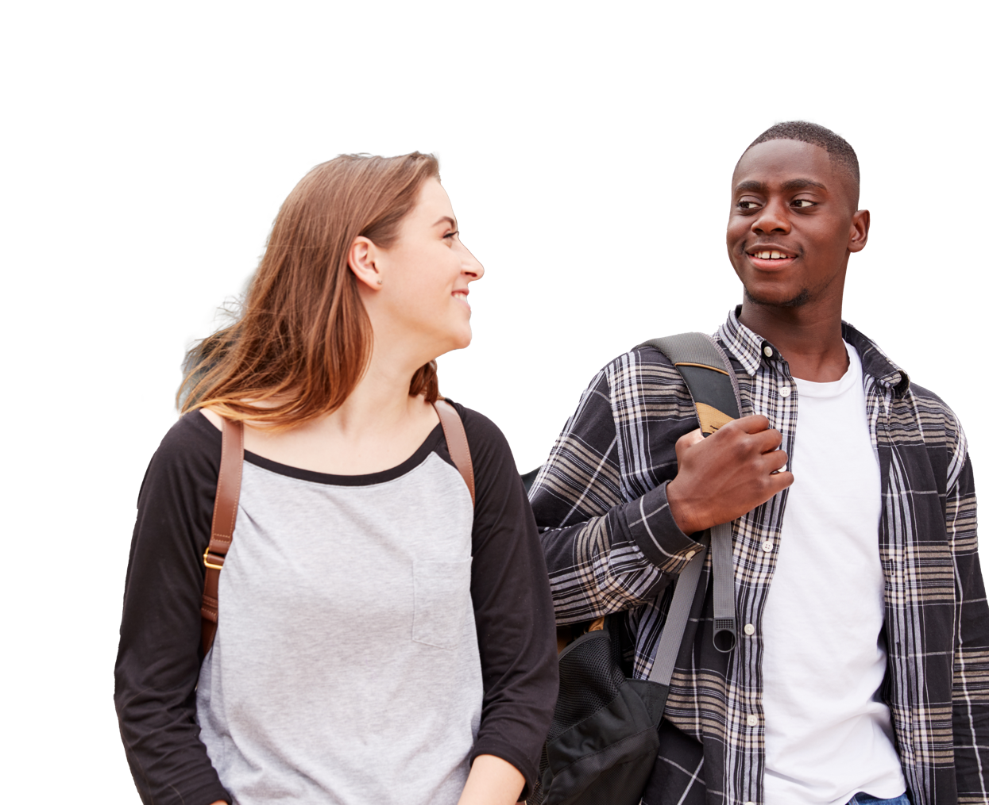
One-to-one relationships

Slide 2

Overview
These resources will address the new curriculum guidance for KS3 and KS4 RSE and PSHE around one-to-one relationships.
The lesson is based on students having one worksheet to work through and fill out as the lesson progresses. By the end of the lesson, students will have their own sheet to take away that reminds them of the characteristics of a positive one-to-one relationship, positive relationship behaviours, signs that a relationship is becoming unhealthy, and signposting to external services.
Age group
11-16 (Key Stages 3-4)
Time required
45-60 mins.
Additional comments
You do not need subject knowledge in PSHE to use this resource.
Using this presentation
The slides and slide notes include the vocabulary and subject knowledge you’ll need to teach this topic with confidence.
Slides 2-6: Overview for teachers.
Hidden slides will not display in presentation mode.
Slides 1,7-18: Slides to use with students.
Slide notes contain further guidance.
Slide 19: Extension activities
Resources:
Printed worksheets.
Three different coloured pens per student (if available).
Developed with teachers
This resource has been developed in partnership with practising teachers.

Slide 3
Overview
Learning objectives
Recognise the qualities and signs of a positive relationship
Describe examples of positive relationship behaviours
Identify the features of unhealthy, unsafe or abusive relationships
Explain how someone can seek help if they or others are experiencing abusive behaviours
Curriculum links
PSHE Programme of Study
KS3
Students will understand:
R1. about different types of relationships, including those within families, friendships, romantic or intimate relationships and the factors that can affect them
R10. the importance of trust in relationships and the behaviours that can undermine or build trust
KS4
Students will understand:
R1. the characteristics and benefits of strong, positive relationships, including mutual support, trust, respect and equality
R3. to respond appropriately to indicators of unhealthy relationships, including seeking help where necessary
Relationships and Sex Education (RSE)
By the end of secondary school pupils should know:
that there are different types of committed, stable relationships.
the characteristics of positive and healthy friendships (in all contexts, including online) including: trust, respect, honesty, kindness, generosity, boundaries, privacy, consent and the management of conflict, reconciliation and ending relationships. This includes different (non-sexual) types of relationship.
practical steps they can take in a range of different contexts to improve or support respectful relationships.
how to recognise the characteristics and positive aspects of healthy one-to-one intimate relationships, which include mutual respect, consent, loyalty, trust, shared interests and outlook, sex and friendship.
Notes:
Sources:
https://pshe-association.org.uk/curriculum-and-resources/resources/programme-study-pshe-education-key-stages-1%E2%80%935
https://assets.publishing.service.gov.uk/government/uploads/system/uploads/attachment_data/file/1090195/Relationships_Education_RSE_and_Health_Education.pdf

Slide 4
Overview
Activity | Time required | Slide number | Resources and preparation needed
Starter and learning objectives | 10 minutes | Slides 7-8 | Worksheet
Positive relationships | 15 minutes | Slides 9-12 | Worksheet, 3-4 different coloured writing pens (if available)
Concerning relationships | 15 minutes | Slides 13-15 | Worksheet and support sheet
Signposting and plenary | 5 minutes | Slides 16-18 | Worksheet

Slide 5
Core message
Everybody has the right to be in positive, healthy and nurturing relationships, both intimate and not. Positive relationships have clear defining features, and they are taught in this lesson. Negative, abusive or offensive behaviour is never acceptable. It is important to know the signs and to know that there are ways to manage situations and stop it. Someone can start by talking to a person they trust as soon as possible.
Signposting
Students are encouraged to speak to a trusted person, such as family, friends, a healthcare professional, school nurse or a member of staff in their school if they require support and/or guidance with the issues associated with relationships. For further information please visit Young Minds, Childline, the Samaritans, CEOP or the NHS Urgent Mental Health Helpline.

Slide 6
Classroom tips
Climate for learning
Read through Guidance for Learning in a Safe Environment.
This includes advice on:
developing and revisiting effective ground rules drawn up with students
familiarity with your school’s safeguarding policy and procedures, including Child Protection and other relevant policies
being prepared in case students make a disclosure and informing students that they can approach the teacher separately if there is something they wish to disclose.
including and protecting vulnerable students
using distancing techniques so that students can discuss sensitive issues without being encouraged to make a disclosure
handling sensitive questions
involving students with special educational needs and disabilities (SEND) and/or autism
You may also wish to familiarise yourself with any schemes or offers available in your school, organisation or local area to
support young people’s mental health. Your local public health team, school nurse, mental health leads or SEN support team should be able to help signpost you to this.
Anonymous question box
Place a question box or envelope somewhere in the classroom. Students write down any questions that occur to them during the lesson and submit them anonymously. You can address these questions in the next lesson. If students are not in class you could send them a self-addressed envelope so they can post a question back anonymously if needed.
Identify students for whom this topic may be challenging
Children and young people with experience of difficult relationships, harassment or bullying may find this topic challenging. It is important to be aware of any sensitivities or issues that may come up. Consider briefing or debriefing the lesson with any students who might be affected by this topic and signposting to immediate support that can be offered if students feel they want to talk further with someone about seeking help in their situation.

Slide 7

Starter
Two people in school have been going out for almost a year, they’ve got some friends in common and they’re a really popular couple in the school. They’re in a happy and positive relationship.
How can you tell they’re in a positive relationship? What behaviours or signs
might you see?
How might you be able to tell if someone was in an unhealthy relationship? What behaviours or signs might there be?
Notes:
Starter | 5 minutes | Introduction to lesson topic
Read out the statement on the board.
Ask students to create a mind map with the title ‘One-to-one relationships’.
Give students 2 minutes to discuss with a partner and write ideas down onto the mind map in black or blue pen.
Ask students to volunteer their ideas and suggestions to begin identifying the key characteristics of positive relationships.
Teacher support notes:
The scenario here is deliberately non-gendered.

Slide 8
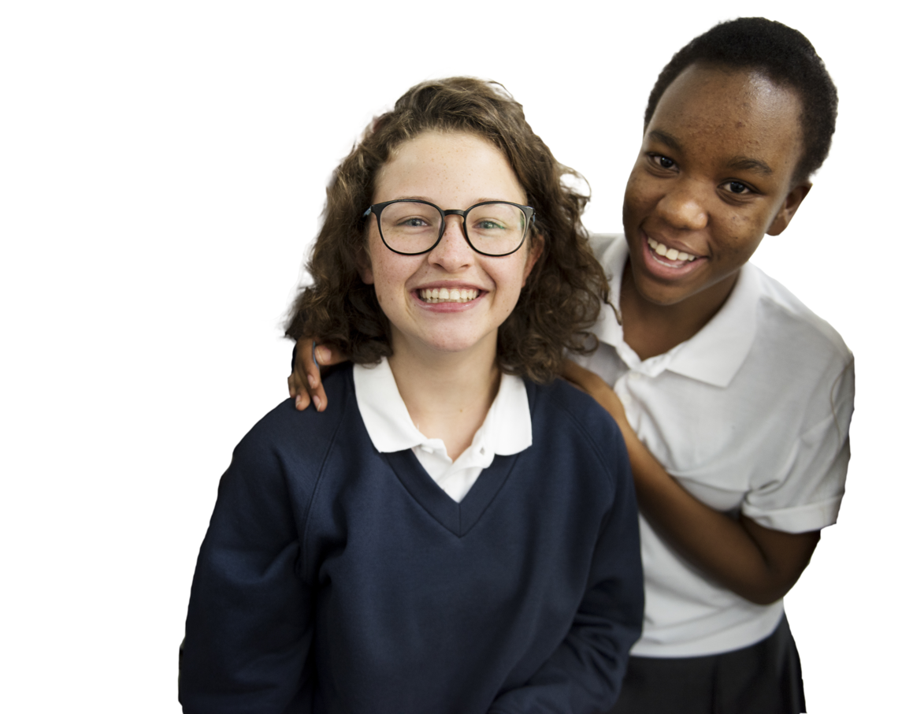
Learning objectives
Recognise the qualities and
signs of a positive relationship
Describe examples of positive relationship behaviours
Identify the features of unhealthy, unsafe or abusive relationships
Explain how someone can seek help if they or others are experiencing abusive behaviours
Notes:
Learning objectives | 5 minutes | Clarify the lesson objectives and outcomes
Read through the learning objectives
As a class discuss the ground-rules that might be important when learning about relationships. This might be written up as a class contract already, or could be written on the board. See the Classroom tips slide for further guidance. (Slide 6)

Slide 9
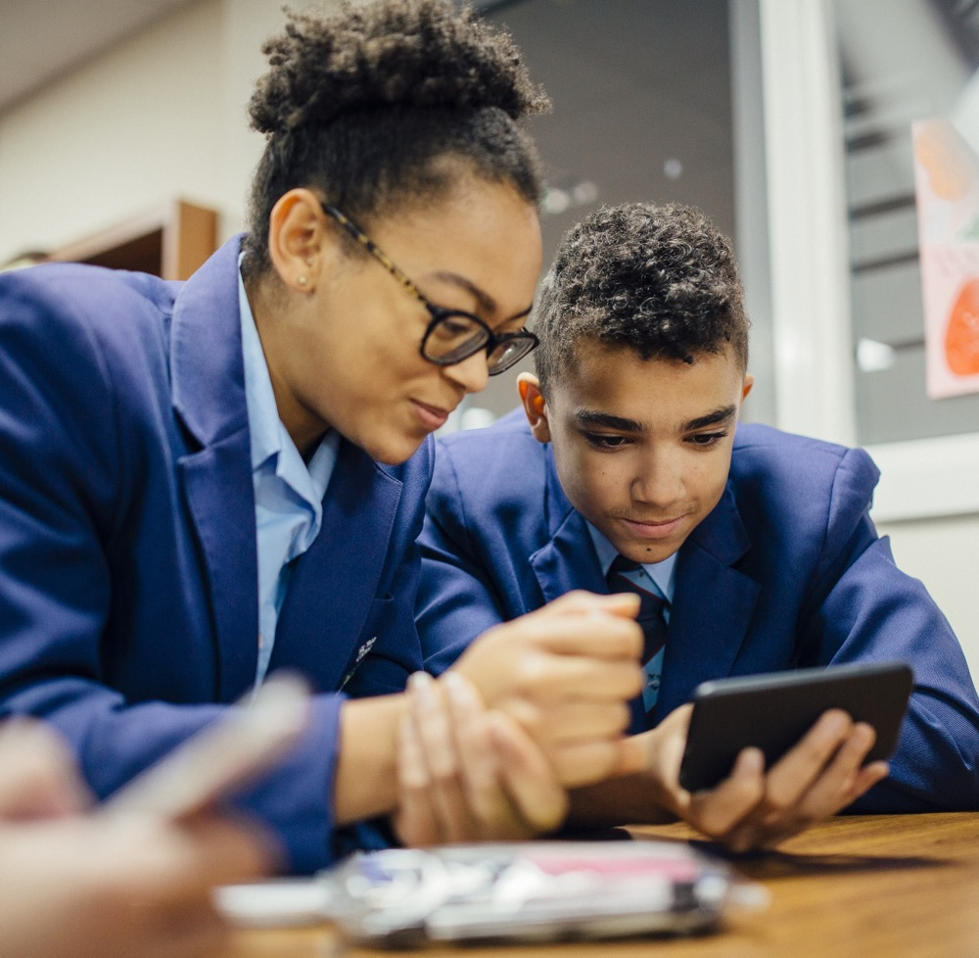

Positive relationships
Throughout their lives, people are likely to have a range of different types of relationships with others.
This includes relationships with family, friends, colleagues and intimate relationships.
It can help to learn about relationships because it’s important to know how people should treat one another.
For example, some relationships are positive but it’s also possible to have challenging relationships with people, or experience harmful and hurtful behaviours in relationships, so it’s good to be aware of this.
Notes:
Exploring the characteristics of a positive relationship | Slide 1 of 4 | This slide - 3 minutes | Exploring the key characteristics of a healthy relationship
Read aloud from the board, or ask for a student volunteer:
“Throughout their lives, people are likely to have a range of different types of relationships with others. This includes relationships with family, friends, colleagues and intimate relationships.
It can help to learn about relationships because it’s important to know how people should treat one another. For example, some relationships are positive but it’s also possible to have challenging relationships with people, or experience harmful and hurtful behaviours in relationships, so it’s good to be aware of this.”
2. Building on the Starter, explain that we are going to create a multi-coloured mindmap with the next activities.
students will need to use 3 different colours of pen/pencil for this activity.
Explain that we will start with one colour (e.g. blue or black) to record our initial ideas, and as we go through the task, we will add more ideas in a different colour.
At the end of the activity, we will be able to see how much we learnt!
If coloured pens are not available, then students can write each round of comments within a different shape or in a different style.

Slide 10
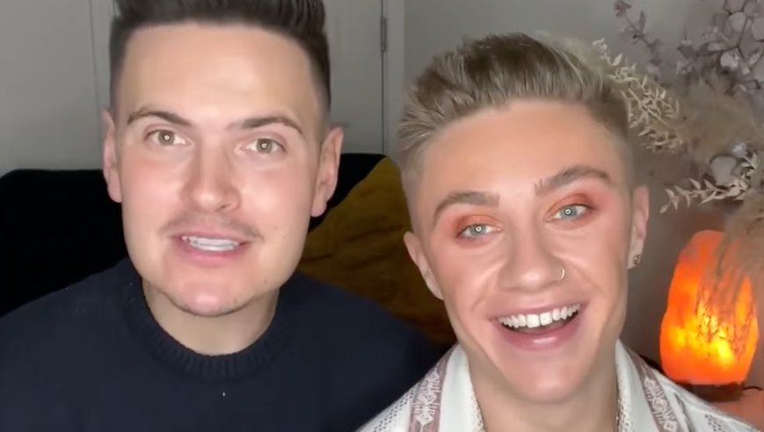
Video
Step 1: Let’s take a look at this video of Matthew and Ryan giving their ideas of what a great relationship looks like.
As you watch, think about these questions:
What do Matthew and Ryan think makes
up a great relationship?
What do they say about trust?
What do they say about being who you are?
Step 2: Thinking about the questions,
discuss your ideas with your partner.
Get ready to feed back!
Step 3: Write up the key ideas on your mindmap.
Notes:
Exploring the characteristics of a positive relationship | Slide 2 of 4 | This slide - 6 minutes | Exploring the key characteristics of a healthy relationship
Note: this video includes aspects of meeting people online. It is recommended to have either taught about personal safety, the differences between people we’ve met in-person and online, and ways young people can help to keep themselves safe, prior to the lesson.
Alternatively, this should be clarified in relation to the video so that it doesn’t normalise the view that getting into a car with someone a young person has met online is safe without further measures. For example, having met in a public place with a parent/carer present first for younger students or with friends present if the students are older.
Introduce the video by explaining that Matthew and Ryan are TikTokers, and they are going to talk about being in a positive relationship.
Highlight the questions on the board for students to think about as they watch the video.
Watch the video: https://youtu.be/gYmCR4Eog_4
Feed back from the video in 3 steps:
students discuss their ideas in pairs.
students report back to the class.
students write up key ideas onto their mind maps in a different coloured pen (or shape/style if coloured pens are not available).
Support: Name three characteristics of a positive relationship from the video.
Challenge: What did Matthew and Ryan miss from their video? Do you have any key points that they could have mentioned?

Slide 11
Key characteristics of a healthy relationship
Respecting each other
Partners listen to each other and observe each other's boundaries. One partner doesn’t do anything to make the other feel uncomfortable, humiliated or scared.
Trust
Partners are able to be apart and spend time with other people without getting jealous,
or worrying about what their partner is doing,
or who their partner is with.
Honesty
One partner can be completely honest with their partner, and can say exactly what they think and feel without censoring themselves or worrying about what might happen.
Communicating well
Partners can say what they need to say, and talk openly, without being scared of what might happen.
Not being scared of each other
Partners are able to be themselves around each other - they can do things that they both enjoy, and spend time with friends and family.
Equality
Partners have equal influence in the relationship, no one has more power than the other. It’s never okay for someone to force anyone else to do something.
Notes:
Defining the characteristics of a positive relationship | Slide 3 of 4 | This slide - 3 minutes | Exploring the key characteristics of a healthy relationship
Read, or ask student volunteers to read aloud the characteristics of a positive relationship from the slide.
Discuss these key points with the class and ask them if they have anything else they would add to this list.

Slide 12


Key characteristics of a healthy relationship
Task
Following the class discussion, write up your own description of what a positive relationship looks like.
Challenge questions:
Why is trust so important in a relationship?
Respect should always be reciprocal.
What does reciprocal mean?
Let’s discuss boundaries, privacy and consent.
Why are these features essential to any
positive relationship?
Notes:
Defining the characteristics of a positive relationship | Slide 4 of 4 | This slide - 3 minutes | Exploring the key characteristics of a healthy relationship
Using the questions on the board, emphasise the importance of trust and kindness in a relationship, explain that respect is reciprocal and highlight the importance of boundaries, privacy and consent (see definitions below).
Task: students to work independently and use the key words to write a description of a positive relationship, including positive relationship behaviours e.g., listening.
Key words:
Boundaries - help people define what they are comfortable with in a relationship and how they would like to be treated by others. Boundaries can be emotional, physical or even digital.
Privacy - having a right to private thoughts, feelings, or experiences without others being aware of them. The ability to share personal information without fear that it will be shared with others or used against you.
Consent - an agreement given willingly and freely without exploitation, threat or fear. It is the responsibility of the person seeking consent to ensure that consent is given. Given consent can be subsequently retracted. People can change their minds and this needs to be respected, seeking consent needs to be seen as an ongoing process
Support: On a whiteboard, draw an image to demonstrate 2-3 of the qualities.
Challenge: Direct students to challenge questions on the board.

Slide 13
Concerning relationships
Read through the characteristics of a healthy relationship. What could the signs be if these characteristics were missing in a relationship?
Below are three scenarios of patterns of behaviour that may occur in a relationship. Read these through, and then follow the think-pair-share task:
Text messages:
“Hey bbz, cn u send me a pic? Plz? xxxxxxx”
“Cn u show me more? ;)”
One person repeatedly sends intimate photographs to their crush, without response.
One person has asked their partner to stop seeing some of their friends because they
don’t like them hanging out with other people.
Two people have been dating for 3 months. They have been hanging out with friends, and had their first kiss. One person wants to start kissing in public, but the other person is happy where things are. They’re worried that if they don’t do what their partner wants that they’ll leave them.
Notes:
Concerning relationships | Slide 1 of 2 | This slide - 5 minutes | Identify patterns in unhealthy relationships
Explain that we are now going to explore what concerning or unhealthy relationship looks like. Invite students in pairs to look at the list of characteristics of a healthy relationships on their worksheet and ‘flip it’ – by discussing what the signs might be if these aspects were missing in a relationship. This will support students with the scenarios. Some examples are below.
Respecting each other -> criticism, ignoring what each other wants
Trust -> Jealousy, control
Honesty -> Hiding things, secrets
Communicating Well -> Resentment, not being sure where each one stands
Not being scared of each other -> Fear, worry
Equality -> One person deciding everything, control
Reveal the scenarios on the board.

Slide 14

Concerning relationships
Think - pair - share:
1) Why are these behaviours concerning?
2) How does this contrast with
the characteristics of healthy relationships?
3) How might this make someone experiencing these behaviours feel?
Key words: pressure,
harassment, abuse
Notes:
Concerning relationships | Slide 2 of 2 | This slide - 10 minutes | Identify patterns in unhealthy relationships
Think-pair-share: students read the scenarios on the previous slide and the worksheet independently, before answering the questions with a partner and then sharing to the whole class discussion. Encourage them to reflect on the list of healthy relationship characteristics.
Support: Read aloud each scenario. Offer students the support sheet to consider concerning signs in a relationship and a feelings board - they could then circle their answers in a different colour for each scenario.
Challenge: How might behaviours in a challenging relationship affect someone’s mental health?
Discuss feedback with the class and use definitions to scaffold contributions and deepen learning:
Abuse: when someone harms someone else or causes them to become distressed. This can be physical, emotional, mental or financial.
Harassment: illegal behaviour towards a person that causes mental or emotional suffering, including unwanted contact, touching or offensive language.
Pressure: using persuasion or intimidation to make someone do something they don’t want to do.
Now ask students to consider how someone could respond in each of these scenarios - what could they do? Ask them to discuss. Example answers below:
Saying no and explaining that it is making them feel uncomfortable. If it continues they could talk to a trusted friend or adult for support.
Report them and block them if it continues.
If it feels safe to do so, they could have a conversation about how that makes them feel and explain that controlling behaviour is a serious concern. If they are unable to listen, they could end the relationship or speak to someone they trust for more support.
Have an honest conversation to communicate their boundaries and how they are feeling. If they are concerned they are not being heard, they should speak to someone they trust for more support.
Highlight that challenges and changes can happen in any relationship, they can be detrimental to mental health. Emphasise that unhealthy relationships make people feel upset and unsafe and are not good. It’s possible to have challenging relationships with different people, including family and friends. If someone is in an unhealthy relationship, they should speak to someone they trust about it so that they can get help. Source: https://www.nhs.uk/every-mind-matters/lifes-challenges/our-personal-lives-and-relationships/ Now might be a good time to check how your students are feeling and that they still feel comfortable with the topics being discussed.

Slide 15
Did you know?
It is illegal to create or share nude or
semi-nude images under the age of 18.
It is illegal to be in possession of an explicit image if that person is under 18. This law is intended to protect young people and not to charge them for self-generated images. If someone has shared an image and it has been shared online the Report Remove tool can be used to help remove the image.
Harassment can be reported to the police,
and a person can be charged with criminal harassment if the person has committed the harassment more than once.
Jealousy is complex emotion, and everyone experiences it at some point. In relationships, jealousy can be a healthy sign when communicated clearly and safely, e.g. “I’m feeling envious, and I want to work through it”.
However, jealousy can turn into control,
pressure or intimidation, e.g. “I don’t want you to see them any more”.
Consent happens when all people involved in any kind of sexual activity agree to take part by choice, and they have the freedom and capacity
to make that choice. If someone is pressured
into saying ‘yes’, this doesn’t count as consent. This is confirmed by law, in the Sexual Offences Act, 2003.
Notes:
Did you know? | 5 minutes | Address some of the myths around nude images, consent, harassment and jealousy
Use definitions to scaffold contributions and deepen learning:
Abuse: when someone causes us harm or distress. This can be physical, emotional, mental or financial.
Harassment: illegal behaviour towards a person that causes mental or emotional suffering, including unwanted contact, touching or offensive language.
Pressure: using persuasion or intimidation to make someone do something they don’t want to do.
Report Remove tool: https://www.childline.org.uk/info-advice/bullying-abuse-safety/online-mobile-safety/remove-nude-image-shared-online/

Slide 16
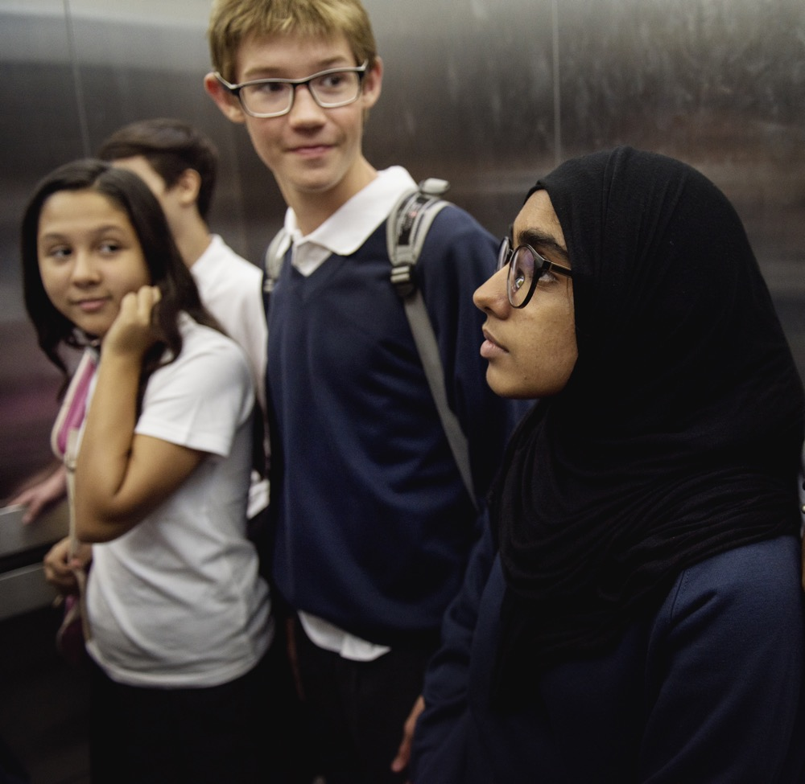
Signposting
It’s not always easy to spot when a relationship is becoming unhealthy or abusive. If something makes someone feel uncomfortable or unsafe about their own relationship or a friend’s relationship, then it’s important to talk about it. It can help to talk to:
A parent, carer or guardian at home
A teacher or trusted adult
Friends or other family
A GP or another healthcare professional, such as a school nurse
Notes:
Signposting | 1 minute | Signpost students to additional sources for more information and further exploration
Note for teacher: Please add in any knowledge you have of local organisations that students could be signposted to.

Slide 17
Signposting
Young Minds - Young Minds is a mental health charity for children
Childline - Get help and advice about a wide range of issues
Shout - text 85258 for free 24/7 mental
health support
Samaritans - Samaritans works to make sure there's always someone there for anyone who needs someone.
CEOP - Get information and support on a wide range of topics
NHS Urgent Mental Health Helpline - Find NHS urgent mental health helplines for people of all ages. Provides 24-hour support from a local service to help with a mental health emergency.
All external agencies can be contacted with any problem, big or small. There is further information on their websites and on their social media profiles.
Write 3 way to get support onto your worksheet.
Notes:
Signposting | 1 minute | Signpost students to additional sources for more information and further exploration
Note for teacher: Please add in any knowledge you have of local organisations that students could be signposted to.
Every Mind Matters self-care tool for teachers
Your Mind Plan can help you to take simple steps to look after your mental health and find what works for you:
https://campaignresources.phe.gov.uk/schools/resources/every-mind-matters-self-care-tool
Additional support for teachers can also be found at: https://www.educationsupport.org.uk/

Slide 18
Plenary
Let’s take a look at what we have learnt in this lesson.
Take a look at your mindmap - how much have you added in different colours/shapes since
we started?
Next, write your own statements on your worksheet:
‘A positive relationship is one where…’
If someone felt concerned about behaviour in a relationship they could…
Notes:
Plenary | 3 minutes | Students reflect on learning and write affirmations
Read through the slide and guide students to complete the plenary activities.

Slide 19
Extension activities
Positive relationship charades | Aim: For students to creatively explore the characteristics of a positive relationship Option 1: Students are given one of the characteristics of a positive relationship, and are given 2-3 minutes to devise a short sketch which they then act out to the class, who need to guess which characteristic it is. Option 2: Charades-style. All key words are put into a bowl, and students come to the front to pick one out individually and act it out to the class, who have to guess which characteristic it is. | 10-20 minutes
Extension activity: Healthy relationship poster | Aim: Students demonstrate understanding of key features of a healthy one-to-one relationship Task: Students create an eye-catching A4 poster to go up in their form room, to share the key characteristics of a healthy relationship using key vocabulary. | 30-40 minutes
Notes:
Extension activities | 3 minutes | Activities designed to extend learning in the lesson, scheme of work, or to set as homework.
Teacher guidance for role-play-based activities
Before undertaking role-play activities in the classroom, ensure that the following ground rules are established with students:
students are not role-playing themselves, people they know or situations they have been in.
students are not role-playing (and therefore rehearsing) a risky, harmful or dangerous behaviour, e.g. bullying/harassing someone.
students have the right to opt out if they feel uncomfortable.
Ensure that time is allocated at the end of the session for students to be debriefed so that they can come ‘out of role’.
Encourage students to use best-practice scenarios when modelling respect, trust, honesty, good communication, not being scared and equality.

