Slide 2
The physical activity contained within this resource may not fit your specific situation. It is your responsibility to decide whether to carry out the activity and, if you do, to ensure that the activity is safe for those participating. You are responsible for carrying out proper risk assessments on the activities and for providing appropriate supervision, including changing the activities as appropriate. We are not responsible for the health and safety of your group or environment and we cannot accept liability for any loss suffered by anyone undertaking any activity referred to or described in this resource. It is also your responsibility to ensure that you or the organisation you are organising it for has the relevant insurance to carry out the physical activity. If you are unsure in any way, we recommend that you take guidance from a suitably qualified professional. By using this resource, you acknowledge that it is the responsibility of supervising adults to ensure the safety of children in their care.

Slide 3
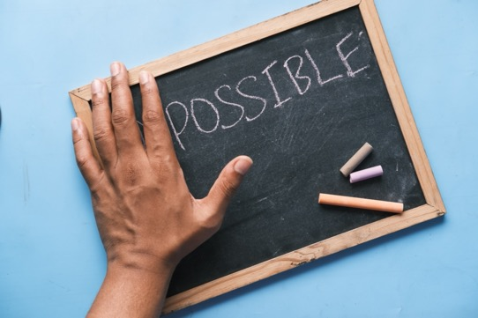
Team Building Challenges
Welcome to the Year 7 and 8 Team Building Challenges.
You will find different challenges that will test you as a class, pair and small group.
You only need to do three things to the best of your ability:
Listen to each other
Work together
Try your best
If you think you and your classmates can do those three things, then let's go to the challenges.

Slide 4
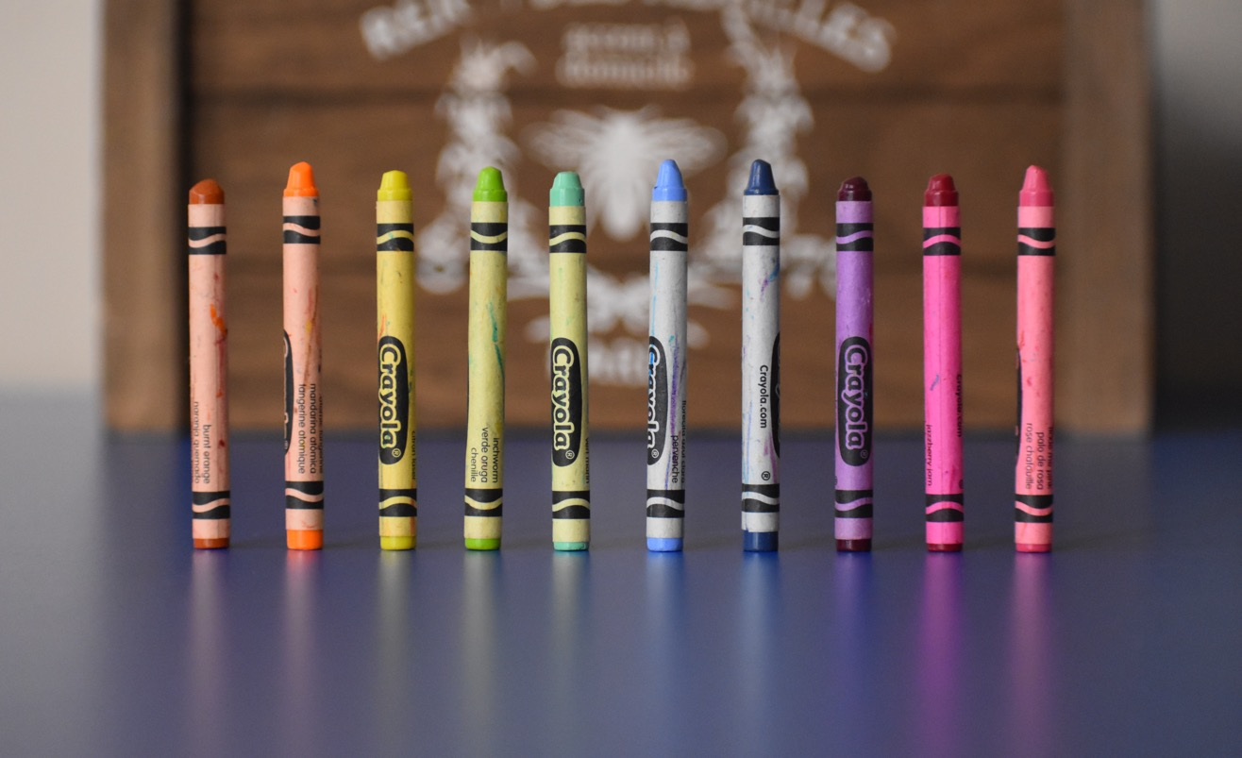
Silent Line Up Challenge
Challenge Instructions:
Without a word, line up everyone in your class in alphabetical order using their first name. Use a stopwatch to time how long it takes.
Once you have done that, try again in order of everyone’s birthday month, starting with January at the front of the line. Use a stopwatch to time how long it takes.
Equipment Needed:
Stopwatch for timing
Top Teamwork Tips
Look out for everyone in your class.
Be calm and thoughtful.
WHOLE CLASS

Slide 5
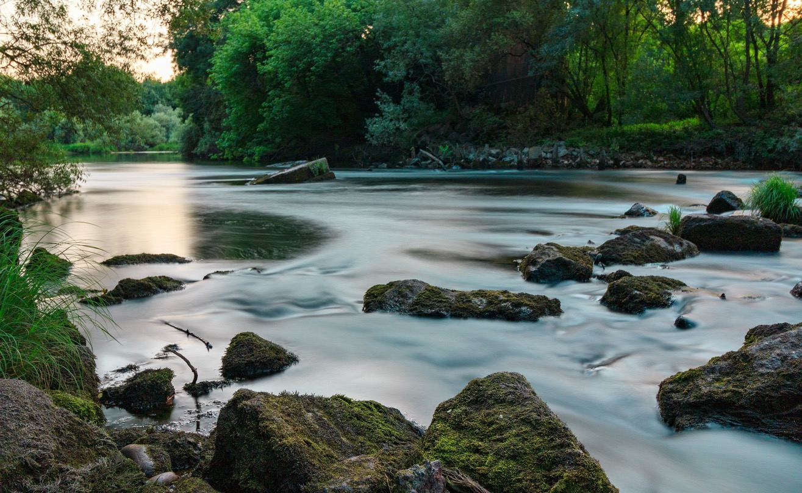
Hoops Across the River Challenge
Challenge Instructions:
The goal of this challenge is to cross the river by only using hula hoops placed on the ground (river). Everyone needs to always be in a hula hoop. Imagine the hoops are like rocks that can be moved and stood on across a river.
Create an imaginary river outside or in a large indoor space. There must be two clear sides - where you begin and finish.
Everyone needs to get from one side to the other without stepping in the river (outside of the hula hoops).
For an additional challenge, time how long it takes. Or, you can put a rule for how many people can be in one hula hoop at a time.
Equipment Needed:
Hula Hoops - enough to make it challenging for the class size
Stopwatch for timing
WHOLE CLASS
Top Teamwork Tips
Aim to have roles in the group.
Move the hula hoops by using different people.

Slide 6
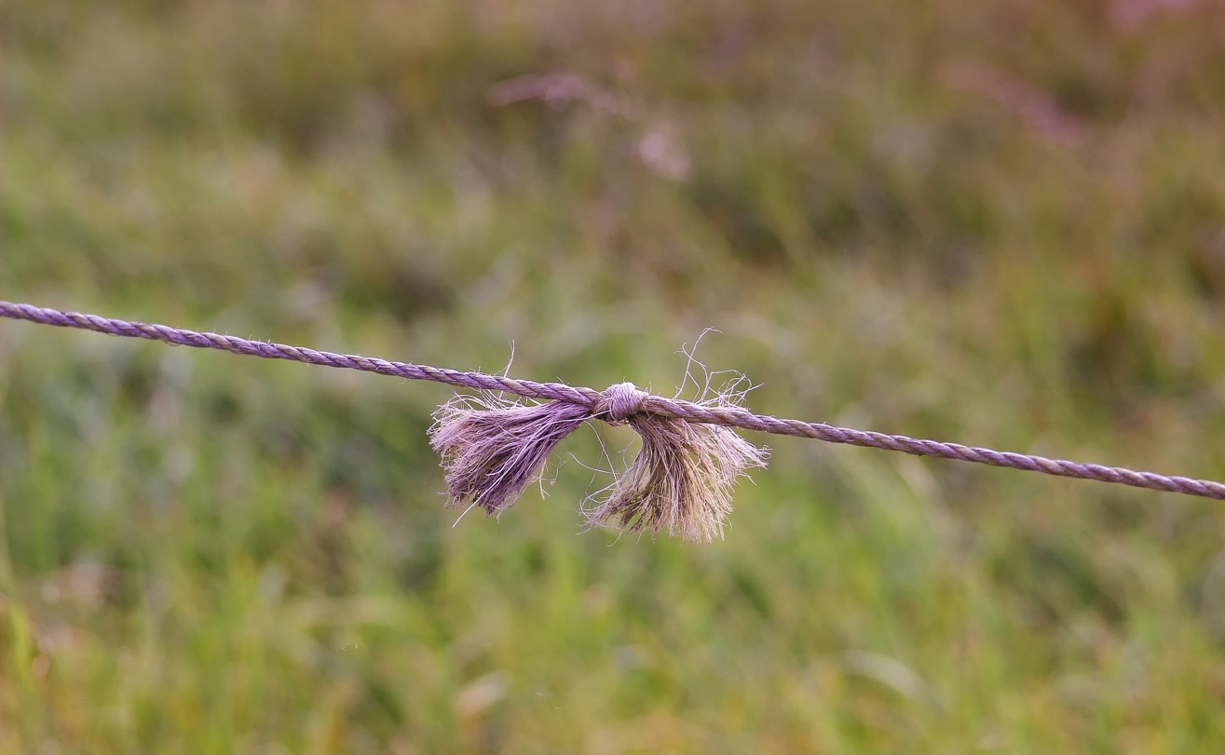
Kiwi Electric Fence Challenge
Challenge Instructions:
The goal of this challenge is to get everyone in the group over the electric fence.
The string attached to the two chairs is ‘electric’.
Use a suitable width for the electric fence, depending on your class or group size.
3. Make sure the height of the fence is manageable and safe.
Time how long it takes to get each team over the fence.
Equipment Needed:
String
Two chairs that act as fence poles (tie the string to both)
Stopwatch for timing
Top Teamwork Tips
This game is best played on grass or by using small mats on either side of the fence.
WHOLE CLASS

Slide 7
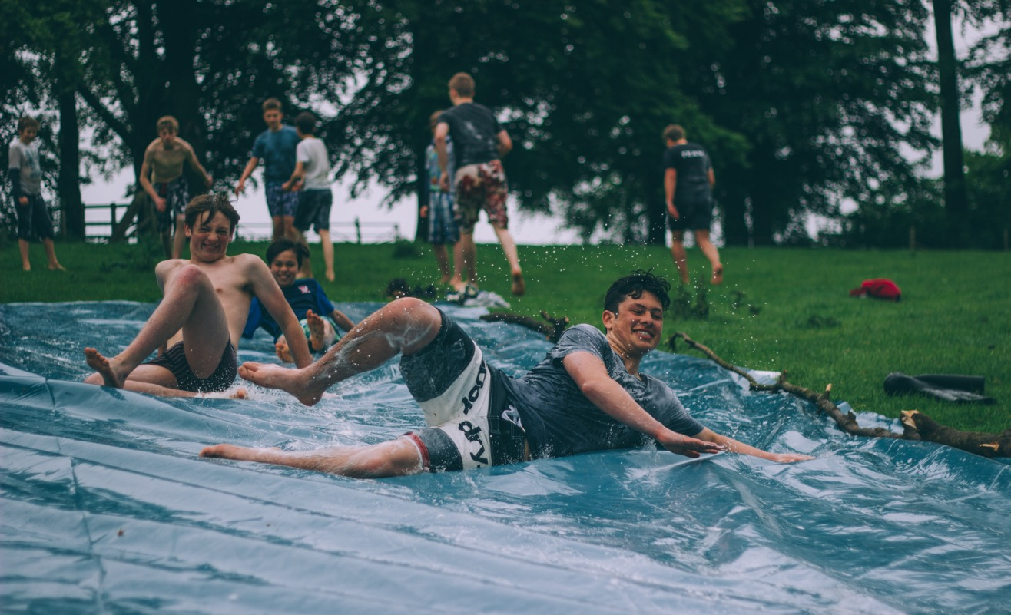
Turn Over The Sheet Challenge
Challenge Instructions:
The class or group stands on a large tarpaulin or sheet.
Then, they have to flip it over without anyone stepping off it.
Equipment Needed:
Large tarpaulin or sheet (large enough to have the whole class or group stand on it)
Stopwatch for timing
Top Teamwork Tips
Cooperation and teamwork are very important in this challenge.
WHOLE CLASS

Slide 8
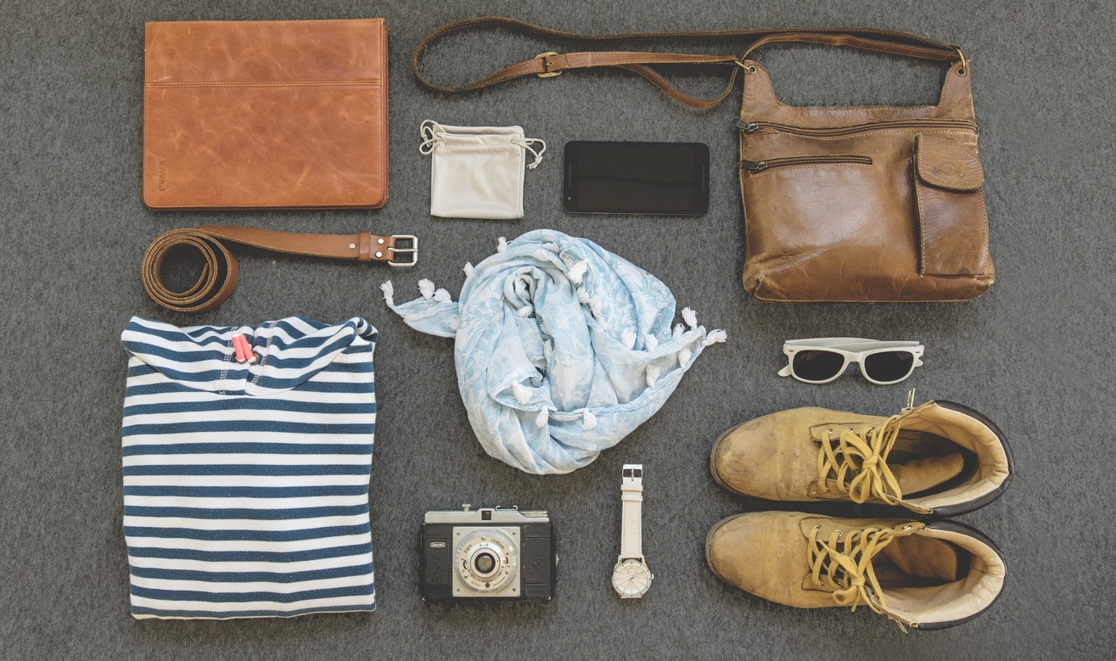
What's On The Tray? Challenge
Challenge Instructions:
This challenge could be completed in large or small groups (teams).
Version 1 - Whole Class
Place objects on a tray.
Gather the group together and reveal the tray with the objects on it.
Time for one minute, then cover the tray and get the students to write down what they saw, on a piece of paper.
After a few minutes, stop the group and reveal the tray and its contents.
Version 2 - Small Groups
Place objects on a tray and keep it out of sight.
Put students into groups of 4-6 and provide each group with paper/pencil.
Have one person from each group come and observe the tray and look at the items; keep a time limit on this.
They then go back to their group and write one item on their paper, and then another person comes up and does the same.
Give all groups a time limit. Once time is up, check which group has the most correct items.
Equipment Needed:
Tray with a variety of everyday objects (at least 20 items)
Sheet or towel to cover the objects on the tray
Stopwatch for timing
WHOLE CLASS / GROUPS
Top Teamwork Tips
This is a good test of your strategies for remembering something.

Slide 9
Team Shapes Challenge
Challenge Instructions:
This challenge could be completed as a large group or in small groups (teams).
Have the class or group form a large circle. Arrange a long piece of string, which they will all hold onto, keeping the circle shape.
Instruct the class or group to form shapes with the string by moving together. Can they create a square, rectangle, triangle or a figure eight?
For an extra challenge, some of the students could wear a blindfold.
Equipment Needed:
String
Blindfolds (if required)
Top Teamwork Tips
Communicate clearly.
Work together slowly.
WHOLE CLASS / GROUPS

Slide 10
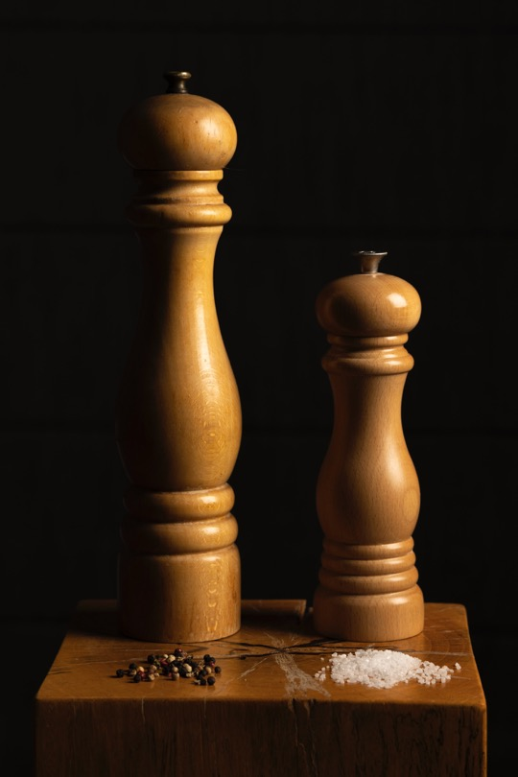
Where's My Partner? Challenge
Challenge Instructions:
This challenge involves the class or group finding a word partner to match the word they have on their forehead.
Write all of the word pairs out on a piece of paper (SEE NEXT SLIDE FOR WORD PAIRS).
Hand out the word pairs, so each student gets one word. Students should not look at their word or show anyone else.
The words are then stuck on each player's forehead (so players can not see their own word).
On an instruction, each player moves around the space. The person running the challenge stops everyone and instructs them to stand next to someone. Give students 30 seconds to try and find out who they are by asking yes/no questions.
Repeat until all of the pairs are found.
Once pairs find each other, they can try and find one thing they each have in common and share it with the group at the end.
Equipment Needed:
Paper and pencils for writing pairs
WHOLE CLASS
Top Teamwork Tips
Communicate clearly.
Listen carefully.

Slide 11
Where's My Partner? Challenge Pairs List
List of word pairs to use for the Where's My Partner? Challenge:
first/last salt/pepper fish/chips yes/no late/early law/order rock/roll
high/low knife/fork pen/pencil rain/shine entry/exit short/sweet
noughts/crosses arm/leg lost/found slip/slide give/take peace/quiet
up/down left/right king/queen bread/butter cat/dog pots/pans

Slide 12
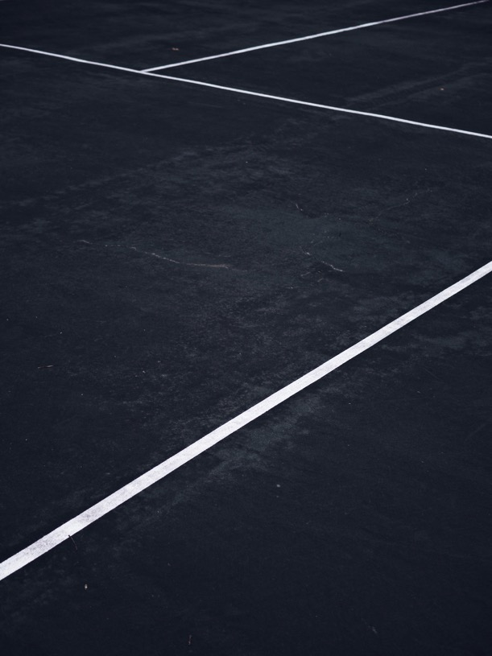
Crossing the Line Challenge
Challenge Instructions:
This is a fun and very simple challenge.
Each person in the class or group needs to be touching in some way.
They then have to try to cross a line all together and connected as a group.
Sounds simple… but is it?
Equipment Needed:
A court or surface with lines
Top Teamwork Tips
Focus on leadership, clear communication and excellent listening.
WHOLE CLASS

Slide 13
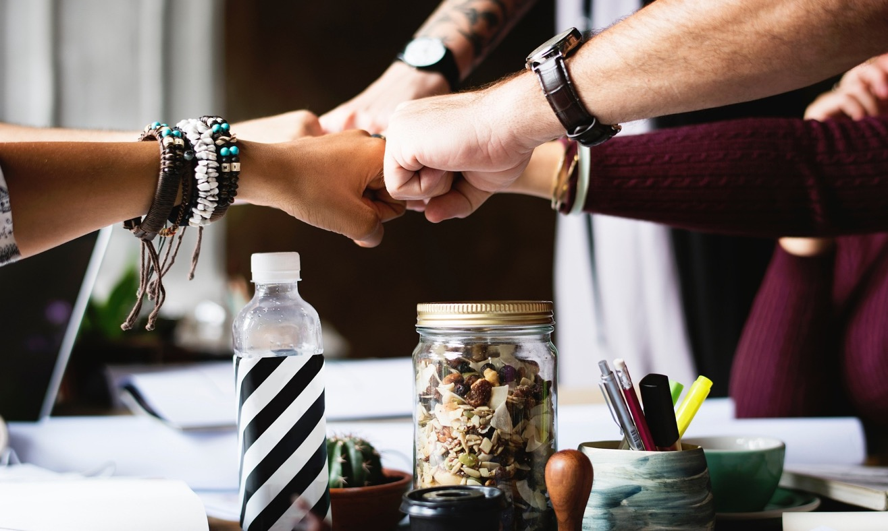
Fist Bump Challenge
Challenge Instructions:
This challenge involves a group of up to ten people.
Each person selects a hand to use as a fist bump in the middle of a formed circle.
All fists meet in the middle.
One person takes the first turn. They think of the number of fists that will be left in the middle of the circle. Once they have it, they countdown from 3. On 1, players can leave their fist in the middle or take it out. If the number of fists left in the middle matches the number the person had in their head, they get one point. If wrong, no point is awarded.
Then the turn moves to the right, and all players put their fists in again, waiting for the new turn taker to think of their number and begin the countdown.
The game continues until one person has reached a set amount of points.
Equipment Needed:
None needed
BEST IN GROUPS
Top Teamwork Tips
Focus on taking turns, fair-play and fast reactions.
Honesty

Slide 14
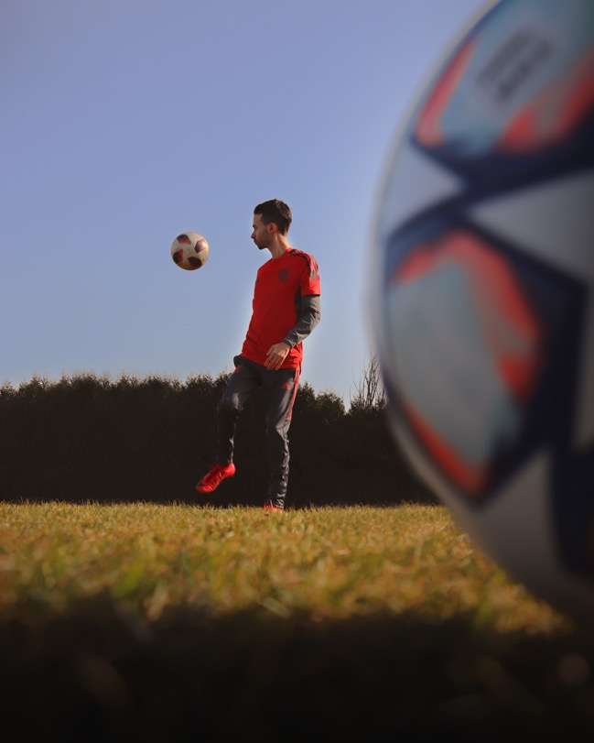
No Gravity Ball Challenge
Challenge Instructions:
This challenge involves a group of up to ten people.
Starting at number one, give each person in the group a number.
The object of the challenge is to keep the ball off the ground using any part of your body (hands, head, feet).
Each player must stay in the designated area.
You are only allowed to keep the ball up when it is your numbered turn (number one starts, number two keeps it up, then number three and so on).
How long can the group keep the ball up in the air?
Can the group get through all of their numbered players without the ball touching the ground?
Equipment Needed:
A soft ball (the bigger, the better)
A designated area that players must stay within
BEST IN GROUPS
Top Teamwork Tips
Call the number out that you are keeping the ball up for.
Move near the ball when it is your turn.

Slide 15
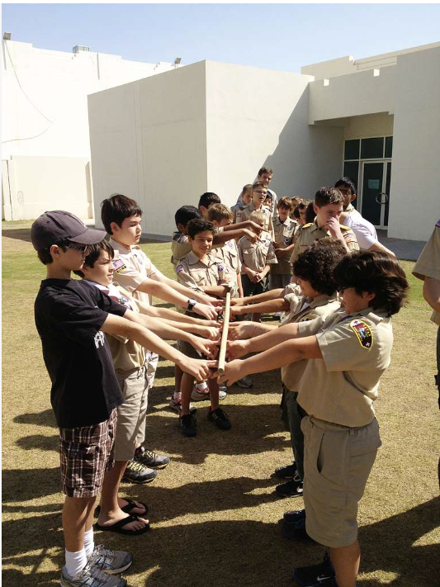
Floating Stick Challenge
Challenge Instructions:
This challenge involves a group placing their index fingers under a stick and then lowering it to the ground, all without any of the fingers being removed from the stick.
To begin, line up the group, standing opposite each other.
Show them the floating stick, and have the group bring their index fingers under the stick (shoulder height is a good place to start) until the stick is balanced on top of the groups’ fingers.
Next, they must lower the stick to the ground, always having both index fingers in contact with the stick. (They should not be pinching it; the stick should always be resting on top of their fingers.)
Equipment Needed:
A long stick, tent pole or something similar
Top Teamwork Tips
Focus on communication, concentration and control.
BEST IN GROUPS

Slide 16
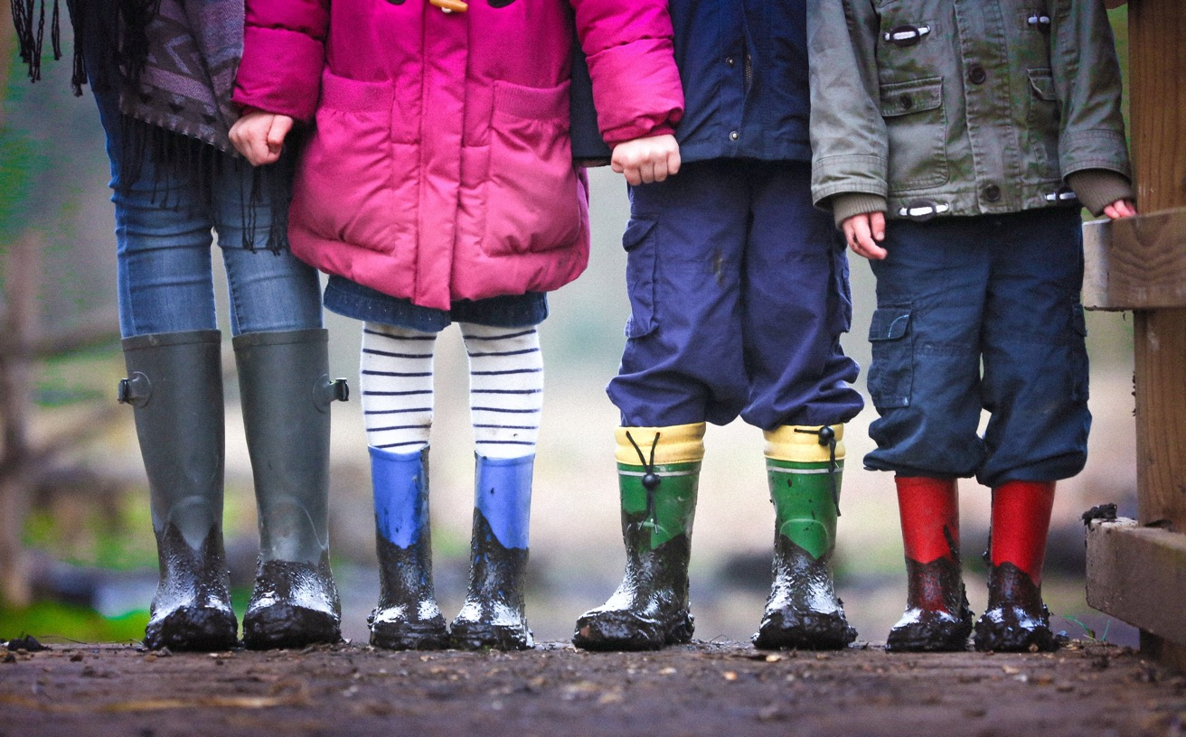
Spot the Difference Challenge
Challenge Instructions:
This challenge is a real-life version of ‘spot the difference’.
It could be played in different ways:
Small groups against each other
Small groups against the rest of the class
First, each group discusses what they will change when acting out their 'spot the difference' turn. This discussion means that all groups know what they are doing. Limit how many changes they can make when it is their turn - this makes it clear for the groups to guess.
One group stands in front of another group (or the class) and stays in a discussed posed position for about a minute. They then leave the area and change what they need to before reappearing in front of the group or class, e.g. one person might change a hat.
Can the other groups or classmates spot what the differences are?
Equipment Needed:
If there is any dress-up clothing or costuming, it would add to the fun of this challenge.
Top Teamwork Tips
Focus on creativity.
How observant are you?
BEST IN GROUPS

