Slide 2
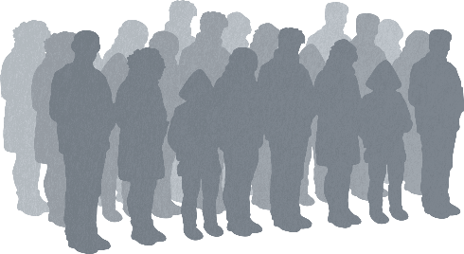
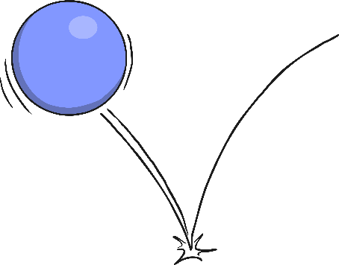
What Is Resilience?
The dictionary definition of resilience is:
‘the capacity to recover quickly from difficulties’.
An individual person can be resilient or a group of people, an organisation or even a whole country can be described as being resilient.
Being able to ‘bounce back’ after a tough situation is not something we are all naturally good at and some people seem to be more resilient than others.

Slide 3
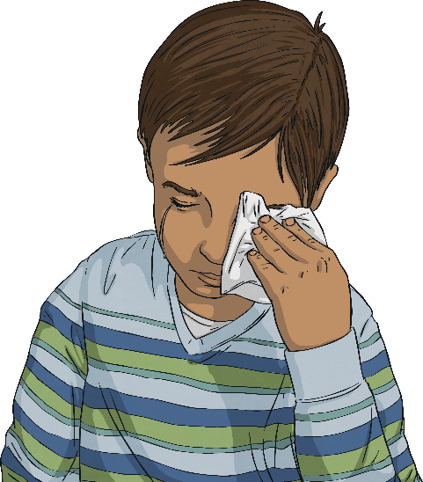
Why Is It Important to Be Resilient?
In life, we all experience ups and downs, highs and lows, good times and not-so-good times.
Being resilient doesn’t mean not finding things difficult or not getting upset. It means being able to deal with things that are difficult and move on.
This is important so we can cope with whatever life throws at us and moving on means we can enjoy the good times that are often just around the corner!
Also, research has shown that people who are more resilient, tend to be happier and more successful in life.

Slide 4
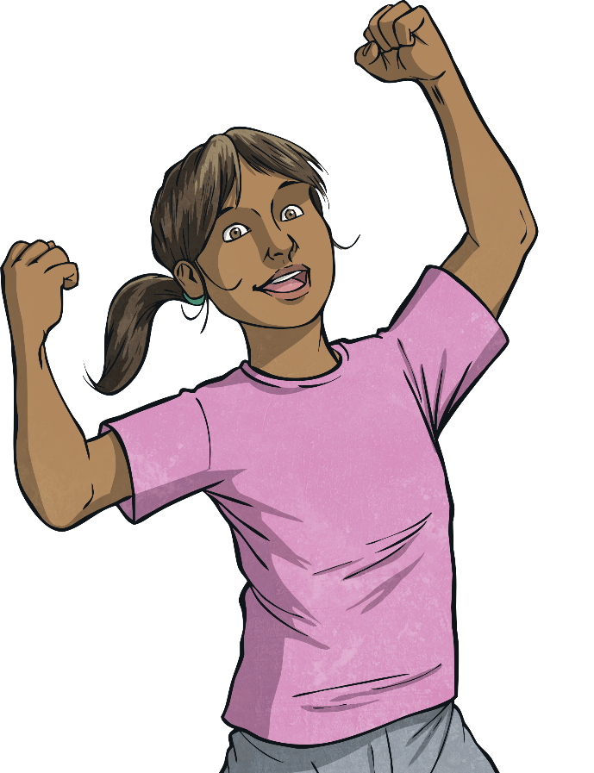
How Can We Become More Resilient?
Can we become more resilient?
Absolutely!
There are lots of things we can do in order to become more resilient. Like most things, the more we practise, the better we get.

Slide 5
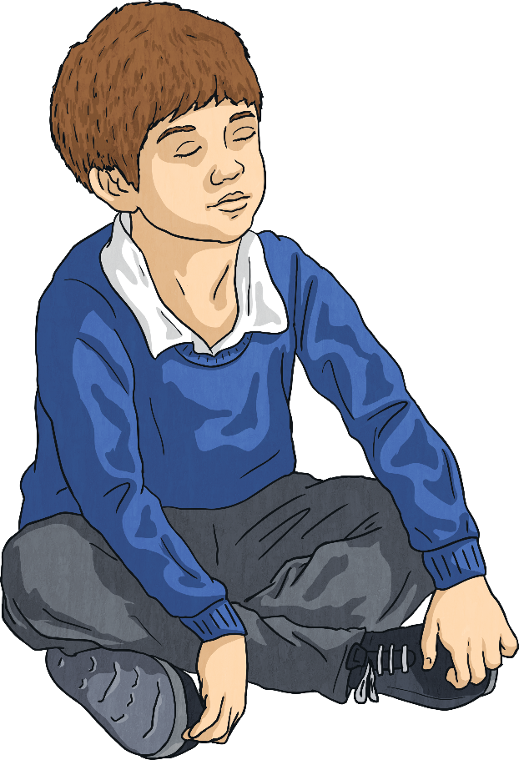
Believing That You Are in Control of Your Life
In life, sometimes we may feel that things are out of our control and we might start to panic.
I am in control of my thoughts, feelings and actions.
Remembering that we can make decisions about the way we think, feel, act and react can give us back the confidence we need to carry on.

Slide 6
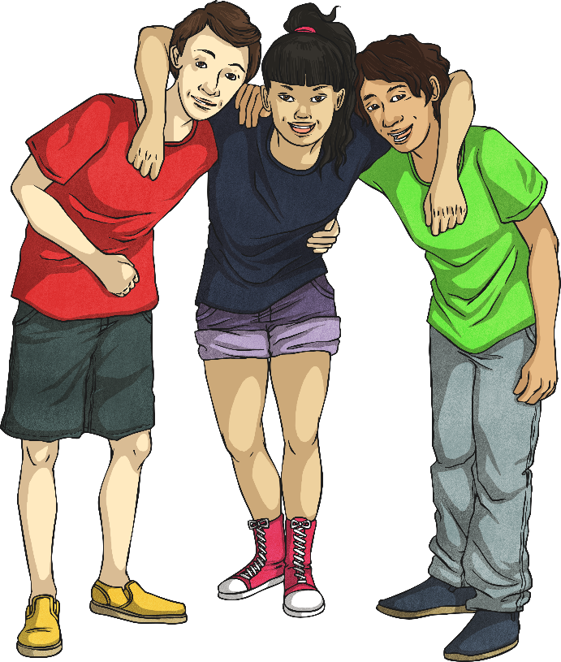
Believing That You Have Value
Every single one of us is amazing!
We all have parts of our personality that others love.
We all have something we can do for others.
We all have things we are good at.
We are all important.
We are all loved.

Slide 7
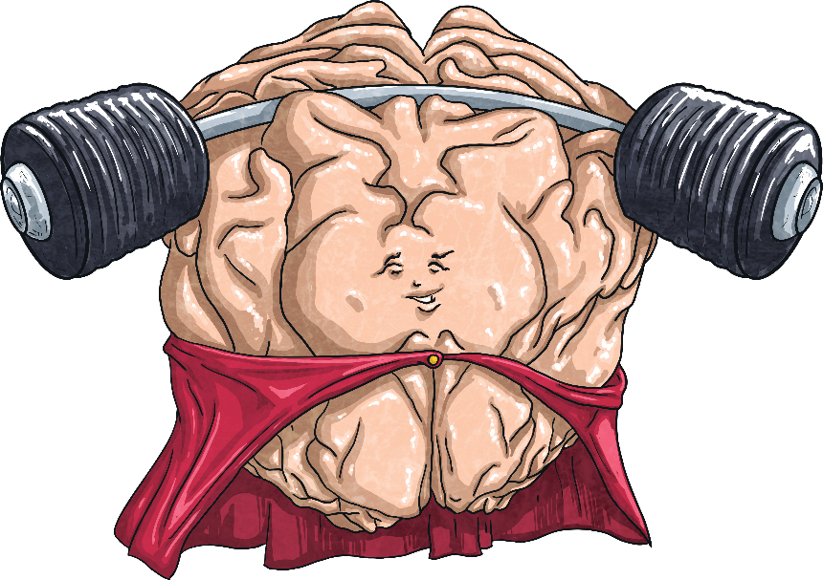
Believing That You Can Do What You Set Your Mind to
Having a growth mindset is a big part of being more resilient.
It’s all about having a ‘can-do’ attitude and remembering that we have learnt to do so much since being born.
If there is something we really want to be able to achieve, then we can! It might take time, patience and a lot of effort but we can achieve anything we set our mind to.

Slide 8
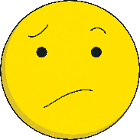
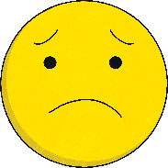
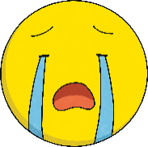
Understanding and Managing Your Own Emotions
We experience many different emotions in life. Emotions can be wonderful but understanding our emotions can be challenging.
Sometimes we don’t understand why we feel a certain way.
Sometimes we experience a new emotion that is unfamiliar and can be a little scary.
Sometimes we feel like we can’t control our emotions.
Focusing on your emotions rather than pushing them away and working out why we are feeling that way, can be a really powerful thing to do.

Slide 9
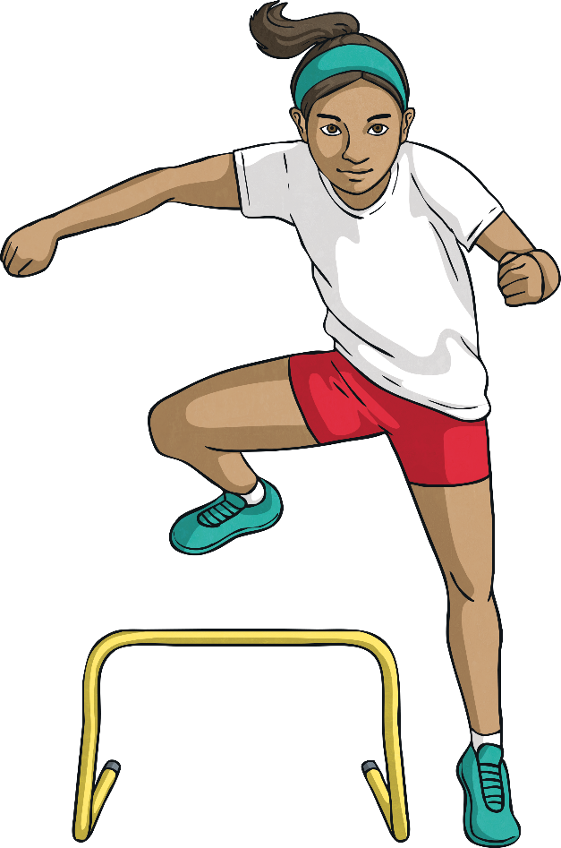
Engaging in Life
When we connect with others, doing something that we really enjoy, it makes us feel better.
Participating or joining in with activities is great to help us feel good about ourselves and keep our minds active.
Feeling good about ourselves means we are more likely to be able to cope if things don’t go so well.

Slide 10
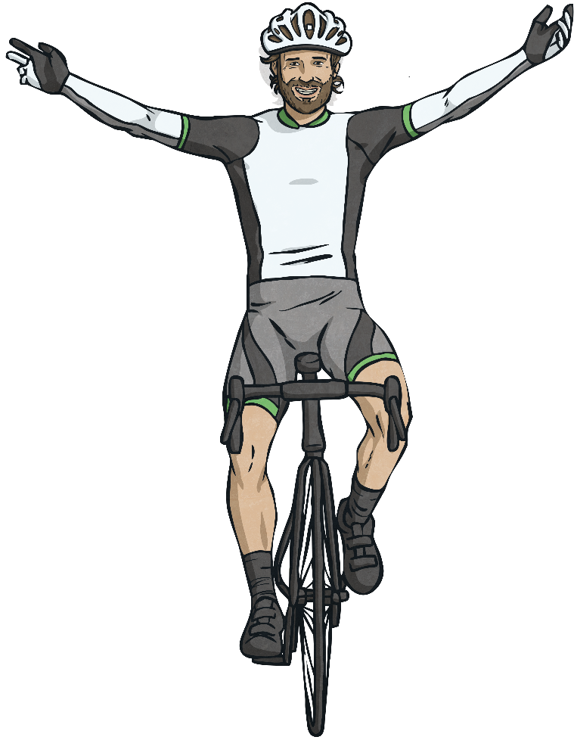
Looking Forward to the Challenges Life Brings
Challenge is exciting. Sometimes new challenges can be different and daunting, but taking on the challenges life brings can be also be positive.
It enables us to practise skills we have already developed, solve problems, learn new skills and become more confident along the way!
And there is nothing quite like the feeling of overcoming a challenge and looking back afterwards at how you did it!

Slide 11
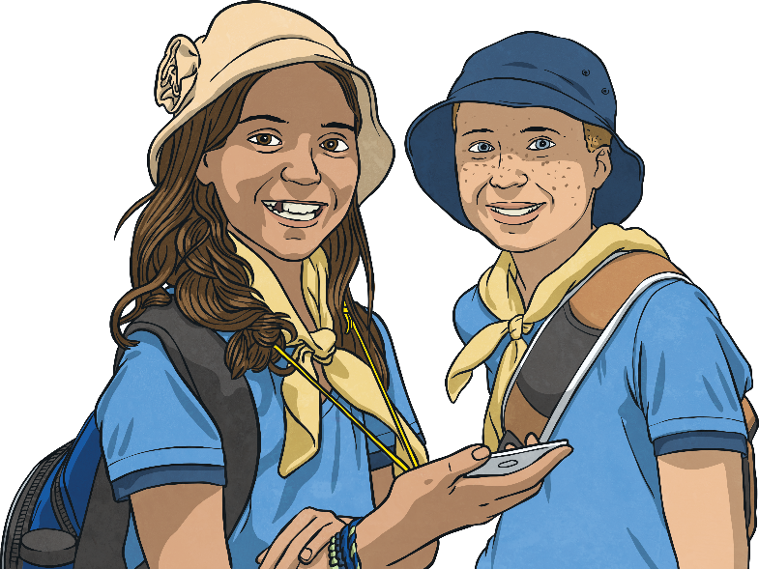
Feeling a Sense of Purpose
When we realise that we are needed by others and that we have an important role to play in life, it helps us to pick ourselves up, dust ourselves off and carry on when times are tough.
Perhaps someone else looks up to you for help and advice like a younger brother or sister.
Perhaps your friend relies on you to cheer them up.
Perhaps you have a position of responsibility, like a team captain, a librarian or being a guide or scout.
Maybe you have a great idea for a life-changing invention that you want to work on when you’re older.
All of these are great reasons to keep going!

Slide 12
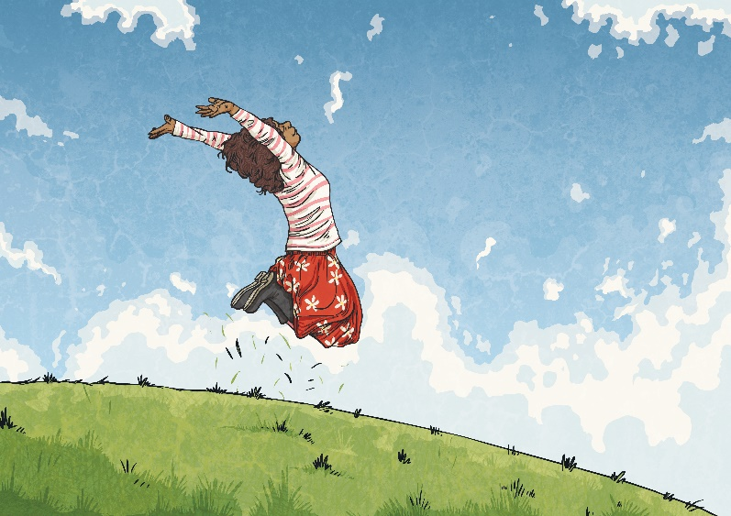
Appreciating What You Have and Being Grateful
As individuals, we tend to be pretty good at focusing on what we don’t have rather than all the positive things we do have.
We can be grateful for anything; our family and friends, the place we call home, the food we eat, our toys and clothes.
We can also be grateful for so much in nature: the fresh air to breathe, the sun, rain and the wonderful plants, trees and creatures in the world.

Slide 13
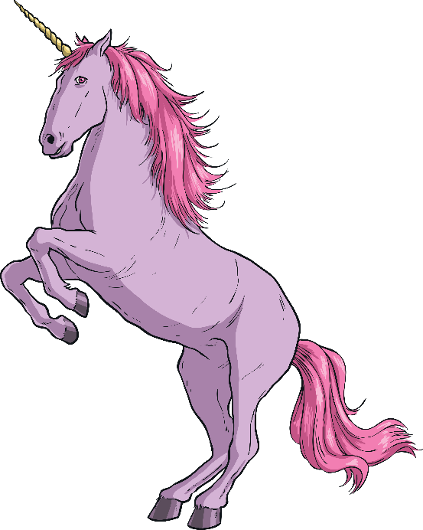
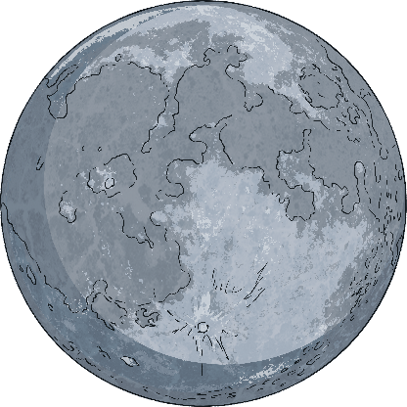
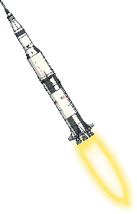
Setting Yourself Goals
Goals are great and targets are terrific!
It feels empowering to be focused on a goal or target and feels amazing to achieve those goals or targets.
Try to set yourself goals that are realistic (maybe not becoming a unicorn!)
Also, try to set goals that are achievable (maybe not flying to the moon!)
We need to be able to achieve our goals with effort but not too easily!

Slide 14
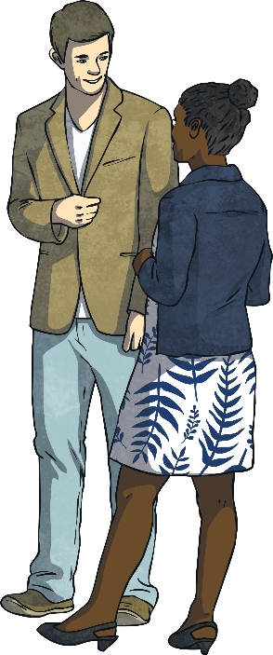
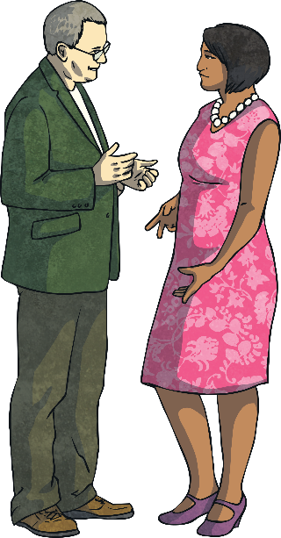
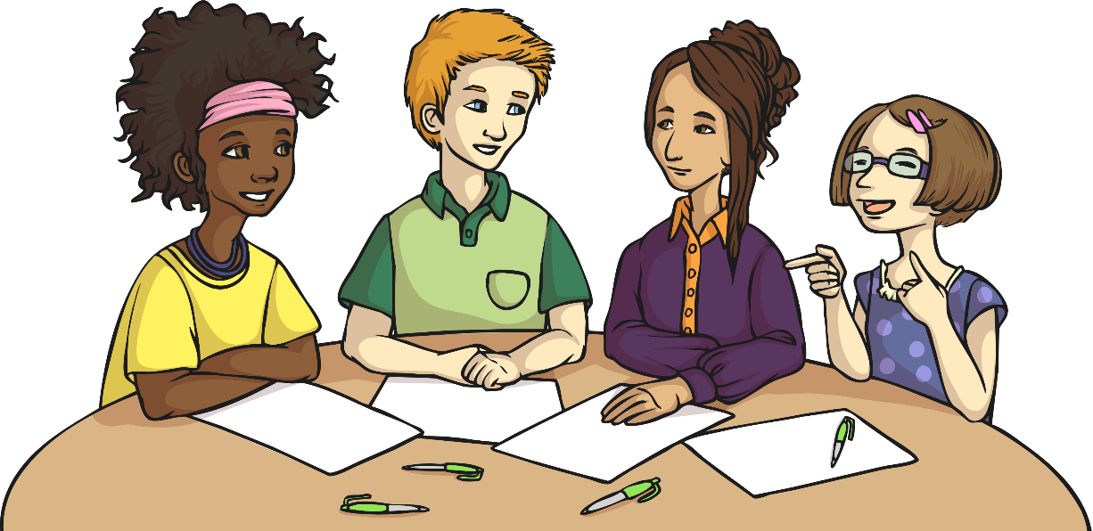
Keeping Your Thinking Flexible
Lots of things change day-to-day that are out of our control. Being able to change the way we think about something and maybe change our plans is really important.
We need to remind ourselves that it’s OK to be wrong about something, that it is OK to change our minds about something and that it is OK for others to do the same.

Slide 15
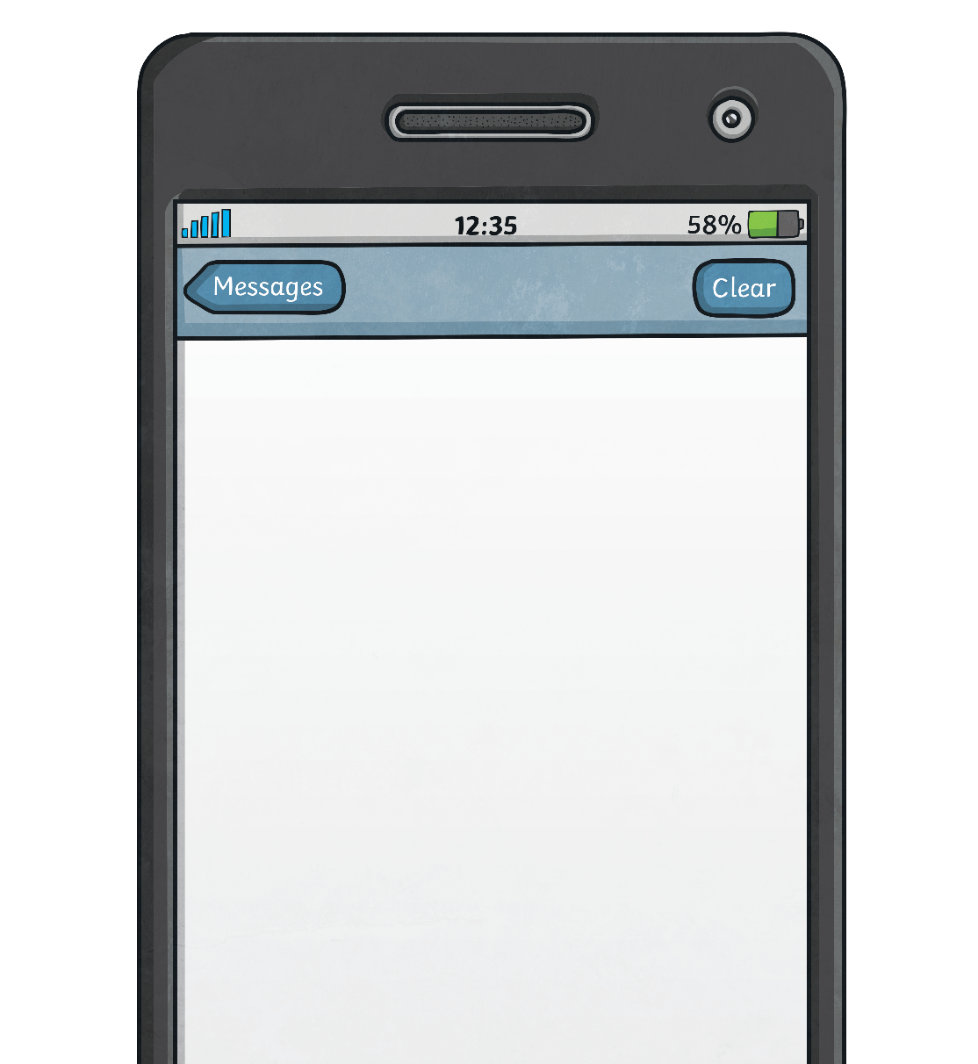
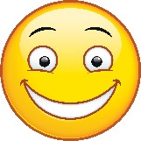
Using Positive Statements
The more we become aware of positive statements, the more we start to get used to thinking these positive statements independently.
Try saying a positive statement to yourself, a family member or a friend at the start of every day.
Today is going to be a great day!
Perhaps you could write down some positive statements and stick them on the wall? Or, if you keep a diary or use social media try recording just the positive things.

Slide 16
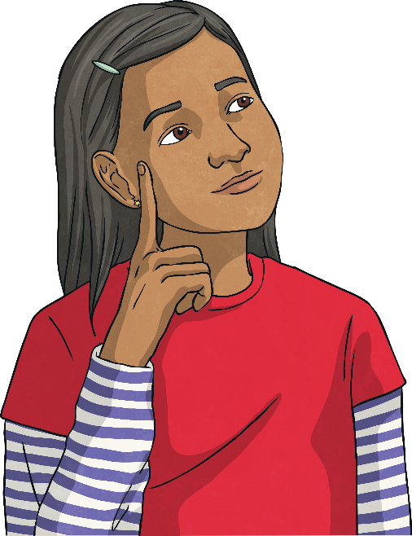
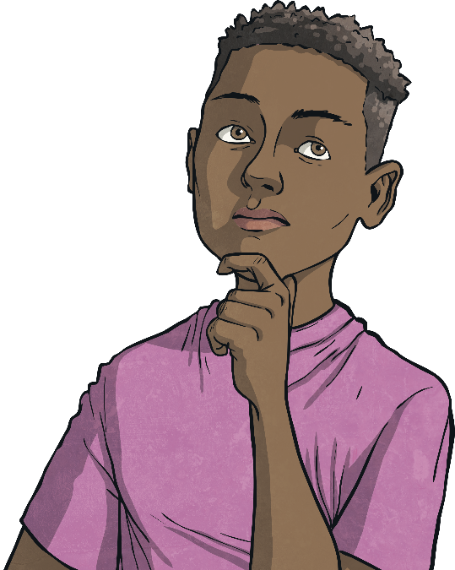
Being Resilient
What have you learnt about resilience today?
What might you try to do to become more resilient?
How can we help each other to be more resilient?

