Slide 1
Disclaimer
We hope you find the information on our website and resources useful.
Animations
This resource has been designed with animations to make it as fun and engaging as possible. To view the content in the correct formatting, please view the PowerPoint in ‘slide show mode’. This takes you from desktop to presentation mode. If you view the slides out of ‘slide show mode’, you may find that some of the text and images overlap each other and/or are difficult to read.
To enter slide show mode, go to the slide show menu tab and select either from beginning or from current slide.
You may wish to delete this slide before beginning the presentation.

Slide 3
What Is Time Management?
Time management is a skill that helps you take responsibility for completing your tasks.
Having good time management skills can help you prioritize your tasks, complete multiple tasks in a given time frame and reduce stress and anxiety.
The following slides include a range of tips to help develop your time management skills.

Slide 4
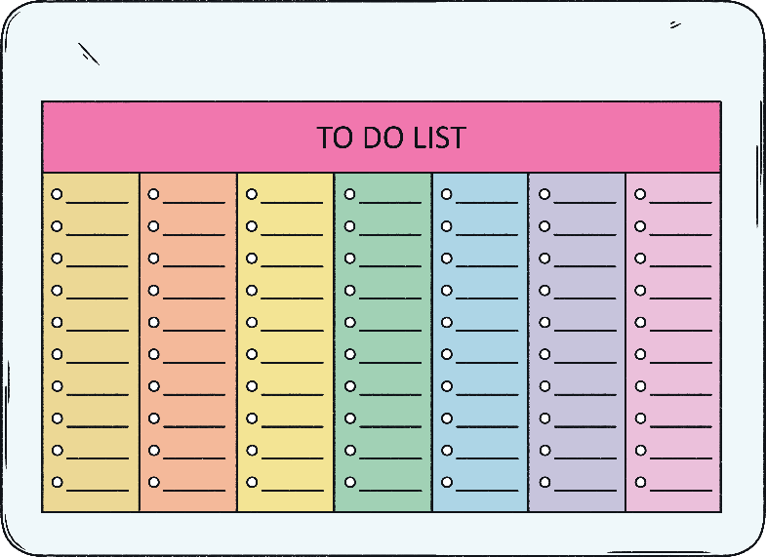
Make a List of Tasks
Start by listing all the things you need to get done.
Once you have them all written down, you can decide which order to do them in.
Do any of them have a deadline? Those are the tasks you should do first.

Slide 5
Create a Schedule or a Routine
If you find yourself forgetting things that you need to do regularly, it may be helpful to create yourself a schedule or routine.
For example, when you come home from school you may have jobs to complete such as; homework, helping with dinner, tidying up, caring for a pet, washing or brushing your teeth.
It can be easy to become caught up in doing something you enjoy like watching TV or playing video games.

Slide 6
Create a Schedule or a Routine
With good time management, you can plan to do the things you enjoy as well as your regular responsibilities.
Time | Task
4:00 - 4:30 | Homework
4:30 - 5:00 | Walk the dog
5:00 - 6:00 | Free time (TV, video games etc.)
6:00 - 6:30 | Eat dinner and help tidy up
6:30 - 7:30 | Free time (TV, video games etc.)
7:30 - bedtime | Wash, brush your teeth, free time before bed

Slide 7
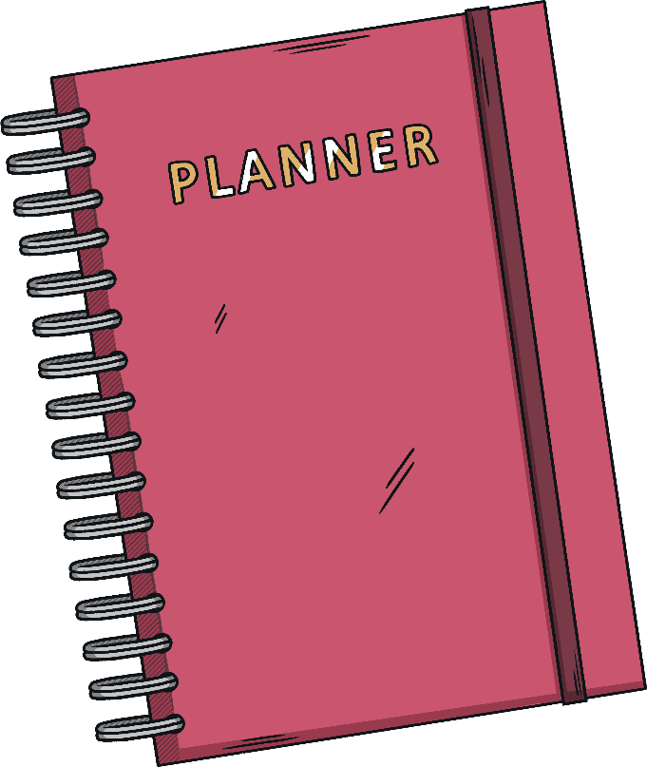
Stay Organised
You could use a diary or calendar to help stay on top of deadlines.
You could use it to keep track of when your homework is due, special events like birthdays that you may need to buy a card or present for or any school trips or exams that you may need to prepare for.

Slide 8
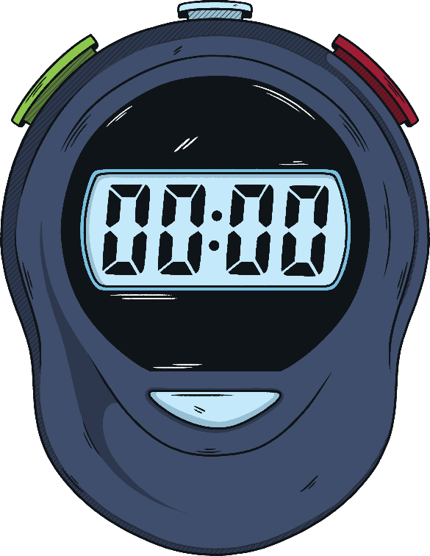
Use a Timer
You could use a diary or calendar to help stay on top of deadlines.
You could use it to keep track of when your homework is due, special events like birthdays that you may need to buy a card or present for or any school trips or exams that you may need to prepare for.

Slide 9
Set Yourself Boundaries With Gadgets
It is very easy to lose hours of time playing games or scrolling through social media.
Many electronic gadgets now give you an option to set an amount of screen time per day. If you are finding yourself spending too much time on your electronic devices, it may be helpful to set yourself a daily time limit.

Slide 10
Why Is It Important to Develop Time Management Skills?
Good time management is a life skill. It is important to be able to manage your responsibilities for life after school.
You will need to manage your time at work, in order to complete your tasks.
As an independent adult, you will also need to manage your time at home; stay on top of your bills, cleaning, food shopping etc.
If you are able to learn good habits and routines now, it will become easier later in life.

