Slide 1

PSHE and Citizenship
Living in the Wider World | Aiming High
PSHE and Citizenship | LKS2 | Living in the Wider World | Aiming High | When I Grow Up | Lesson 6

Slide 3
Aim
I can discuss what job I might like to do when I grow up and what skills I will need to achieve this.
Success Criteria
I understand how applying a growth mindset can help achieve goals.
I can talk about my strengths and how I might use these in the future.
I can set goals for myself to help me to succeed.
This resource is fully in line with the Learning Outcomes and Core Themes outlined in the PSHE Association’s Programme of Study.

Slide 4
The Big Questions

Slide 5


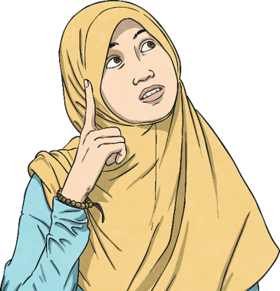
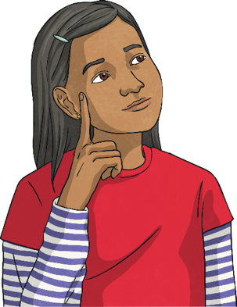
What might we like to do when we grow up?
What skills would we need to develop in order to
achieve this?
Sit quietly for a moment and think about your answers to these questions.

Slide 6
Reconnecting

Slide 7


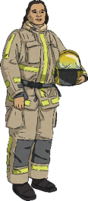


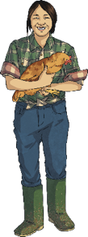
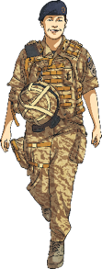
Useful Skills
Is there a job you think you would like to do when you are older?
You might not know for sure, but you probably have an idea of something you might enjoy and be good at.
Take a moment and close your eyes if you are happy to do so. Think about a job you would like to do when you grow up and try to imagine yourself doing that job.
Now, think of the sorts of skills you might need in order to be able to do that job well.

Slide 8
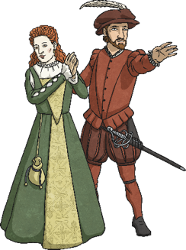
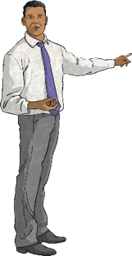
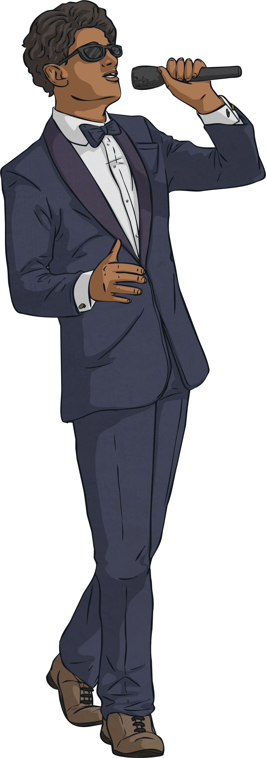
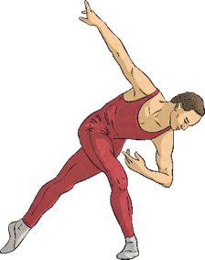
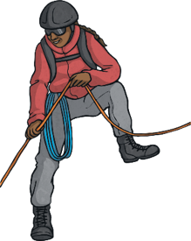

Useful Skills
Let’s play a game.
Keeping your job in mind, we are going to look at some skills needed for certain jobs.
If a skill comes up that you think you would need to be able to do the job you would like to do, stand up.
You might find that some skills are very important in lots of
different jobs.

Slide 9
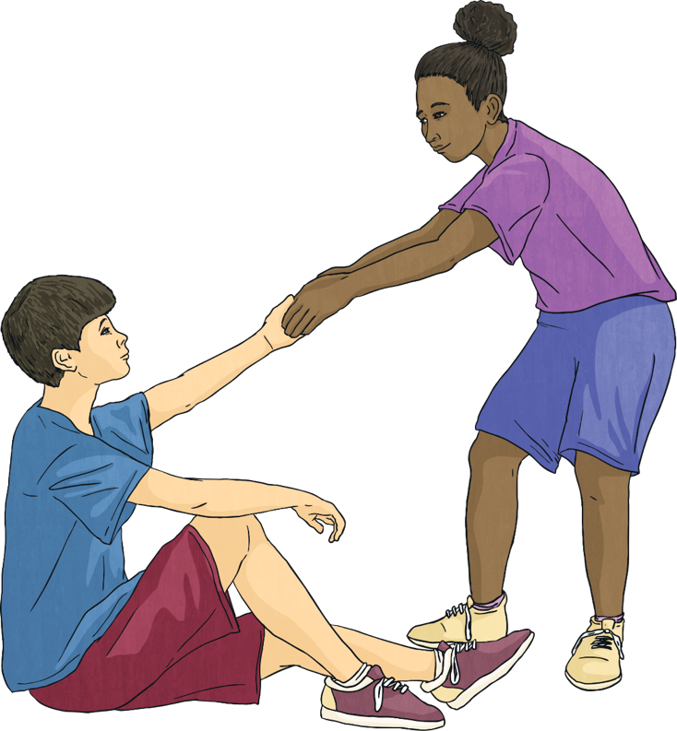
Useful Skills
caring for others

Slide 10
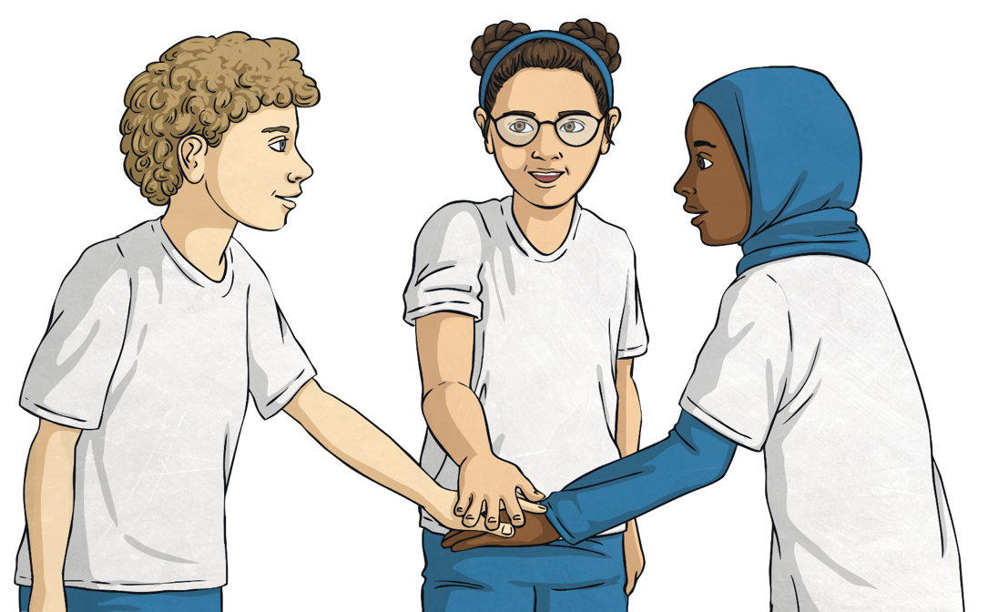
Useful Skills
great at working in a team

Slide 11
Useful Skills
being a good problem-solver

Slide 12
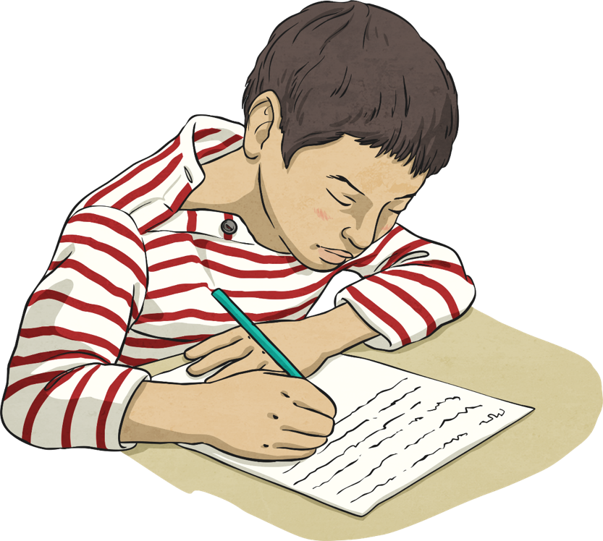
Useful Skills
great with words, numbers or both

Slide 13

Useful Skills
good at following instructions

Slide 14
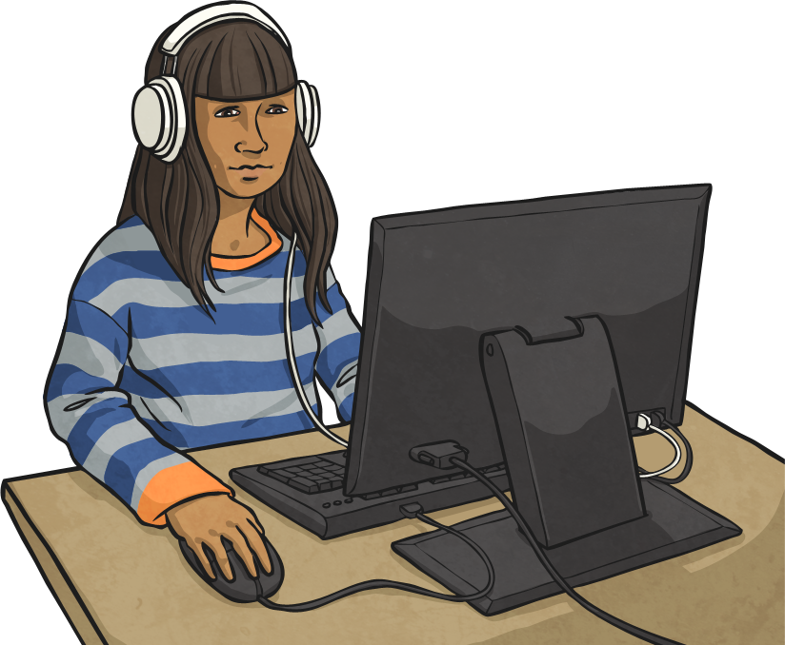
Useful Skills
an ability to learn new skills

Slide 15
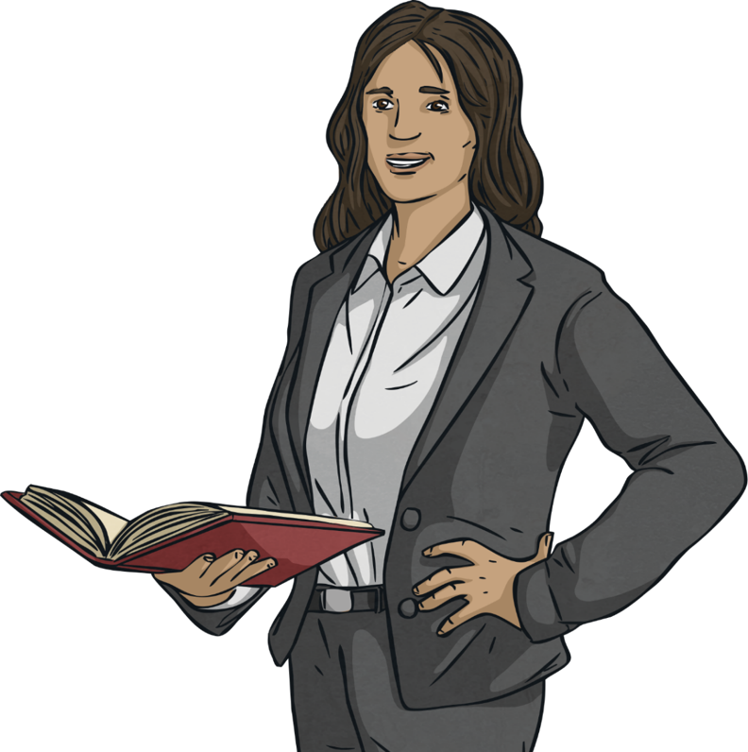
Useful Skills
being reliable and organised

Slide 16
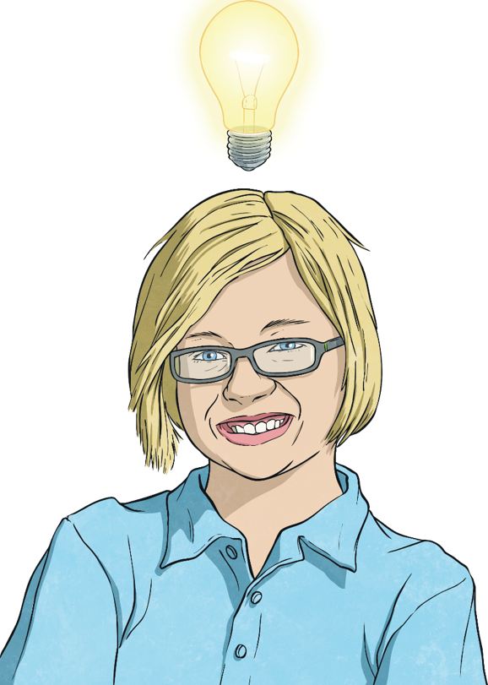
Useful Skills
being able to come up with great ideas

Slide 17
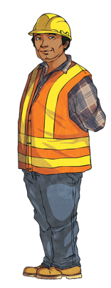
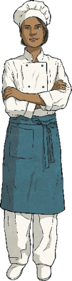
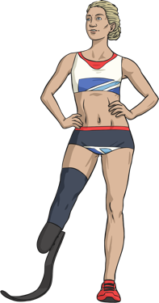
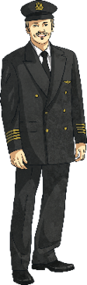
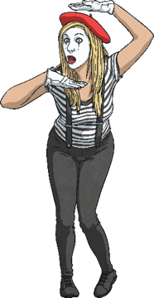
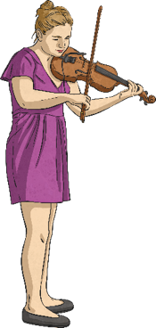
Useful Skills
How many times did you stand up in the game?
Did a lot of people stand up at the same time as you?
Do you think a lot of jobs need similar skills?
Once we know what sort of skills we might need for our dream jobs, we can focus on practising them and improving them.

Slide 18
Exploring

Slide 19

My Skills, My Strengths
Think back to the skills we have just been thinking about in the game. Did you recognise some of them as being skills you already have?
You will all have skills and strengths already. These are things you are good at and enjoy doing.
It could be anything, from looking after your pet at home to being great at gymnastics at school.
In your group, take turns to share your skills and strengths. Make sure everyone gets a turn and remember to value what everybody says. What one person considers a strength, another may not but that is fine because we are all different.

Slide 20
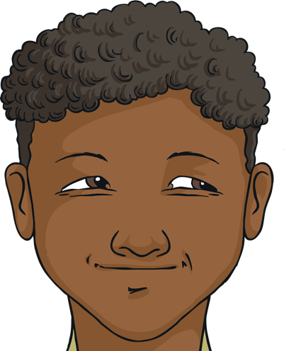
My Skills, My Strengths
Identifying our skills and strengths is a very important part of developing our self-worth. These are the feelings we have about ourselves, our self-esteem and the respect we feel we deserve from others.
We all have many strengths, skills and interests and knowing what they are., supports our mental wellbeing.
We are all different, we are all great and we all have a lot to offer! This should be celebrated.

Slide 21

Overcoming Obstacles
Having an idea of the job you want and knowing you already have some of the skills needed is a super place to start when it comes to achieving our dreams and goals.
But getting your dream job is not always so easy. Most people find there are challenges to face, obstacles to overcome and setbacks along
the way.
Of course, these are not things that should stop you from reaching your goal. They are simply things we need to prepare for.
Applying a growth mindset and understanding that we can keep trying are important skills for us all to have.

Slide 22
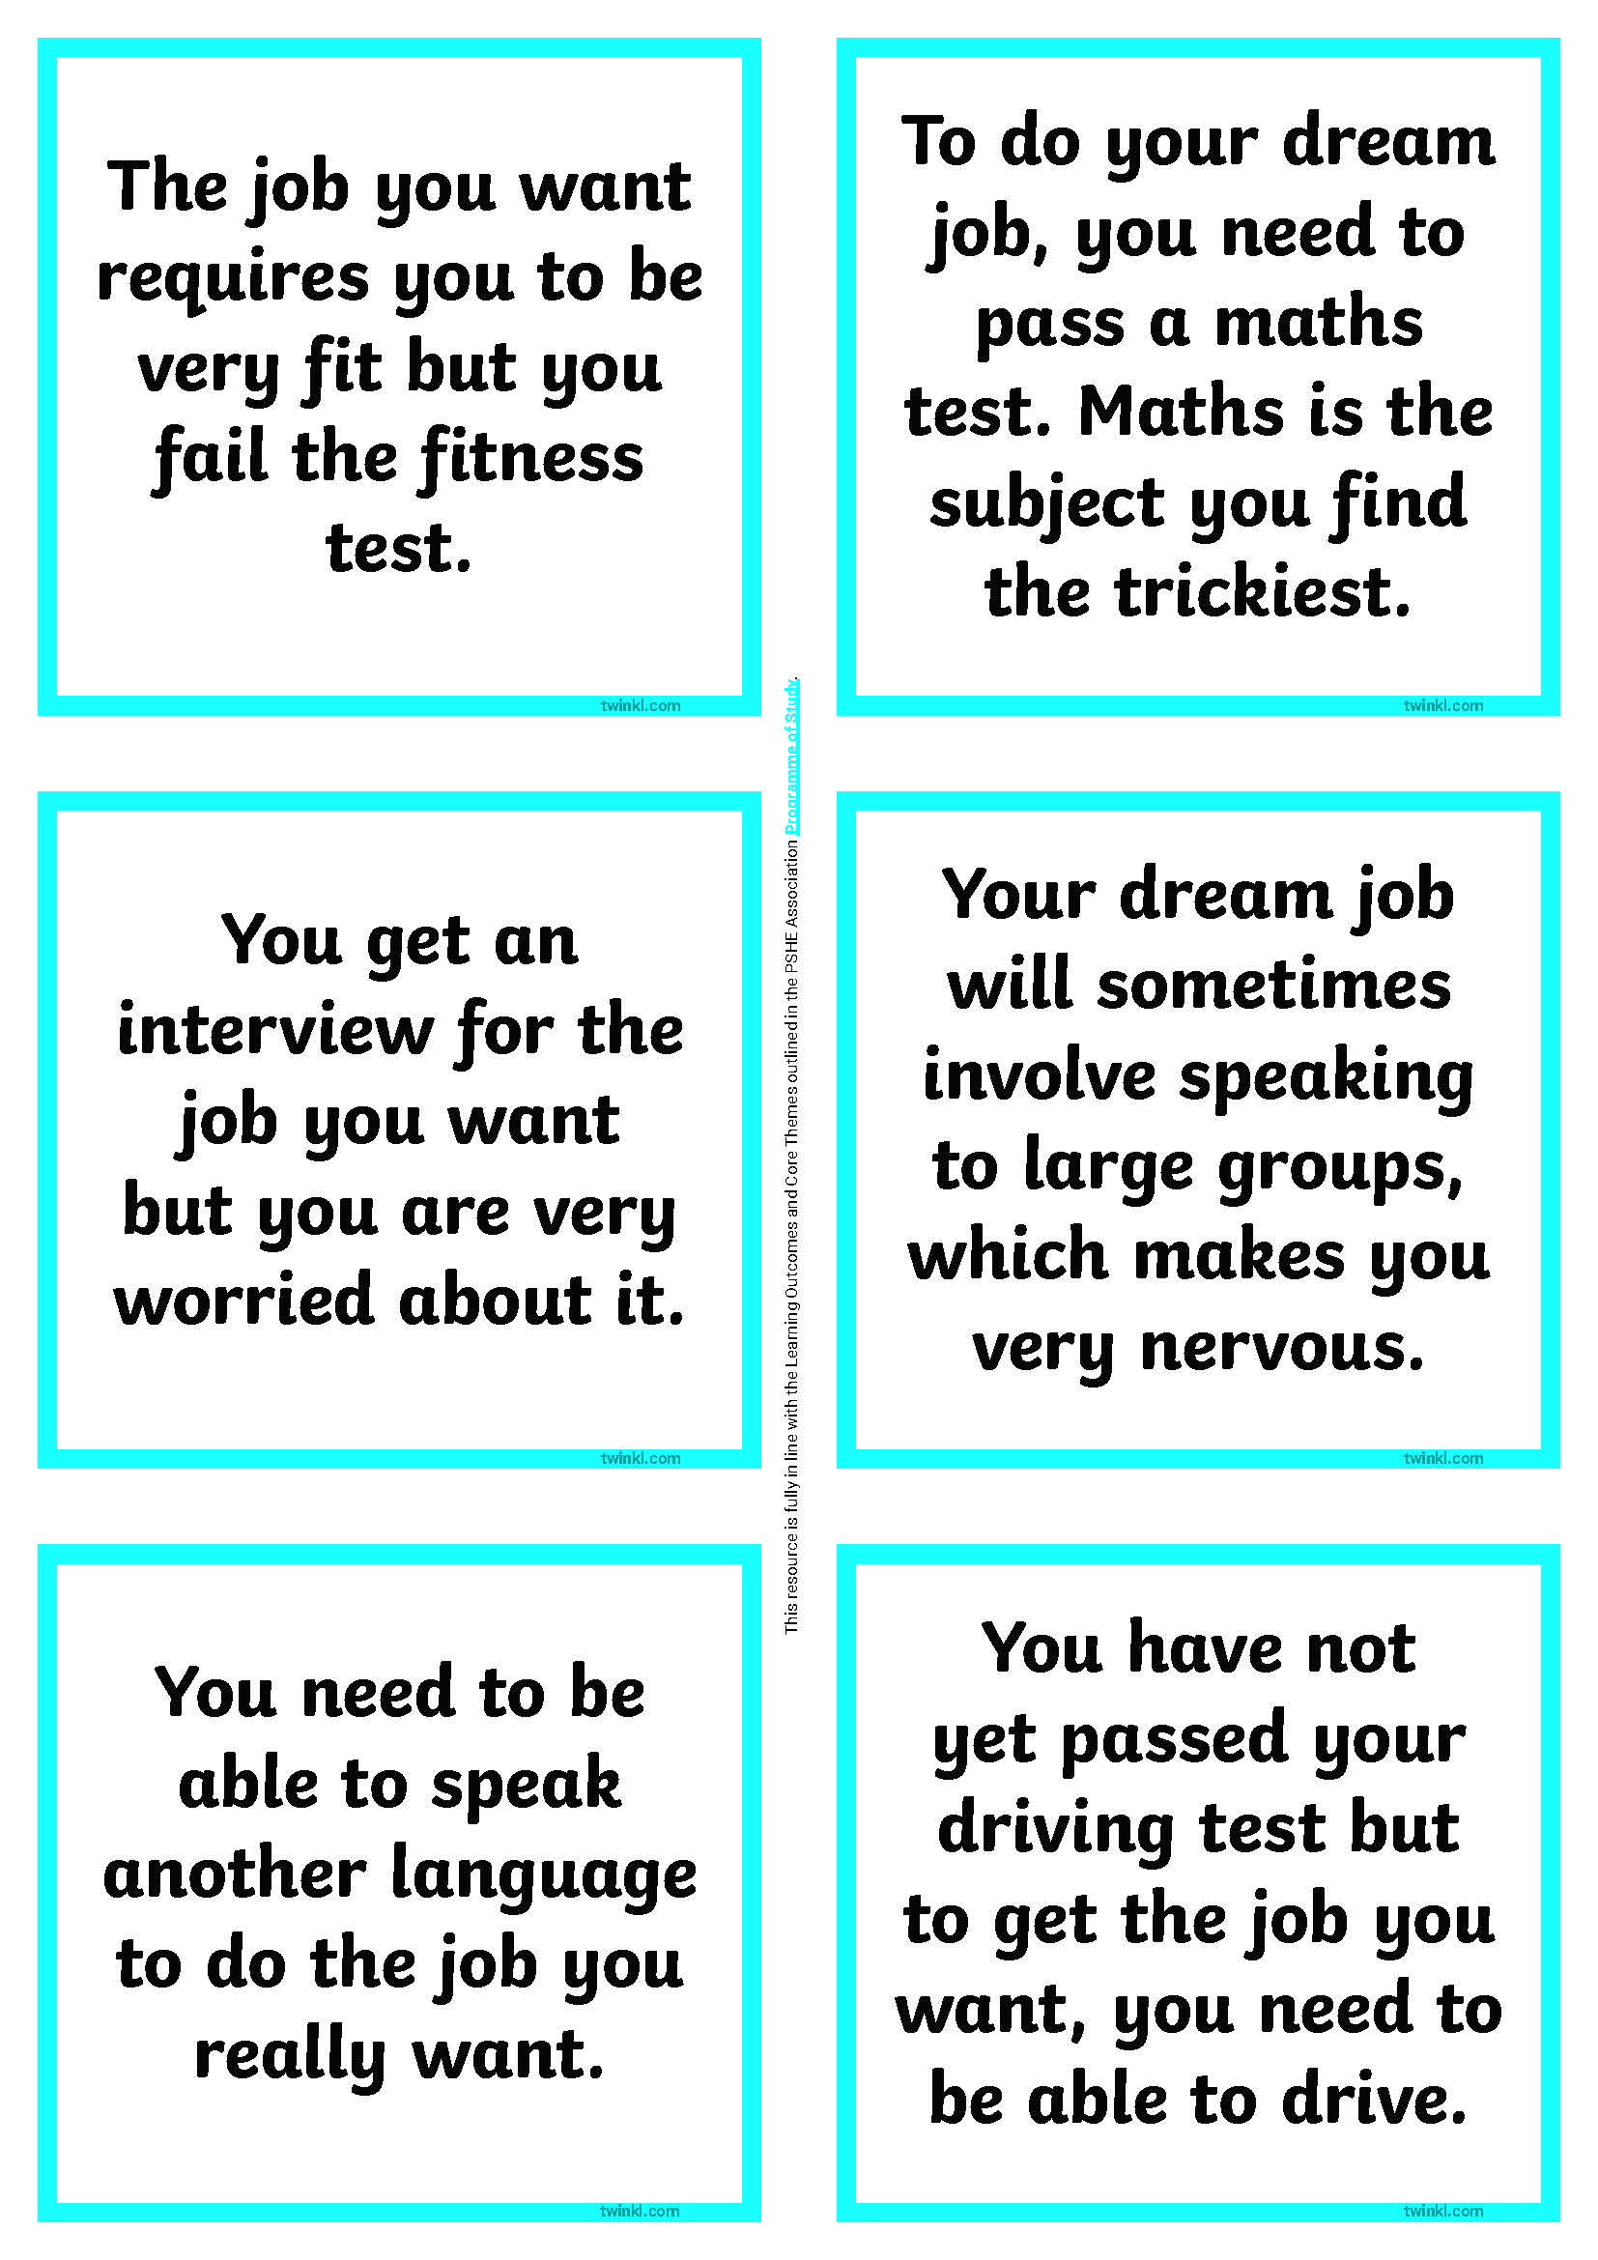
Overcoming Obstacles
We face obstacles everyday. The more challenges we face, the better we get at coping with them.
With your partner, you are going to look at some possible obstacles that a person might face when trying to get their dream job.
As you turn each card over, discuss together how a growth mindset could be applied to the problem and what that person could do when faced with that challenge.

Slide 23
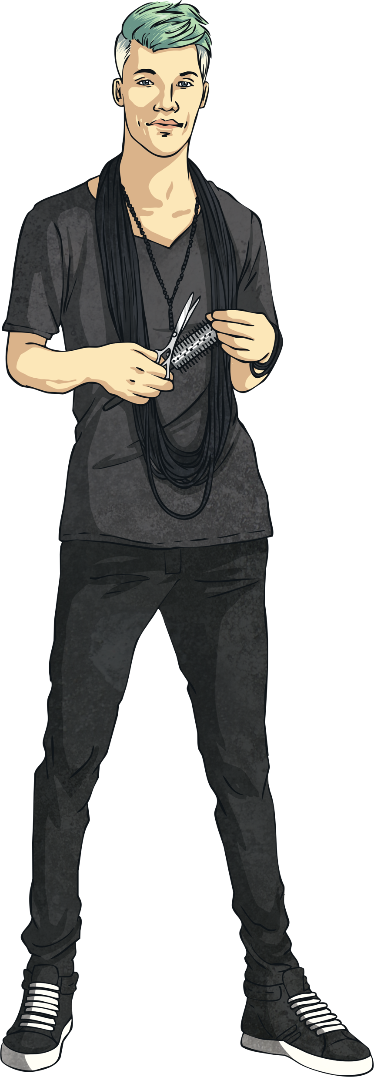

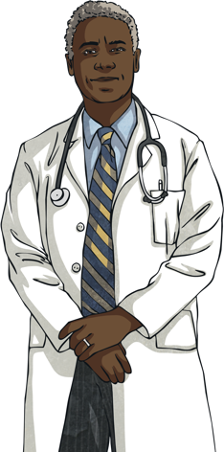
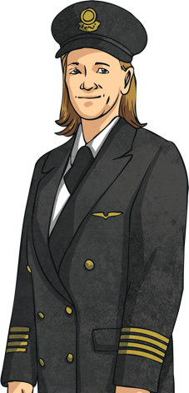
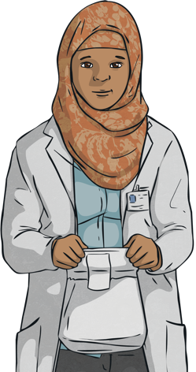
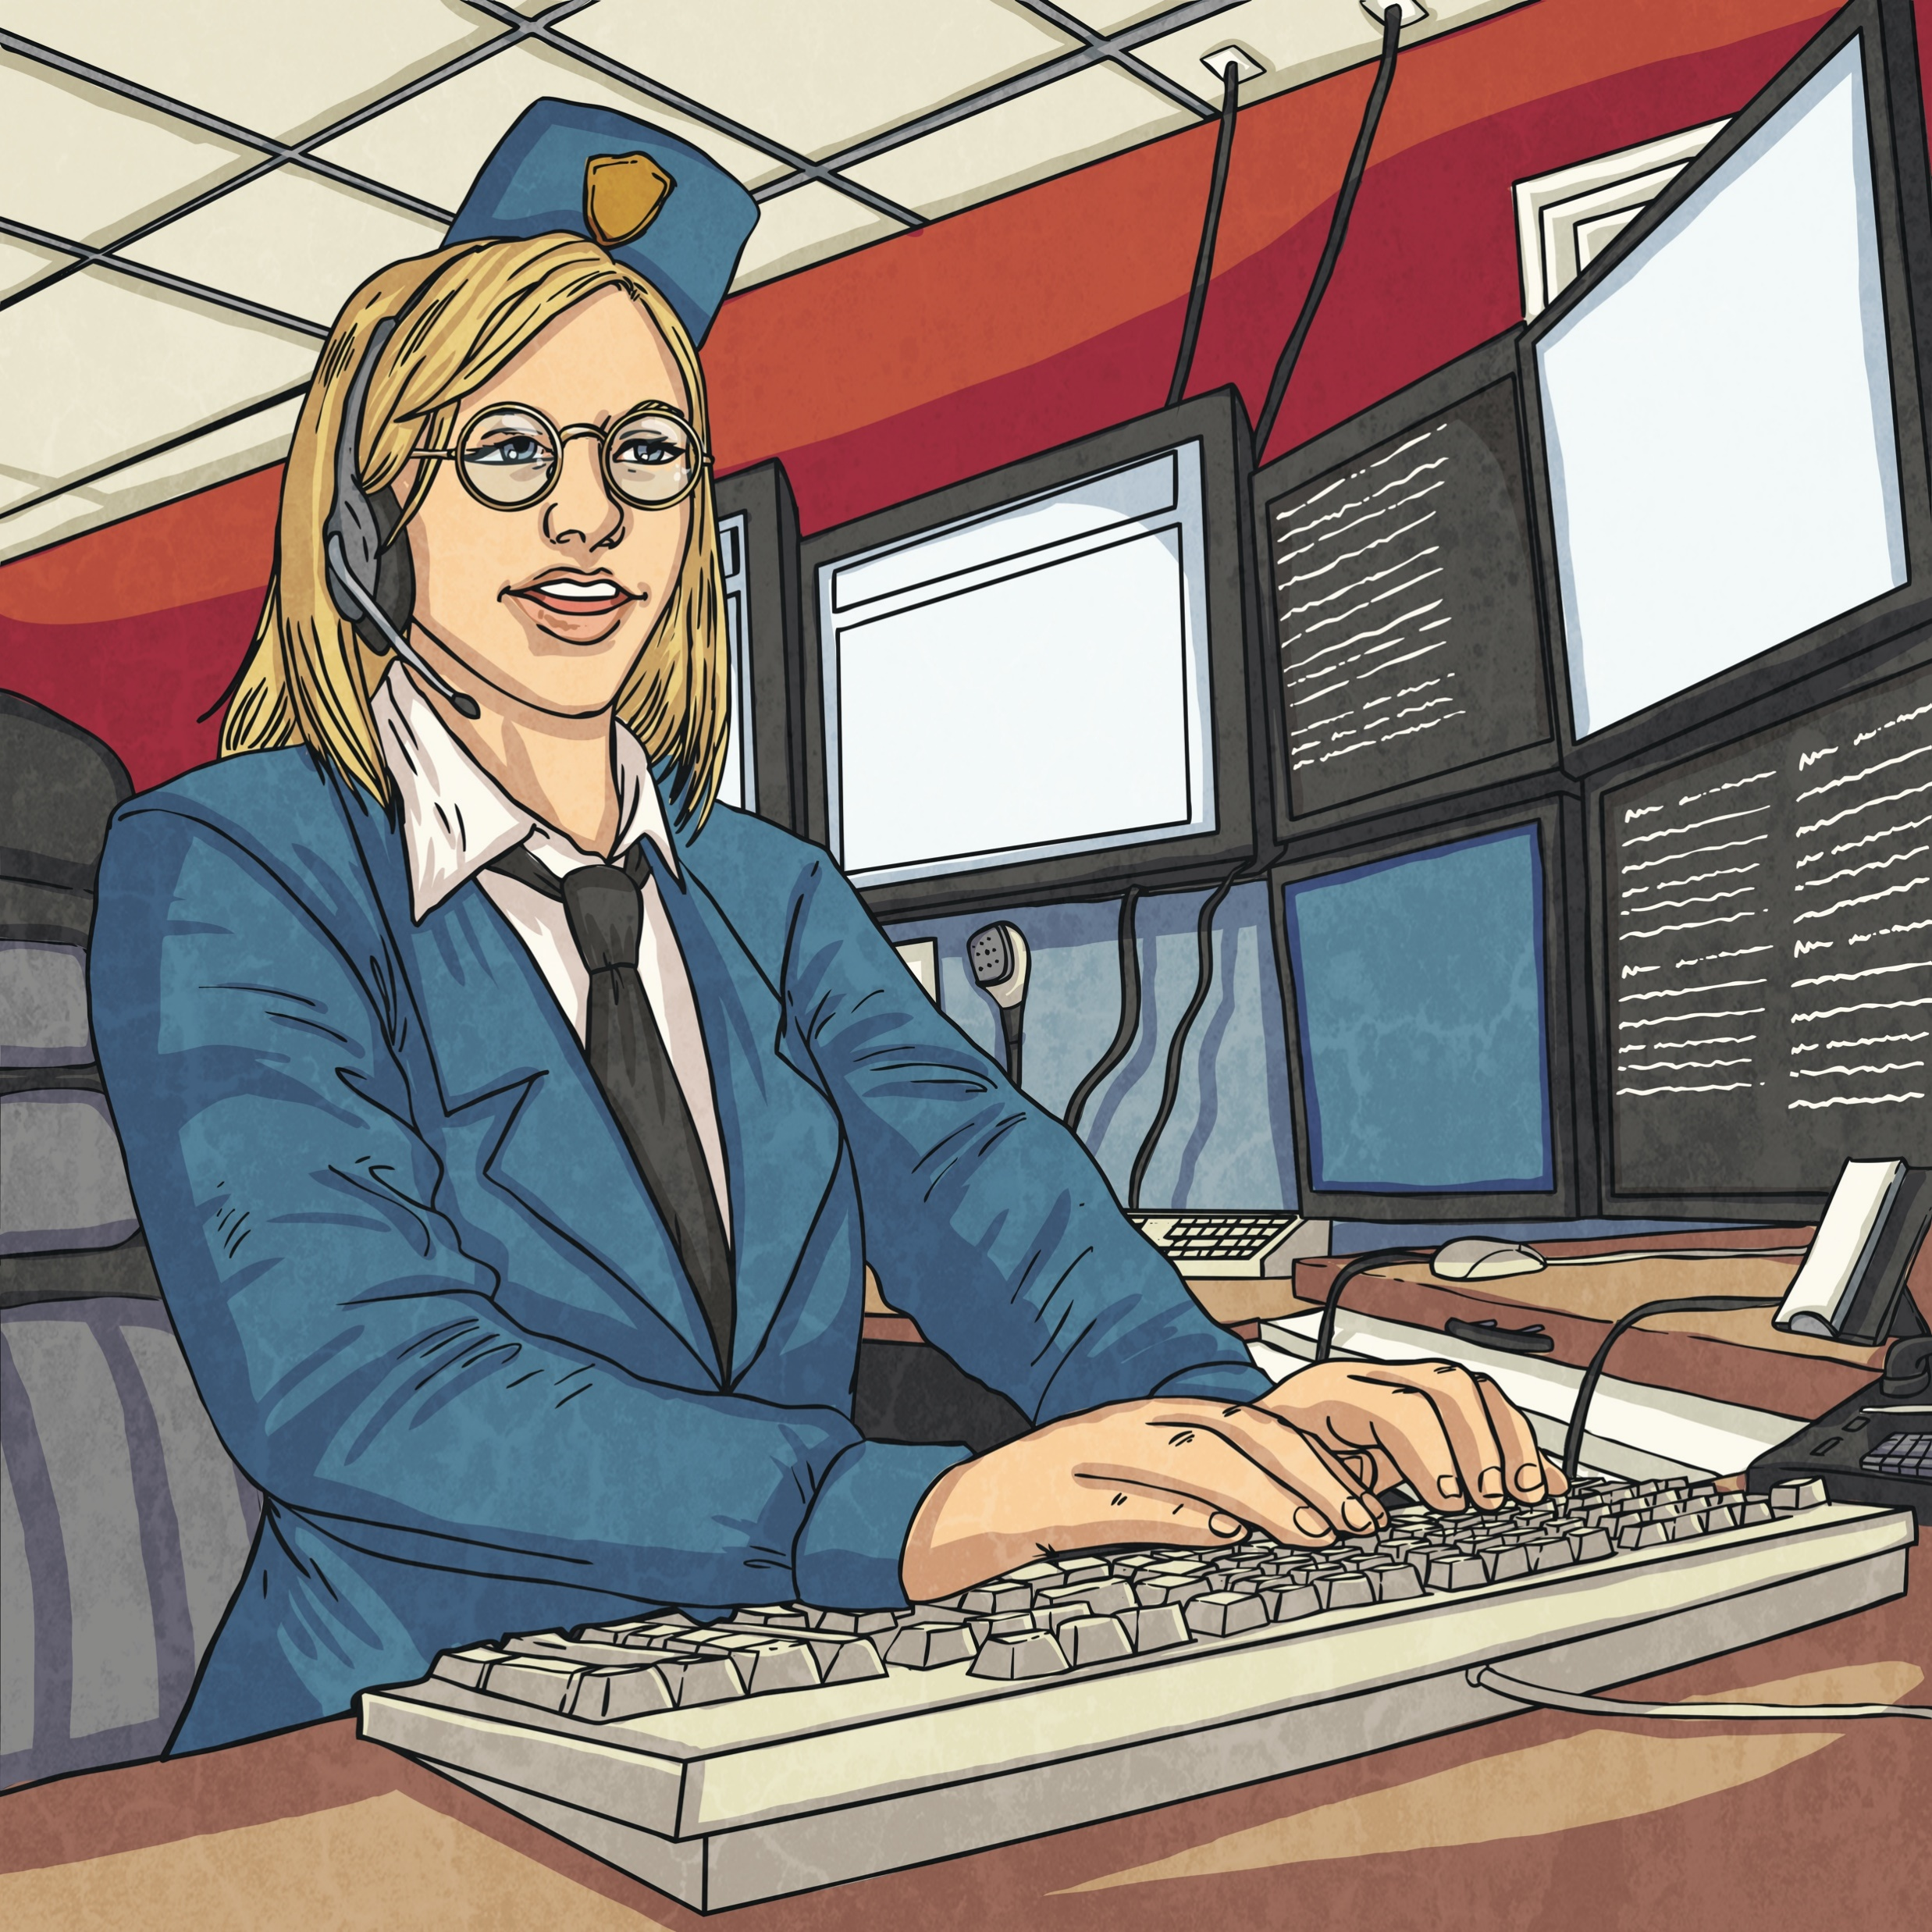
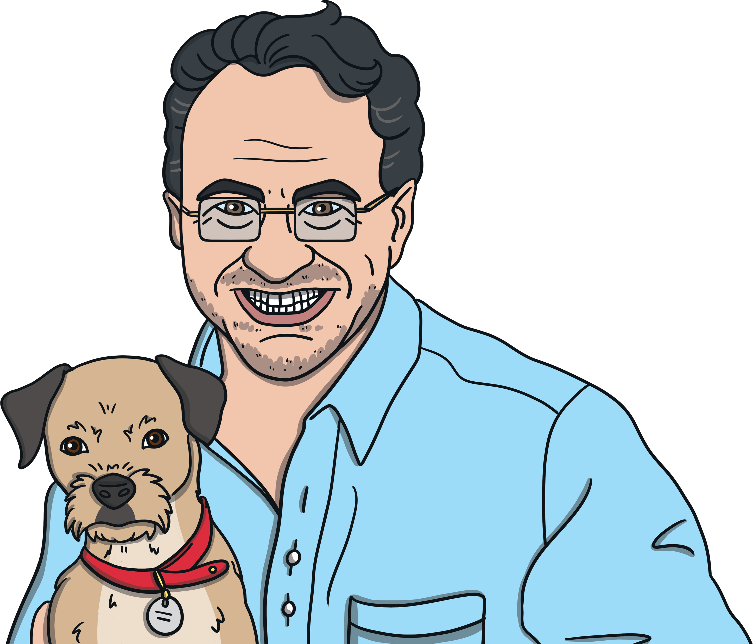
Overcoming Obstacles
Now, let’s consider the routes we can take into different jobs.
Some jobs require university qualifications.
Some jobs require certain qualifications in certain core subjects.
Some jobs require experience gained through an
apprenticeship. This means you get experience while
you are training to do the job you want and earn
some money straight away.
When you go to university, you choose to study the subject area that most interests you or the field that you will need for your dream job.
This is something you can start
to work on straight away.

Slide 24
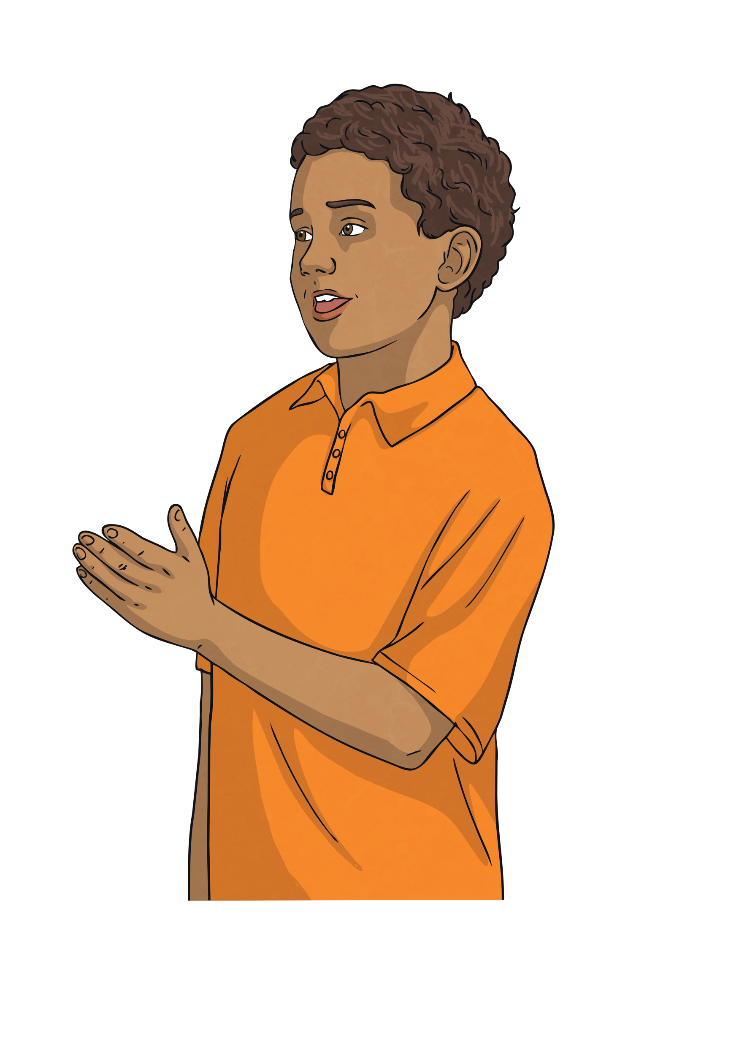
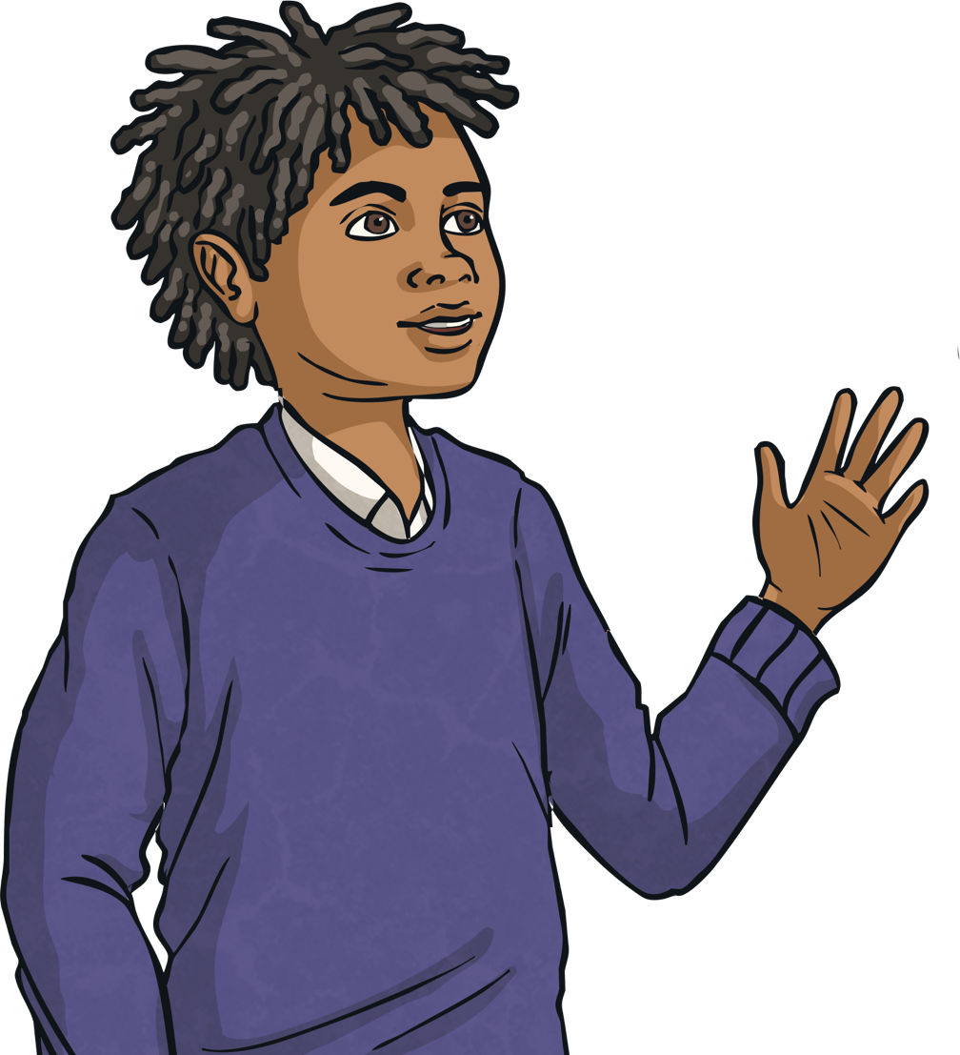
Overcoming Obstacles
To do my dream job, I need to go to university but so many people want to go, should I even bother trying to get in?
To be accepted onto an apprenticeship, I need to fill out a big form. It’ll take so long.
My dream job requires a GCSE in maths; I find maths very difficult.
Let’s start now then! Doing a little bit at a time won’t make it seem so long and it’ll give you chance to think carefully about each part.
Speak to your teacher and think about which parts you find tricky. Learn from others around you and see each lesson as an opportunity to overcome this challenge. With determination, we can succeed!
Go for it! Make your application great, add in lots of the exciting things you’ve
done and accept the challenge!
There are lots of different ways to get into the world of work. Some jobs have one clear way in, whereas some jobs can be achieved in lots of different ways. Think about the obstacles we have just been discussing. With your partner, use the cards to find an obstacle that you might face when getting into a job through one of the routes we have just looked at.
How could someone overcome this obstacle?

Slide 25
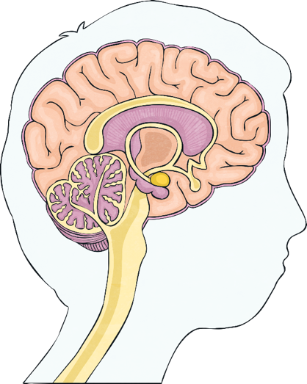
Overcoming Obstacles
Well done! Hopefully, in your pairs, you were able to think of things that someone could do to overcome these obstacles.
A resilient, determined person does not let things like this stand in the way of achieving their goals.
They find ways to try again or try another way. Sometimes, we just have to put more effort into something in order to achieve it.
Consolidating
Reflecting

Slide 26
Consolidating

Slide 27

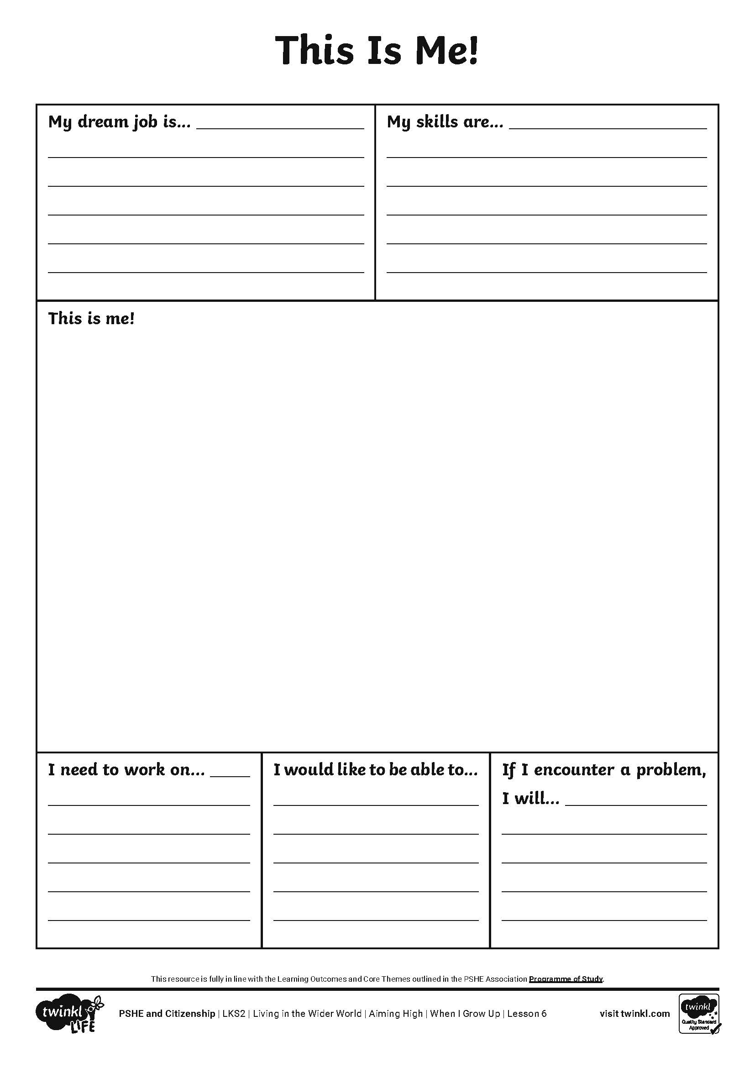
This Is Me!
We are all different and have different goals.
We are good at different things and need to practise different skills.
We all enjoy doing different things and we will all end up doing all sorts of different jobs in the future.
Complete your This Is Me! Activity Sheet by thinking about your goals, your strengths, things you would like to get better at and how you might overcome any obstacles you meet along the way.

Slide 28
Reflecting

Slide 29
Achieving Those Goals
It’s great to have goals in life, such as an idea of the job you would like to do when you grow up.
In order to achieve your long-term goal, the end result, we need to think about the things we need to achieve along the way.
A good way to think of this is as steps to success:
What do I want to achieve in the end?
What do I need to achieve in the mid-term?
What do I need to achieve soon?

Slide 30

Achieving Those Goals
On your sticky notes, have a go at writing three steps to achieving your goal; a step for the short-term, a step for the mid-term and a step for the long-term.
Try hard to improve my reading by reading every day.
Get good grades in English at secondary school.
Take a writing course to learn how to write children’s books.
Whatever you would like to be when you grow up, go for you goal and achieve your dreams!

Slide 31
The Big Questions

Slide 32
What might we like to do when we grow up?
What skills would we need to develop in order to
achieve this?
In what ways has your learning in this lesson inspired you?

Slide 33
Aim
I can discuss what job I might like to do when I grow up and what skills I will need to achieve this.
Success Criteria
I understand how applying a growth mindset can help achieve goals.
I can talk about my strengths and how I might use these in the future.
I can set goals for myself to help me to succeed.
This resource is fully in line with the Learning Outcomes and Core Themes outlined in the PSHE Association’s Programme of Study.

Slide 34


