Slide 1
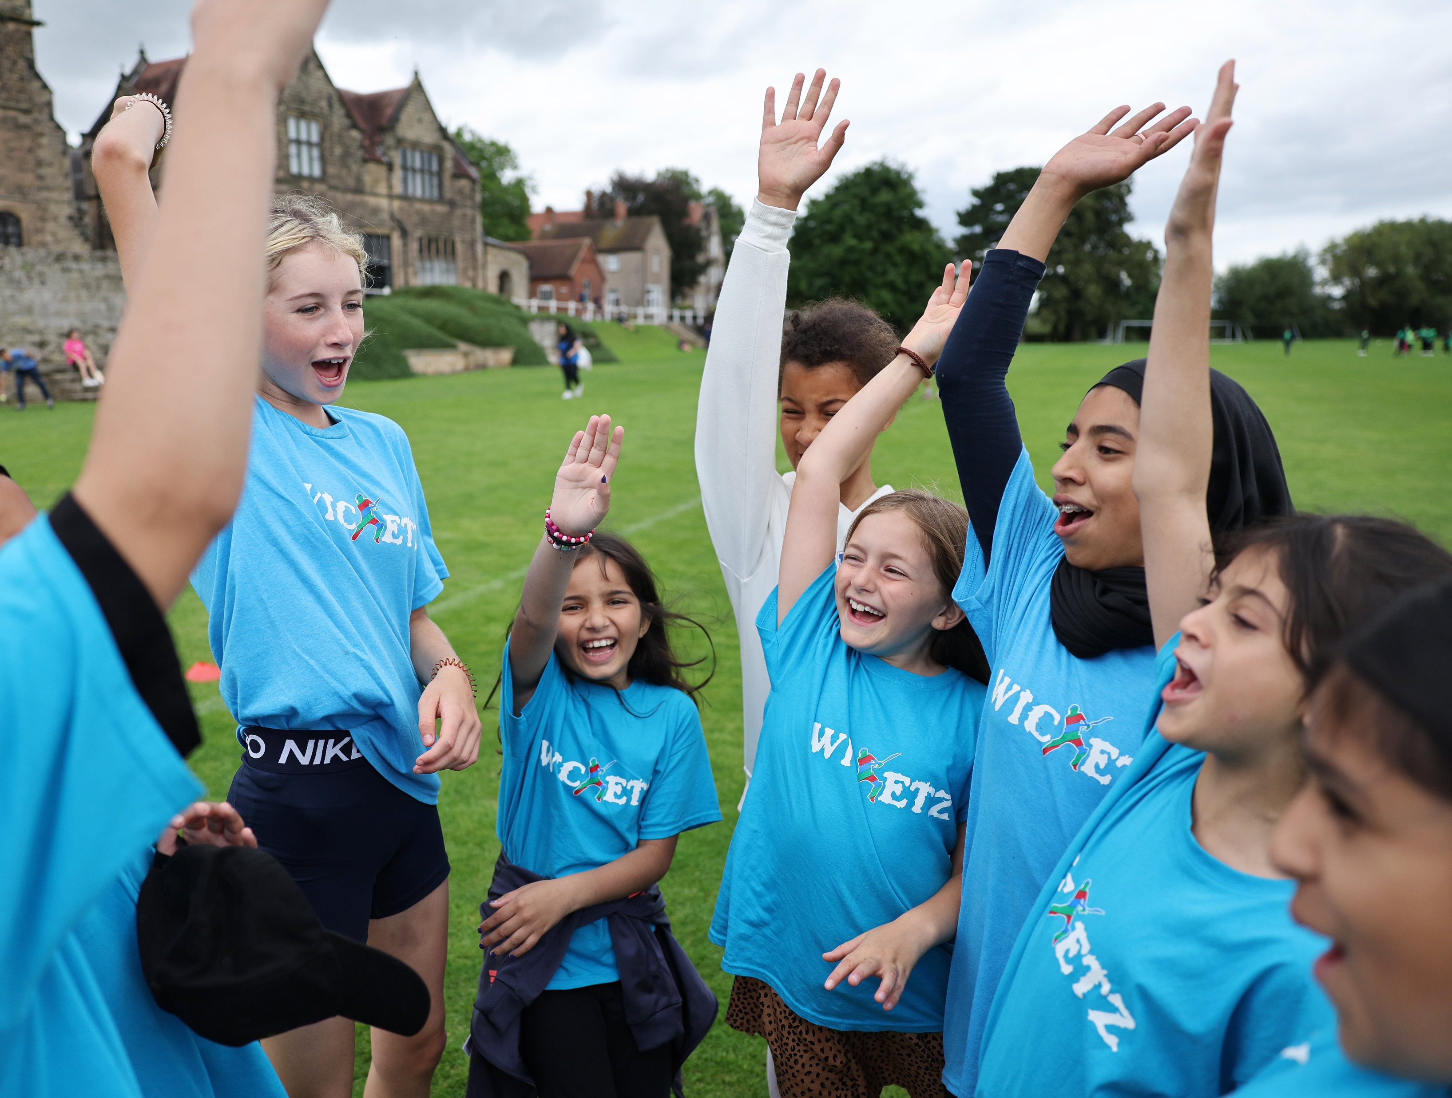
Female Engagement Guide
Help to support you to create the ‘I can play’ mentality by empowering and welcoming more woman and girls into your weekly hub sessions

Slide 2
Contents
The need for change
Barriers
Motivations
Key themes & Support

Slide 3
Why is it important?
Two million fewer woman & girls play sport than men, with 13 million woman & girls saying they are wanting to become more active. Just over 6 millions of those women/girls are NOT currently active (This Girl Can, 2022)​
By the time puberty hits, 64% of girls drop out of sport- this is double the rate of boys and to make matters worse, only a third of girls meet the minimum requirement for exercise (NetballHer, 2023)
This present a fantastic opportunity for Lord’s Taverners…

Slide 4
The opportunity
Research has shown that the ‘traditional’ cricket offer is not suitable or appealing, especially for those who are new to the game.
Within this guide, we will provide you with a wide range of resources, guidance and ideas to help you to encourage more girls to play and fall in love with the game.
What we want to achieve:
Remove barriers to participation
See more women & girls playing and loving the game
Create the 'I can play' mentality

Slide 5
Motivation
It is evident from our research that women and girls are motivated to play for social reason as opposed to learning elite cricket skills. To reach more women and girls, we must relate and respond to the motivations. We have identified 6 motivating factors from our research -
Having fun
Make new friends
Socialising and spending time with friends
To gain confidence and self-esteem
To be part of a team
To improve their mental and physical wellbeing
Top tip: In order to attract more women and girls into Wicketz, we must relate and respond to these motivations at our hub sessions…

Slide 6
What do girls love about Wicketz?

Slide 7
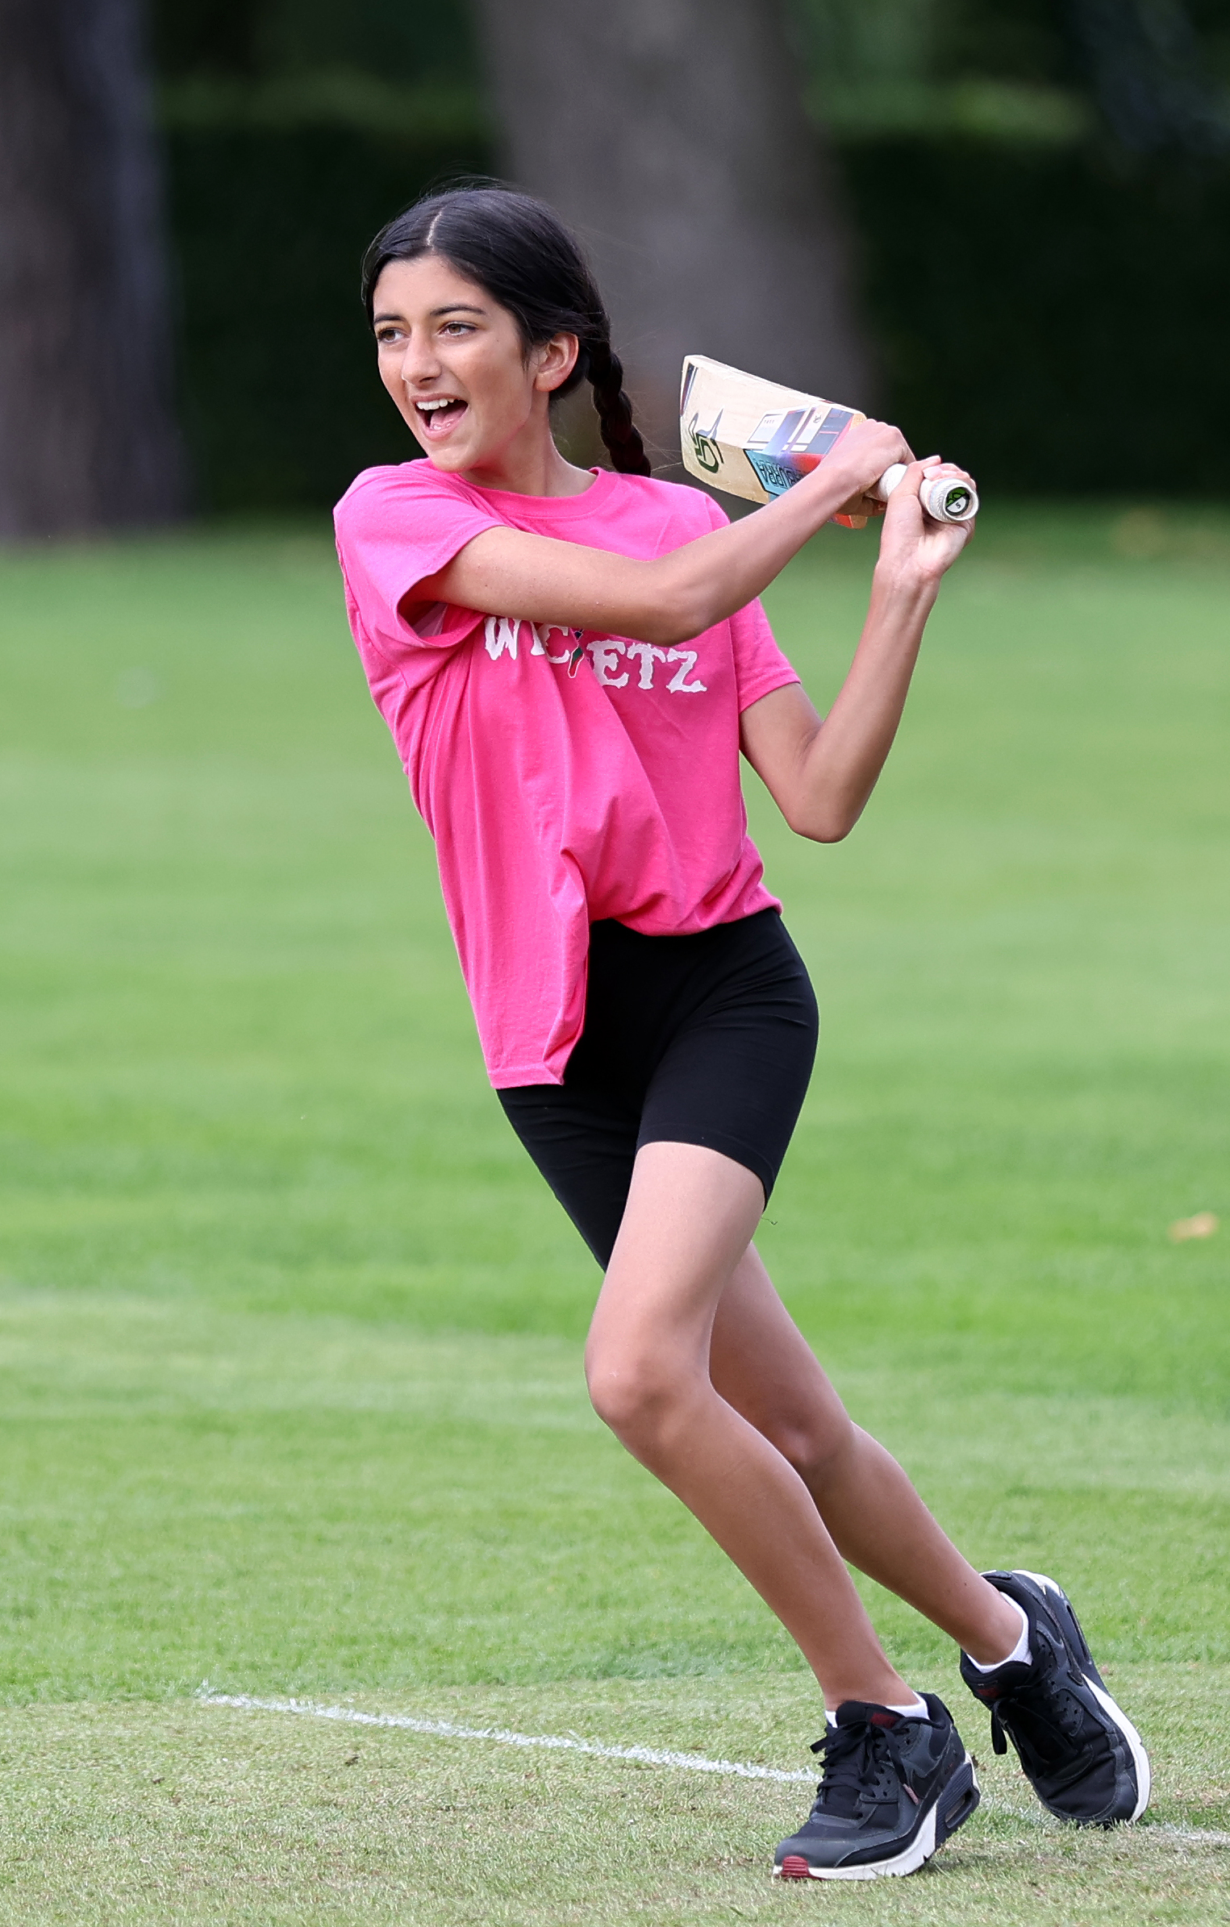
Barriers- what is stopping woman and girls from playing cricket?
We have identified 10 main barriers from women & girls on our programme
Insecurities- worried about how they look or looking silly in front of other people
Stereotypes- the deep-rooted stereotype that cricket is a ‘mans’ game
Male gaze- not wanting to be watched or judged when playing through fear of embarrassment
Friends- not wanting to attend somewhere new on their own and having nobody to go with
Periods- worried about taking part when they are on their period
Equipment- fears of not having the ‘right’ kit or equipment to take part
Facilities- not having appropriate facilities that accommodates girls needs and safety concerns
Awareness- lack of information of how to get involved and what the session involves
Lack of role models- not having female coaches they can relate and feel comfortable around
Wrong activity- sessions focusing on competition and elite cricket skills

Slide 8
Let's get started!
We have identified 5 key themes that we must take into consideration when engaging women & girls
1. Marketing (Pages 9-14)
Create content that is representative, relatable, relevant and appealing
1
2. Recognition & Incentives (Pages 15-19)
Boost confidence & make the offers more appealing
2
3. Facilities (Page 20)
Removing barriers to participation by selecting a venue that suit target audiences needs
3
4. Right Cricket activity and environment (Pages 21-26)
Reframe the cricket offer as a fun and social space where their needs are understood
4
5. Right People (Page 27)
Increase relatable role models and have coaches who understand player's needs
5

Slide 9
Marketing
65% of girls on our programmes said having the right imagery and language is a key step to engagement
Their first experience of advertisement happens before they attend the session; you must provide all necessary information and reassurance they need to take their first steps into cricket
On the next few pages, we will provide key suggestions you should be considering when developing your marketing and communications strategy

Slide 10
Marketing checklist A key starting point is to ask girls on your programme what motivates them; by having a better understanding of this, you will have some ideas to start your messages in promotional material Below are key recommendations of what you should be looking to include in your marketing material
Videos: A great tool to have to provide new starters with reassurance before the session. If they see it, they will believe it.
People like me: Use imagery that represent woman & girls in your community to highlight the range of different body types, ages and ethnicities.
Language: Think about what motivates them to play, do not just talk about cricket; emphasise the wider benefits cricket brings, such as friendships.
Offers: Offering things such as bringing a friend for a reward. Incentives and rewards to help provide a sense of security and value.
Support: They should feel they have all information they need ahead of participating, I.e what to wear, location, cost, facilities available, ability, age.
Journeys: Use participants case studies or good news stories to build on the desire of seeing ‘girls like me’ playing cricket.

Slide 11
Reaching and engaging Women & Girls Utilising communication channels popular with women & girls is the most effective way to engage and communicate alongside the below recommendations
Word of mouth:
Encourage existing participants, parents and other organisations to spread the word about your hub session.
Non-sporting locations:
Disengaged woman or girls are unlikely to go to your website or see a flyer at a sport club. However, they may see a poster in a local café, supermarket or youth group.
Social media:
TikTok, YouTube and Instagram have been identified as popular social media accounts woman & girls on our programmes already interact with.
Partners/organisations:
Working with partners or organisations who have high female engagement. For example, Brownies or girls.
Influential people:
Ask individuals already on your programme who their role models are, if they follow any influencers or sportspeople. Encourage ‘local heroes’ to share and promote your sessions through their channels.
Face to face recruitment:
Face-to- face recruitment or taster sessions allows for immediate reassurance from meeting a friendly face and allowing them to ask any questions before attending.

Slide 12
Empowering participants to advertise their Wicketz hubs
”Come to a Wicketz
session with me”
Repton
residential
Utlising participants creates an if 'she can do it, I can do it too' mentality. Pulling on lived experience to resonate with other women.
Suggestions you could use;
Talk in assembly
Share their experiences, what do they love about it, why should others join, what benefits come with Wicketz?
Promote
Promote Wicketz on social media channels they use frequently
Advertise in their school
Ask their schools if they can promote Wicketz through their social media and mailing lists. Provide them with flyers they can hand out in their school.
Flyer distribution in the community
Putting flyers up where places woman & girls go, where’s a popular meeting space for them?
Youth led taster
Deliver a cricket activity at their school by themselves, with you or a teacher

Slide 13
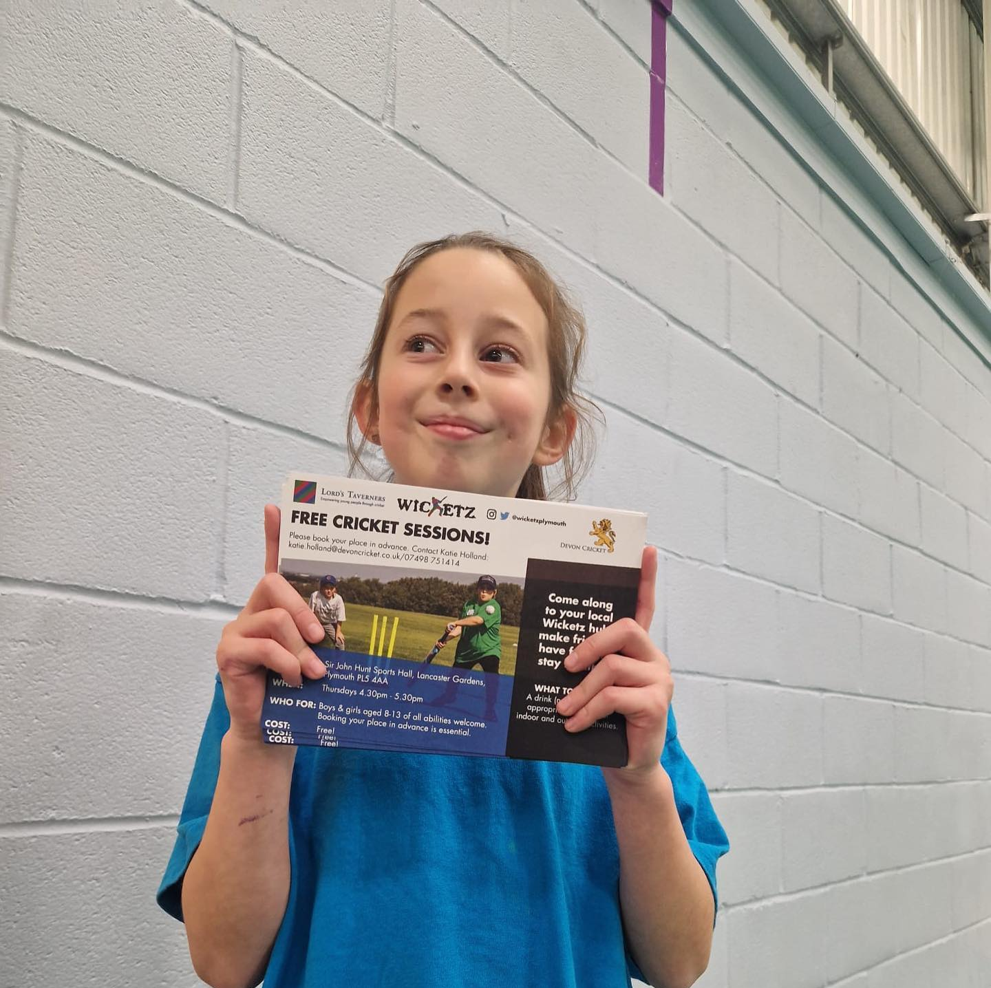
Wicketz Advertisement Champion Example
Lexi, a participant from Plymouth wanted to help inspire more girls to play cricket and share the love she has for it. Katie her coach, provided her with some flyers to hand out at her school.
After handing out flyers in her school, Lexi wanted to do more; not only did she speak in her assembly about the opportunities available, she delivered a series of taster sessions at lunchtime with her PE teacher. This saw not one, not two but ten new participants.

Slide 14
Bring a Buddy
What is it?
Bringing a buddy is exactly as it sounds; participants bring a friend or family member with them to their Wicketz hub but for an incentive. For example, all participants are allowed to invite one friend or family member to one of your sessions, if they do this, they will receive a cricket bat.
Benefits of bringing hosting bring a buddy day/month
Confidence
Studies have shown confidence is influenced by those we are working with, training with a friend can therefore increase confidence, reduce anxiety and improve their openness to try something new.
Enjoyment
Socialising with friends and having fun is a huge motivation for woman and girls on the Wicketz programme. If young people have good first experiences with a new sport club, they are more likely to have fun and continue playing.
Motivation
Everyone has those days where they don’t feel like exercising; but having a buddy can support them on those days where they don’t feel like going. A buddy helps with encouragement which has huge benefits on an individuals mindsets.
To find out how to go about introducing and taking part in bring a buddy click here.
Notes:
Could I have the tiktok and image as an example

Slide 15
Incentives and recognition
The value of fostering a community feel and sense of belonging (e.g, through t-shirts) was apparent when talking to girls in Wicketz.
100% said incentivised participation makes the offer more appealing; the desire, purpose and personal reward and cricket is no exception.
On the next pages, we will provide recommendations and ideas (based off our research) for you to incorporate into your weekly hub sessions to help make your offer more appealing to women and girls.

Slide 16
Incentives
Incentives that cost nothing
Incentives chosen by girls on your programmes
Other opportunities
Social media takeover
Lead photographer for a day
Gets to bat first for the whole session
Choosing the activity
Design the session plan
Be the coach for the day
Food/food vouchers
Wicketz clothing, t-shirt,hoodies, caps
Cricket equipment – get in touch with Cricket Kit Recycling
Award evenings
Social events
Meeting with professional players
Tickets to cricket matches
Cricket festivals/events
Recognised training, young leaders or coaching qualifications
Community engagement, i.e designing posters to put around the community
Planning a Wicketz festival/event
Speaking at an event

Slide 17
Rewards champion; youth led approach
What is a Reward Champion?
An individual who is responsible for partnering with local organisations, cafes or shops to receive rewards for their Wicketz hub.
The reward leader should be empowered to make their own decision on who they choose to contact.
Responsibilities could include:
Letter and emailing writing to organisation to secure prizes and rewards.
Conversations with local businesses to share their story to secure sponsorship.
Networking within the local community to help spread the positive word about Wicketz.
Using social media to reach out to influencers or professional cricketers who may be willing to donate or advertise the sessions.
What's in it for them?​
Develop their leadership and Confidence building.
Improve their verbal and written communication skills through letter writing, face to​ face conversations and phone calls.​
A secured place for a local festival or annual residential​.
Gain experience in letter and/or email writing.

Slide 18
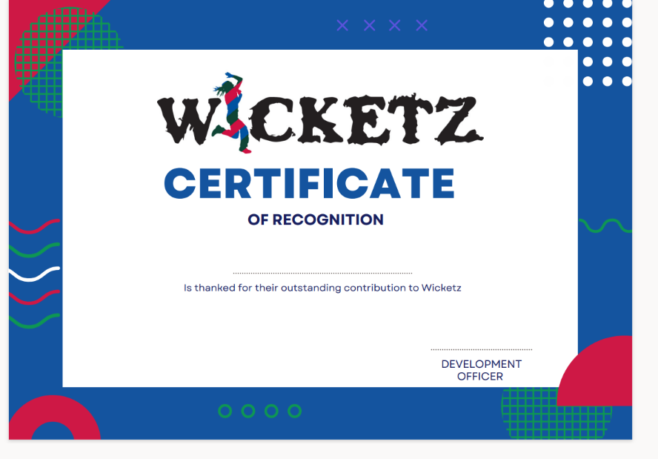
Reframing competition into ‘moments of pride’
Consider using this certificate or reward cards at your weekly sessions to not only help celebrate behaviour girls can be proud of, but to also maintain engagement by giving them something they can work towards.
Ideas for presentation of certificates & reward cards
Support others/ team spirit: for individuals who always encourage and support their team
Personal improvements: for players who have shown signs of improvement, this could be in confidence, their ability etc
Determination: for an individual who shows great determination at every session and always gives it their all
Best mentor: for the player who takes their time to help younger teammates and is always willing to give advice
Resilience: for individuals who never give up and always tries their best
Random act of kindness: for someone who goes out of their way to be kind to another individual
Unsung hero: for those who go above and beyond to support participants & coaches

Slide 19
Achievements
It’s important to start recognising women & girls achievements to not only build trust and a sense of belonging, but it’s also an opportunity to share with other women & girls
Social media
Sharing authentic story telling posts (i.e) personal journeys
Family/parents
To allow continued encouragement/ praise at home
Round robin Feedback Opportunity for them to share what they are proud of/have appreciated amongst others in the team.
Where to share good news stories
Example of a good news story
Lord's Taverners - Sara Yasin - Awards (lordstaverners.org)

Slide 20
Facilities
Our research has shown that the wrong facilities can be a barrier that stops women & girls from engaging with your sessions
To help reinforce a feeling of security and an enjoyment factor, we must consider some of the following:​
Female only changing facilities and toilets​
Private changing facilities​
Changing rooms with mirrors​
Safe, secure and well lit car park and surrounding areas​
Facilities that are out of the public eye or ‘male gaze’
Social area for them to talk to their friends after the session​
Good lighting and security​
Clean and tidy​
Supply of period products

Slide 21
Environment
On the next pages there will be things for you to consider to create a more welcoming environment
For many women & girls, a cricket environment can often be unwelcoming and fail to meet their needs
First impressions mean everything; it’s essential we are creating an environment that supports our target audience's needs

Slide 22
Creating a more welcoming environment
Have a process for welcoming new members
What is it a welcome pack?
A resource you give to new starters once they’ve signed up to provide them with all the information they will need before starting.
To support you with compiling your welcome pack we have provided a template for you to adapt here.
Recruit a young person to be a designated welcome leader
What is a welcome leader?
An individual who is responsible for welcoming and supporting new participants into the group.
To find out more about the responsibilities of the welcome leader and the benefits it has for young people – click here.

Slide 23
Right Cricket offer
What principles should you follow when engaging girls?
Avoid them batting alone, always make sure they are batting in teams or pairs
Make sure failure isn’t the biggest outcome. I.e. getting them to focus on their own personal development
Be inclusive- make sure everyone gets equal and as many goes as possible
Have coaches or volunteers who understand their motivations to play
Empower young people to make their own decisions about what activities they do
Have ‘bolt-ons’, such as music, food or teambuilding activities
Make it fun- provide lots of games and variation
Re-frame cricket activity to incorporate social elements, I.e. social opportunities after the session
The 'traditional cricket offer’ focusing on elite, technical skills is often a barrier, particularly to those who are new to the game. We therefore need to reframe the cricket offer into a more fun, sociable informal setting.

Slide 24
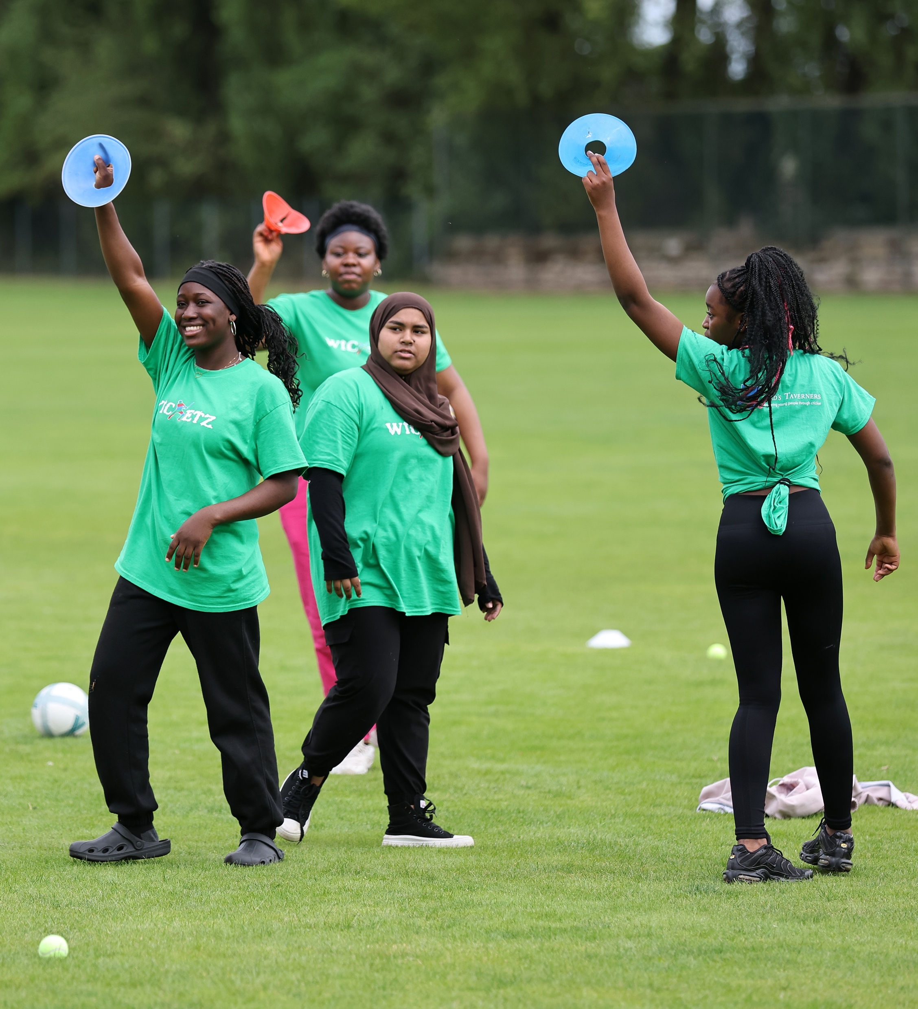
Cricket Activity | Benefit of the activity
Diamond Cricket | Played in a team Nobody is batting on their own Everyone is involved Whole team goes out rather than an individual Your team can bat again when out
Hand hockey | Everyone gets a go and is involved You can add variations to keep it fun and engaging It’s inclusive, everyone gets as many goes as possible
Rapid Fire Cricket | They bat in a group rather than on their own It’s fun and engaging Everyone is involved Everyone gets equal goes
Hit the stumps | You’re working in a team rather than individually Everyone is involved You can change up the throws and add points to help make it fun and engaging
Glow in the Dark Cricket | Helps make cricket more fun and appealing Working in teams rather than individually It incorporates a social element
Designing their own Cricket Activity | Empowers young people to take leadership and shows you which activities they enjoy playing It’s fun and engaging Everyone is involved Provides opportunities to work on personal development skills
Activities to consider delivering

Slide 25
Previous Success: Glow in the Dark Cricket This is perfect spin off to make cricket more appealing and fun
What is it is?
All cricket activities get played in the dark with UV equipment and clothing to create a funky glow in the dark effect
The stumps, balls and bats are taped with florescent tape, UV lights on, main lights switched off. Participants wear different glow in the dark bibs/T-shirts to distinguish between teams and although face paint is option, it is highly recommended
What do you need?
Cricket equipment
UV tape
UV Paint
Glow Sticks (optional)
UV Bibs or T-shirts
UV headbands (optional)
Ultra violet lights

Slide 26
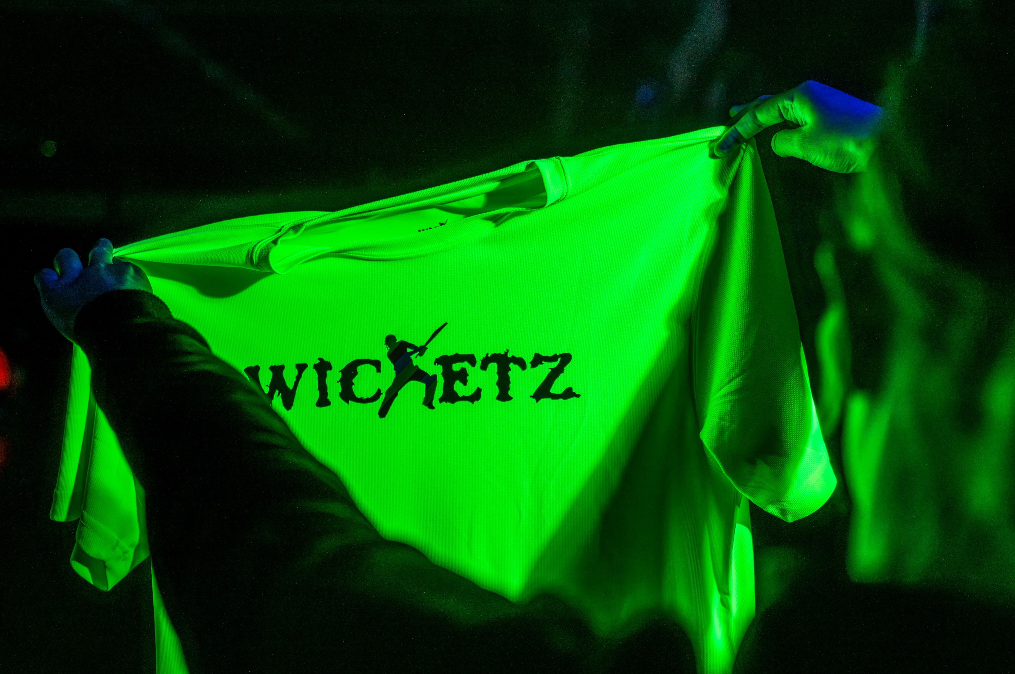
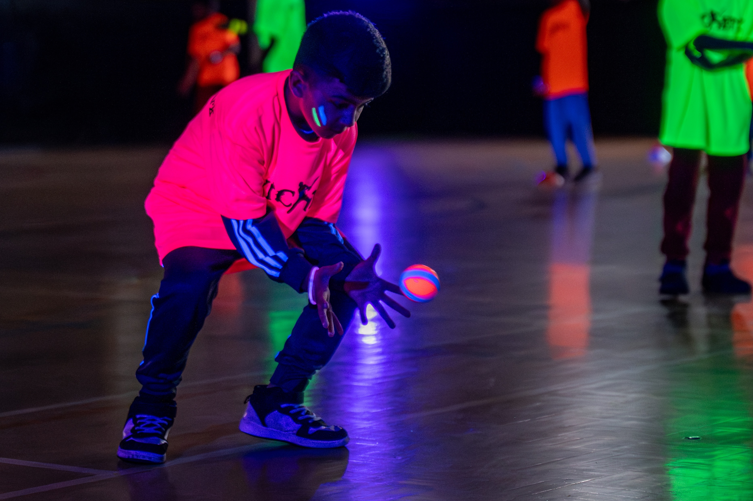

Slide 27
Right people
We’re aware it’s not always possible to have female coaches at sessions, but we can take into consideration the key characteristics girls look for in a coach/leader.
32% of girls on Wicketz have highlighted the importance of having female coaches to improve their experience and to engage with more women & girls​.
Fun
Making the sessions fun by adding variation and a range of activities keeps them engaged.
Listen
They want to be listened to, take their ideas seriously and let them take leadership of their session.
Inclusive
Cater for all abilities and make sure your environment is welcoming.
Praise
Celebrating and praising them for their achievements,
whether it's through certificates or word of mouth.
Understanding
Be understanding of women & girls individual needs, barriers and motivations. One size does not fit all!

Slide 28
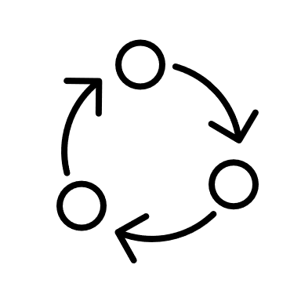
Resources for you to use to inspire and encourage more girls to take part
DO PORTAL- Wicketz Female Engagement Guide & Resources
'Bring a buddy' invite
‘Bring a buddy’; how to implement it
Welcome pack template
Welcome Leader - what is it?
Workshop- designing a poster or video
Reward card template
Moments of pride Certificate

